Slide 1
陕旅版英语六年级上册
Unit5 It Was Here Just Now
第1课时
WWW.PPT818.COM

Slide 2
教学目标：
1.能听、说、读、写词汇：scarf, wallet, sunglasses, gloves, warm jacket, rain boots, school bag。
2.能在实际生活中灵活运用以上词汇。

Slide 3
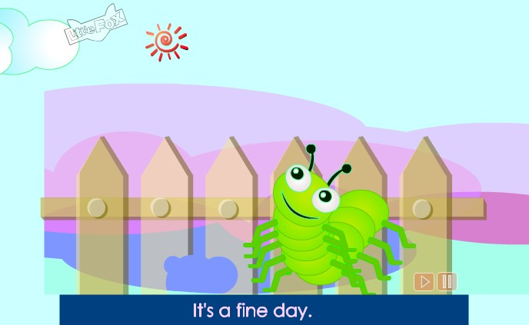
How is the weather?

Slide 4
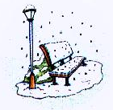
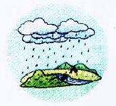
Free talk
How is the weather today?
今天天气怎么样？

Slide 5
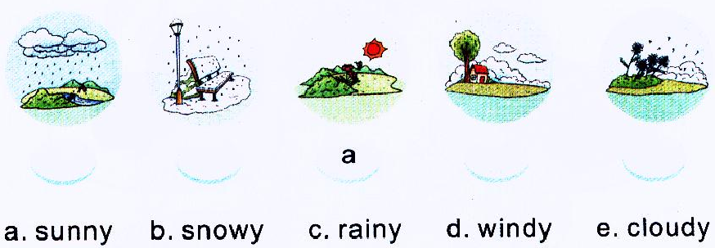
Look and choose
c
b
e
d

Slide 6
What kind of weather do you like?

Slide 7
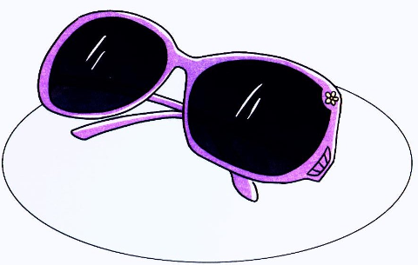
Let’s learn
It’s a sunny day. I will wear my sunglasses.

Slide 9
小调查：Who is wearing glasses?

Slide 10
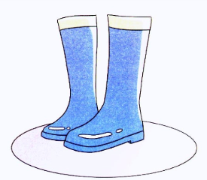
How is the weather today?
It’s raining. So I can wear my rain boots.

Slide 11
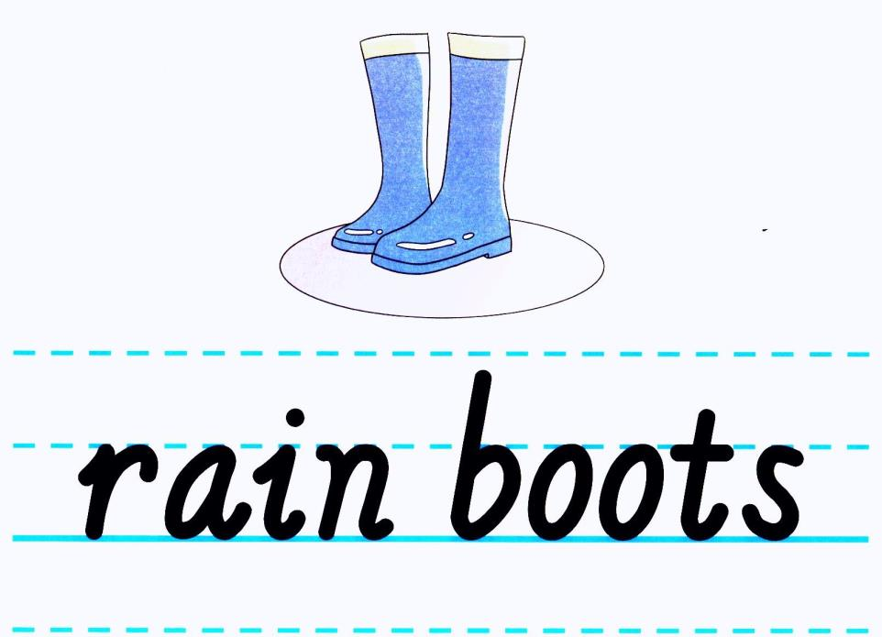

Slide 12
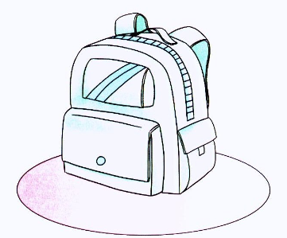
What’s this?
It’s Wu Chen’s school bag.

Slide 13
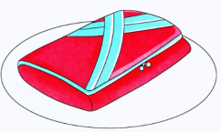
What’s in it? Can you guess?
There’s a wallet.

Slide 15
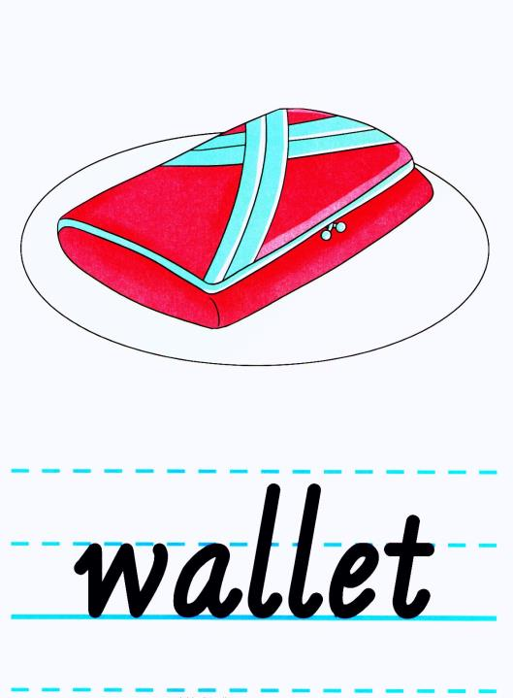

Slide 16
Winter is coming, what do you wear on a snowy day?
scarf
warm jacket
gloves

Slide 17
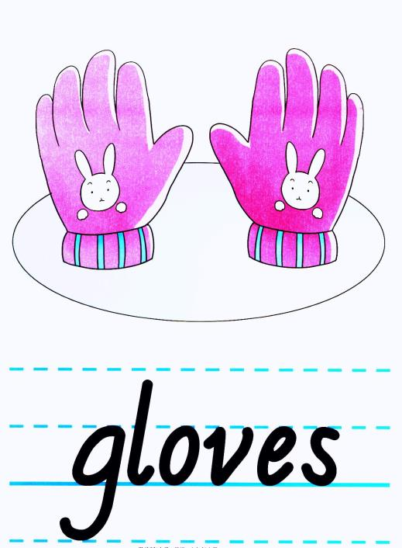

Slide 18
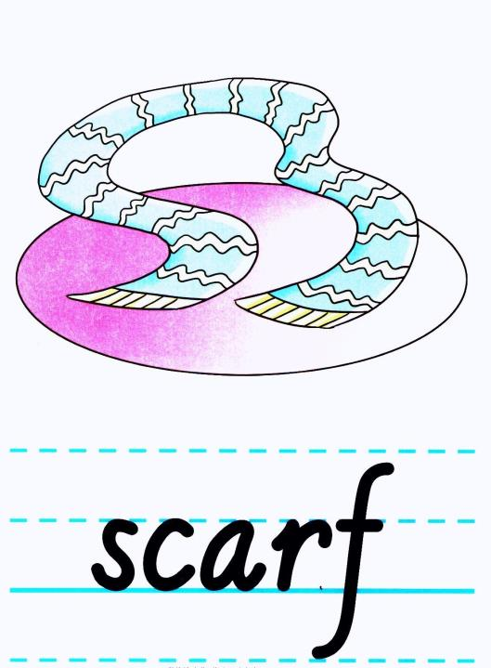

Slide 19
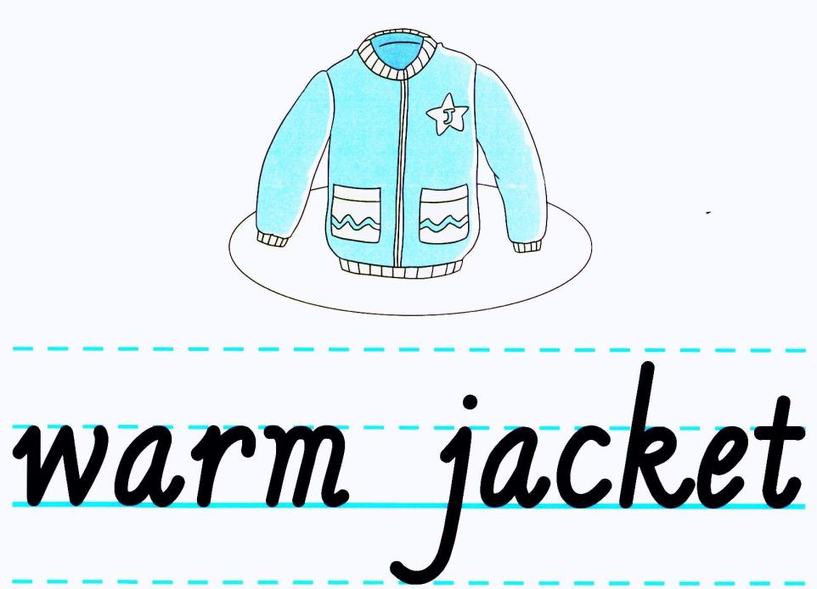

Slide 20
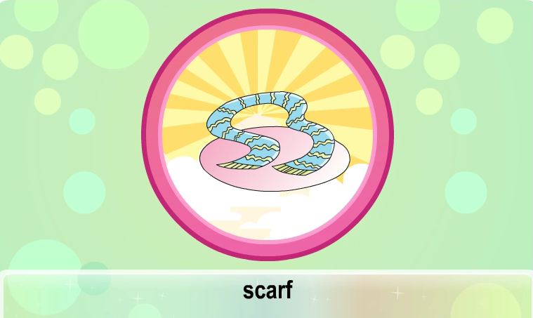
观看动画并跟读

Slide 21
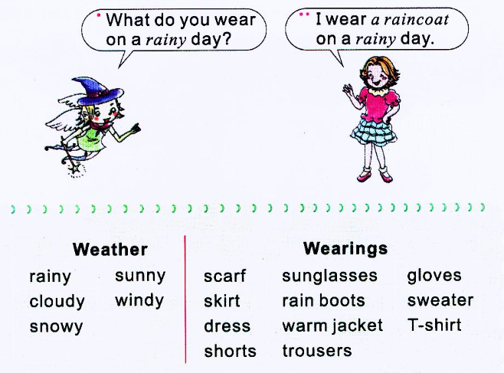
Ask and answer

Slide 22
记忆大比拼
在规定时间内，记忆本课时所学的词汇，看谁记得多。

