Slide 1
Unit 5 Buying and Selling
A Cookie Sale
WWW.PPT818.COM

Slide 2
Learning Targets
1. Be able to use the words and phrases: crazy, beker, sell out of, less than
2. Learn what you can do to help others
3. Learn some key sentences:
·I sold out of my cookies in less than an hour!
·Everyone thinks it’s too dangerous to do homework on a bicycle, so nobody bought it.

Slide 3
Lead in
How do you to help others?
When I take a bus, I will give my seat to the old people.

Slide 4
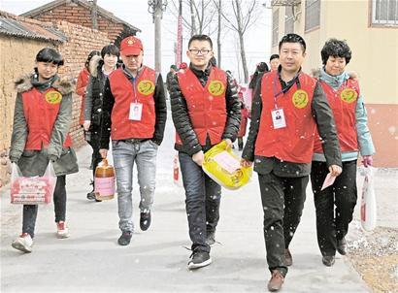
I went shopping with my classmates to visit the elder in the nursing home.

Slide 5
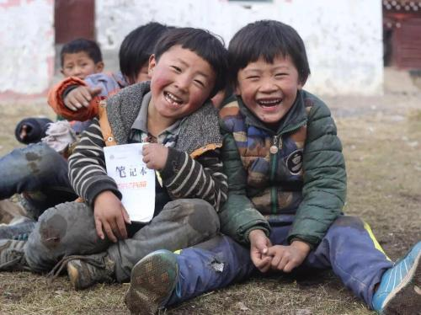
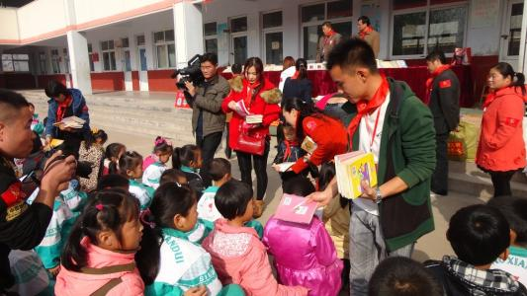
I can donate some books to children who are in poor mountain areas.

Slide 6
Words and expressions
crazy
baker
sell out of
less than
adj. 疯狂的；荒唐的
n. 面包（糕饼）师傅；面包店老板
售空；卖光；脱销
少于

Slide 7
THINK ABOUT IT
What event or activity from this school term is most memorable to you？
What did you do before helping someone？

Slide 8
Presentation
Listen and read the passage.
Dear Li Ming，
How are you doing？Things are OK here, but school life is very busy! Recently Jenny, Danny and I raised some money for our school basketball team. I baked cookies and sold them all！I'm happy that so many people liked my cookies. Jenny did a good job, too. She made a poster for our cookie sale. Everyone

Slide 9
knew about it. I sold out of my cookies in less than an hour！Can you believe it？
Danny is always crazy！He invented a new product—the Danny Desk­Cycle. Everyone thinks it's too dangerous to do homework on a bicycle, so nobody bought it. He really needs to improve his invention!
Brian

Slide 10
Dear Brian，
Good for you!
Selling cookies is a great idea to help others！Every year our school sends books to another school in a village. One day, Ms. Liu had a great idea. She wanted to help us open a shop to raise money for school activities. Maybe we can sell cookies in the store. We can make them ourselves and use the money to buy more books.

Slide 11
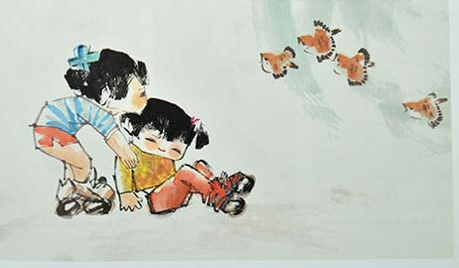
I'll talk with Ms. Liu and some of my classmates. I think that they will support the idea. Are we good bakers？I'm not sure, but we know we must work hard!
Li Ming

Slide 12
Let’s Do It!
1
What did Jenny, Danny and Brian do to raise money? Read the first e-mail and retell the story. You can use the informtion below to help you.
Jenny
make a poster
Raise money
Danny
sell the Danny Desk-Cycle too gangerous
Brian
sell cookies sell out

Slide 13
Read the second e-mail and answer the questions.
2
1. How does Li Ming’s school help another school in a village every year?
Every year his school sends books to another school in village.

Slide 14
2. How can they make money this year?
Ms. Liu wanted to help them open a shop. Maybe they can sell cookies to make money.
3. Do you think Li Ming’s classmates will support the idea? Why or why not?
I think Li Ming’s classmates will support the idea. Because it’s good to themselves and others.

Slide 15
The words or phrases in italics are from this lesson. Tick the correct answers to make the sentences meaningful.
3
1. Thomas Edison was the ________ to make the electric bulb. It was his invention.
 first  second
√

Slide 16
2. You speak ________ English than before. You really improved a lot.
 poorer  better
3. If a person or a thing ________ you, it is dangerous.
 hurts  toches
√
√

Slide 17
4. The students think Ms.Liu's idea is ________，so they all support her.
 boring  great
5. Brian sold out of his cookies, so he ________.
 doesn't have any cookies now
 still has some cookies now
√
√

Slide 18
Work in groups.What can you do to help students in another school? Talk about it with your group members.
4
Task tips：
You can use the following expressions：I think…，I guess…，I hope…
For example, you can donate books to them or volunteer to be a teacher there.

Slide 19
Language points
1. I sold out of my cookies in less than an hour!
sell out为不及物词组，意思是“卖光”。
例： Sleeping bags sold out almost immediately.
睡袋几乎马上就卖光了。
Tickets for the show sold out in 70 minutes.
演出门票在70分钟内售罄。

Slide 20
sell out of为及物词组，意思是“售空，卖光”。
例：We have sold out of the books.
我们的书卖完了。
All the bikes are sold out of in a day.
所有的自行车一天就卖光了。
The store wants to sell out all of its winter
clothes to make room for the summer ones.
商店想把所有的冬装都卖掉，为夏天的衣服
腾出地方。

Slide 21
2. Everyone thinks it’s too dangerous to do homework on a bicycle, so nobody bought it.
It too dangerous to do sth.表示“做……太危险”，it是形式主语，真正的主语是后边的不定式短语。例：It’s too dangerous to play on the street.
在街上玩太危险了。

Slide 22
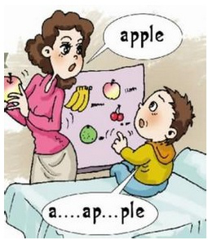
Exercises
一、根据汉语意思完成句子。
1. 你要退学真是发疯了。
You’d be _____ to drop out.
2. 对不起，我们的咖啡卖光了。
Sorry, our coffee ________.
3. 9比7少2。
Seven is two ________ nine.
4. 这男孩年龄太小，不能上学。
The boy is ___ young __ go to school.
crazy
sold out
less than
too to

Slide 23
二、汉译英。
1. 我有信心赢得这次疯狂英语演讲比赛。
I have confidence in winning the Crazy English speech contest.
2. 他从未见哪个展览的作品卖得如此之快。
He had never seen a show sell out that quickly.
3. 这个年轻人不到 20 岁。
The young man is less than twenty years old.
4. 他走得太慢，不能按时到达那儿。
He walks too slowly to get there on time.

Slide 24
Summary
1. Learn some new words and expressions, such as crazy, sell out of, less than.
2. Make students learn the way to help others.
3. Let students have a sense of love.

Slide 25
Homework
1. Copy the sentences and translate the new words and phrases.
2. How to help students in another school? Make a poster to call on people to help them.

