Slide 1
父亲节英文介绍PPT课件
❤ 20XX-06-XX ❤

Slide 2
The origin of father’s day 父亲节由来
01
C
目录
on tents
02
About father’s day 关于父亲节
Celebrate father’s day 庆祝父亲节
03
04
Father's Day phrase 父亲节由来
Father‘s Day blessing 父亲节祝福
05

Slide 3
01
The origin of father’s day
父亲节由来

Slide 4
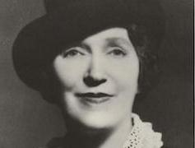
The origin of father’s day 父亲节由来
Mrs. John B Dodd, of Washington, first proposed the idea of a “father’s day” in 1909. Mrs. Dodd wanted a special day to honor her father William, whose wife died while giving birth to their sixth child. Mr. Smart was left to raise the newborn and his other five children by himself on a rural farm in eastern Washington state. It was after Mrs. Dodd became an adult that she realized the strength and selflessness her father had shown in raising his children as a single parent.
约翰.布鲁斯.多德夫人
华盛顿州的约翰.布鲁斯.多德夫人在1909年首先提出了设立“父亲节”的提议。多德夫人希望有一个特殊的日子来向她的父亲———威廉.斯玛特表示敬意。他的妻子在生他们第六个孩子时因难产而死。斯玛特先生在华盛顿州东部乡下的农场里独自养大了六个孩子。多德太太成人后她才意识到她的父亲一个人养大孩子所表现的力量和无私。

Slide 5
The origin of father’s day 父亲节由来
The first Father’s Day was observed on June 19,1910 in Washington. And it was in 1966 that President Lyndon Johnson officially declared the 3rd Sunday of June as Father’s Day.
First
Father’s Day
1910年的6月19日人们在华盛顿庆祝了第一个父亲节。林登.约翰逊总统最终于1966年宣布每年六月的第3个星期天为父亲节。

Slide 6
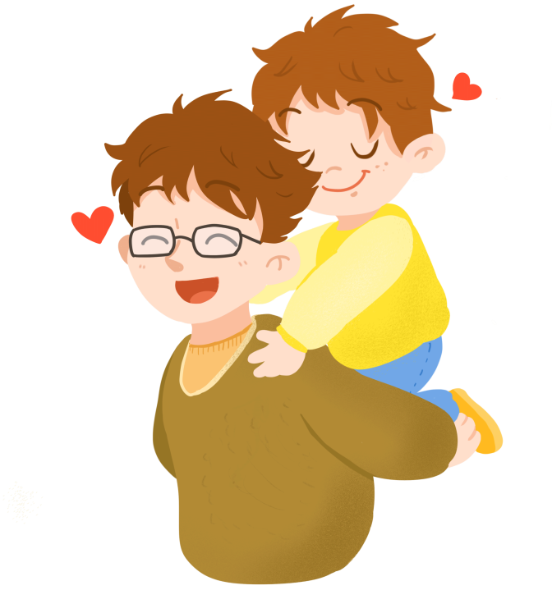
The origin of father’s day 父亲节由来
Father’s Day has become a day to not only honor your father, but all men who act as a father figure. Stepfathers, uncles, grandfathers, and adult male friends are all honored on Father’s Day.
父亲节现在已经成为向父亲及所有扮演父亲角色的人表达敬意的节日。继父，伯父，祖父所有成年男性都将在父亲节受到尊敬。

Slide 7
02
About father’s day
关于父亲节

Slide 8
The meaning for father 父亲的含义
F---faithful
A---always there
T---Trust worthy
(忠实的/可信的)
(一直在)
(值得信赖)
H---Honoring
E---Ever-loving
R---Righteous
(尊敬/荣誉)
(永远爱你的)
(很好/很对 )

Slide 9
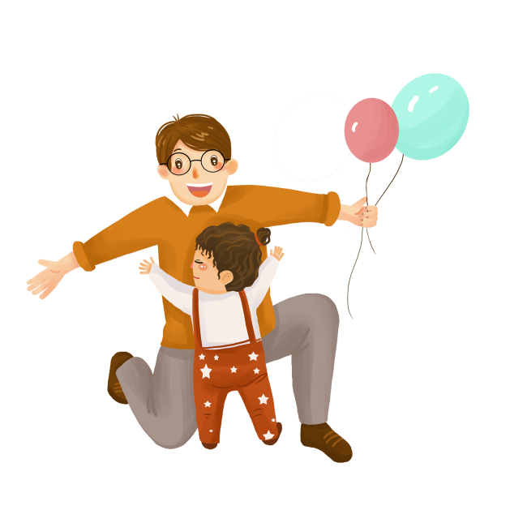
The meaning for father 父亲的含义
Different countries have different definitions on father's Day
Chinese Name:
父亲节
Engish Name:
Father's Day
Source:
the United States National.
Date:
the third sunday of June every year

Slide 10
03
Celebrating Father's Day
庆祝父亲节

Slide 11
Celebrating Father's Day 庆祝父亲节
一张爱的贺卡
most people would buy their fathers а card. The card would probably have a nice message in it saying what a great Dad their father is. Some people do buy presents as well.

Slide 12
Celebrating Father's Day 庆祝父亲节
领带
杯子
袜子
巧克力
Popular gifts for Dads are probably ties, chocolates or socks because these are things that Dads can always use even if they don‘t want them. In the run-up (预备期) to Father’ s Day, or indeed Mother‘s Day, there will be adverts ( 留意) (on. the TV giving us ideas of CDs or gadgets we can buy. Card shops will be full of mugs or pens and similar merchandise with word’s Greatest Dad’ written on them.

Slide 13
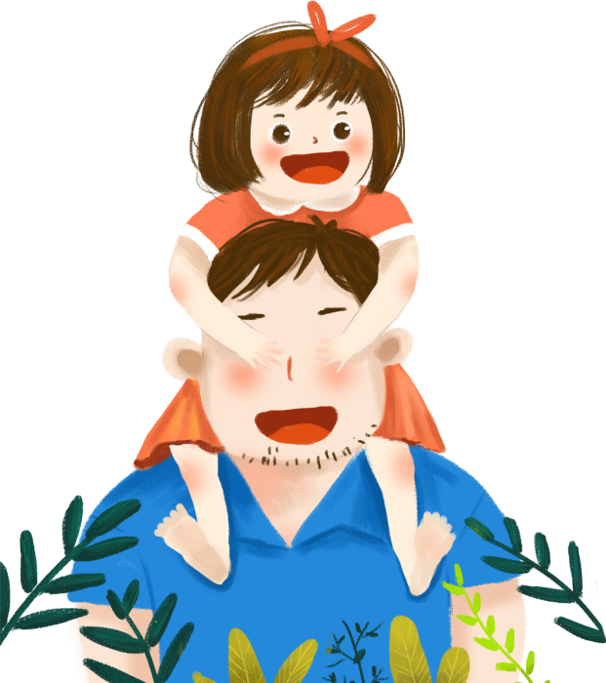
Celebrating Father's Day 庆祝父亲节
一次特殊的款待
Some families might do things together to celebrate .Father' s Day like going for a meal. As a special treat, British people might give their Dad a bit of a rest .make him a cup of tea, or even wash his car and mow the lawn to make him feel really appreciated.

Slide 14
Celebrating Father's Day 庆祝父亲节
Best Father's Day Songs
Dance With My Father
Father's Day
Father And Daughter
[ Papa, Can You Hear Me ? ]

Slide 15
04
Father's Day phrase
父亲节短语

Slide 16
Father's Day phrase 父亲节短语
he wish is father to the thought. 愿望是思想之父。 | A miserly father makes a prodigal son. 有吝啬的父亲必有败家之子。
The child is father of the man. 岁定到老。 | One father can support ten children; the children cannot support one father. 一个父亲可以供应十个孩子，十个 孩子却不能供养一个父亲。
be old enough to be somebody’s father 比某人年龄大多了

Slide 17
Father's Day phrase 父亲节短语
Many a good father hath but a bad son. 好父亲偏生不肖子。 | The sins of the fathers are visited upon the children. 父辈的罪孽，会及子孙。
One father is more than al hundred school-masters. 一个父亲胜于一百个教师 | The father buys, the son big , the grandchild sells and his son thig. 老子买地，儿子盖房，孙子卖产， 重孙讨饭

Slide 18
Father's Day phrase 父亲节短语
from father to son 从父到子，世代相传 | lie with one’s fathers 葬于故乡
The father of a whipping 一顿痛打 | the father of a 非常大的;十分严重(或严厉)的
Father earns and son spends. 老子挑重担，儿子穿绸缎。 | Like father, like son. 有其父必有其子。

Slide 19
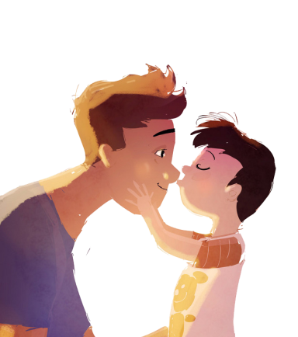
Father's Day phrase 父亲节短语
Holy Father 罗马教皇
Father оf lіеѕ 谎言始祖
The Father of lights 上帝
father confessor 告解神父
Father Christmas 圣诞老人
a ghostly father 听忏悔的神父
Father of the Church 早期基督教著作家
Father‘s Day

Slide 20
04
Father‘s Day blessing
父亲节祝福

Slide 21
Father's Day phrase 父亲节短语
1、Over the years we have had our differences, but I always love you.
这些年来，虽然我们常有意见不合的地方，但我一直敬爱着您。
2、You've been father, friend, adviser, all of these and more.
您不仅是我的父亲，您还是我的朋友，顾问甚至更多。
3、Words can't tell how much you mean to us，we wish you happiness on this special day.
我们无法用言语描述您对我们是多么重要，在这特别的一天，我们祝您父亲节快乐!
4、On this special day, I want to say I am proud of you . Appreciate all you've done for me and I love you.
在这特别的一天，我想说我为您感到骄傲，爸爸，谢谢您为我做的一切，我爱你。

Slide 22
Father's Day phrase 父亲节短语
5、Thanks for holding my hand when i needed it.
谢谢您在我需要的时候伸出援助之手。
6、Happy father's day to an extraordinary father，I love you so much!
祝我独一无二的老爸父亲节快乐，我非常爱您!
7、I owe all of my skills of fatherhood to you dad. happy father's day.
爸爸，我所有的为父之道都来自于您的恩赐。祝您父亲节快乐。
8、I didn't see what a good father you were to us before, but I do now.
我以前不知道您是一个多么好的父亲，但是现在我知道了。

Slide 23
Father's Day phrase 父亲节短语
9、Thank you, Dad, for listening and caring, for giving and sharing, for being such a wonderful Dad.
谢谢您，爸爸，谢谢您倾听、操心， 谢谢您给了我许多，可又为我分担忧愁， 谢谢您是这样了不起的爸爸。
10、 Only wishes that are made with special love will do for a dad who is wonderful in every way as you.
只有用挚爱绢成的祝福的话， 才能献给像您那样慈爱的爸。
11、On your special day and every day, may love and joy surround you, because you bring such happiness to everyone around you.
愿您在生日和平日，天天都沉浸在爱和欢乐里， 因为您让身边亲人，个个生活在这样的幸福里。
节日PPT模板 http://www.1ppt.com/jieri/

Slide 24
父亲节快乐

