Slide 1
Section Ⅰ Listening and Speaking &
Reading and Thinking—Comprehending
WWW.PPT818.COM

Slide 2
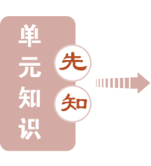
UNIT 3 THE INTERNET

Slide 3
UNIT 3 THE INTERNET

Slide 4
UNIT 3 THE INTERNET

Slide 5
UNIT 3 THE INTERNET

Slide 6
UNIT 3 THE INTERNET

Slide 7
UNIT 3 THE INTERNET

Slide 8
UNIT 3 THE INTERNET

Slide 9
UNIT 3 THE INTERNET

Slide 10
UNIT 3 THE INTERNET

Slide 11
UNIT 3 THE INTERNET

Slide 12
UNIT 3 THE INTERNET

Slide 13
UNIT 3 THE INTERNET

Slide 34
本部分内容讲解结束
按ESC键退出全屏播放

