Slide 1
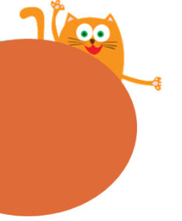
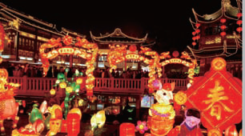
Module 4 Things we enjoy
Chinese festivals
11
WWW.PPT818.COM

Slide 2
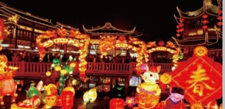
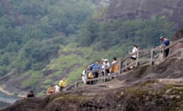
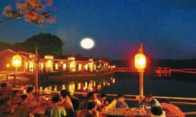
Look and learn
the Spring Festival
the Double Ninth
Festival
The Mid-Autumn Festival

Slide 3
Look and match
the Spring Festival
the Mid-Autumn Festival
the Double Ninth Festival

Slide 4
Festival | Time | Activities
 |  | Have a big dinner ,
 |  | Get red packets, Visit their friends and relatives
The Spring Festival
January or
February
Eat dumpling
Watch fireworks
Notes:
4

Slide 5
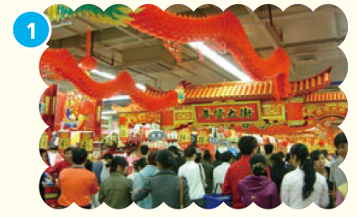
The Spring Festival comes in January or February every year. It is an important Chinese festival. People also call it Chinese New Year.

Slide 6
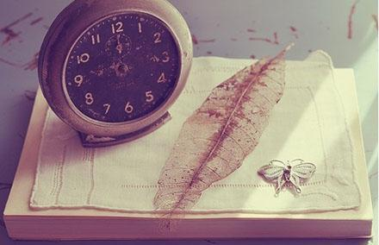
important
Read and spell
重要的
e.g. Time is very important .

Slide 7
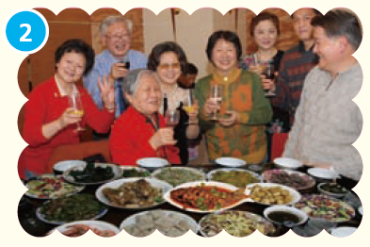
On Chinese New Year’s Eve, families have a big dinner together. They often eat fish and dumplings.

Slide 8
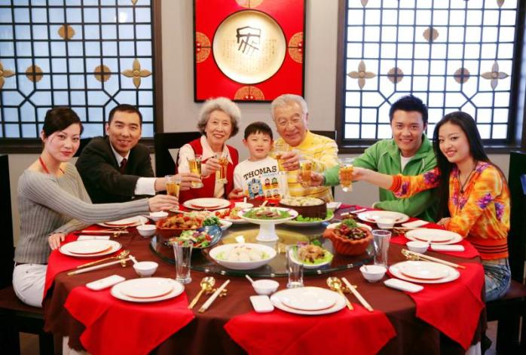
Look and say
have a big dinner

Slide 9
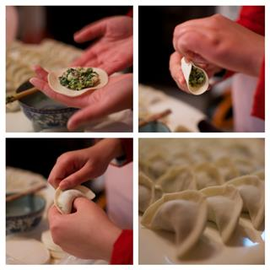
Look and read
fish
dumplings

Slide 10
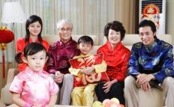
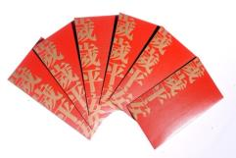
Think and answer
1. Who do you visit at the Spring Festival?
We visit our friends and relatives.
2. What do children often get at the Spring Festival?
Children often get red packets with some money in them.

Slide 11
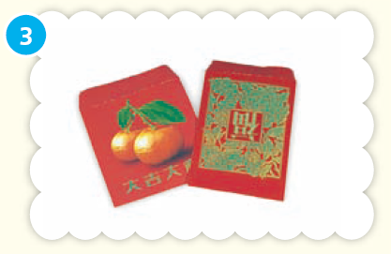
People visit their friends and relatives. Children often get red packets with some money in them.

Slide 12
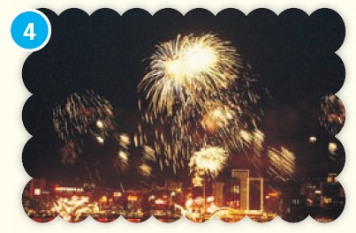
People also watch fireworks at night. They like the beautiful fireworks very much.

Slide 13
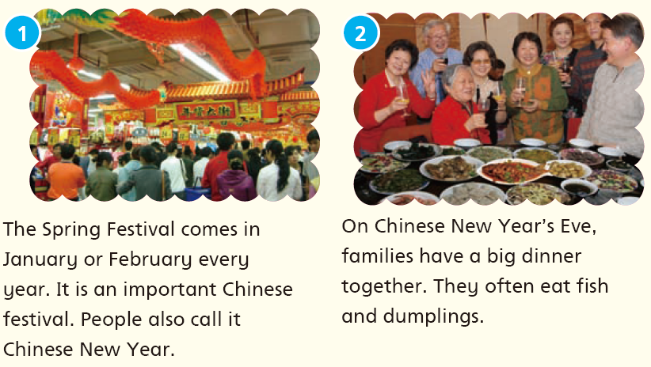

Slide 14
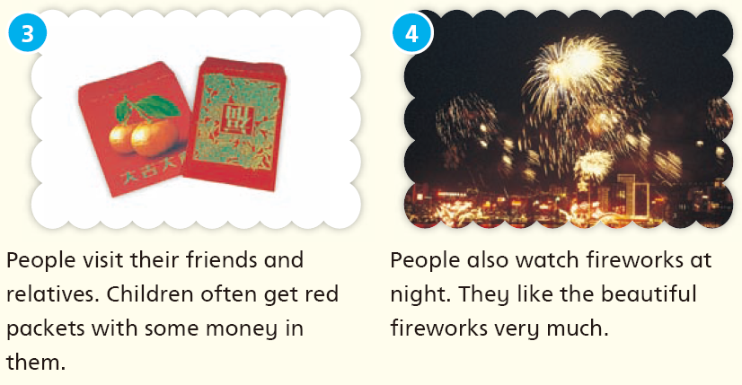

Slide 15
判断下面的句子，正确 T（True ）or 错误F（Flase）.
1. The Spring Festival is a small festival in China.
2. People also call the Spring Festival Chinese New Year.
3. Families have a big dinner together on Children's Day.
4.Children often get red packets.
5. People don't like the fireworks.
(F)
(T)
(F)
(T)
(F)

Slide 16
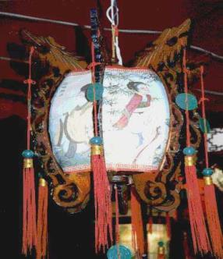
Read and learn
Do you know any other festivals in China?
the Lantern Festival
Month: on the fifteenth day of the first month.
Weather: cold
Activities:Watch fancy lanterns、Make lanterns、 Eat yuanxiao
Notes:
16

Slide 17
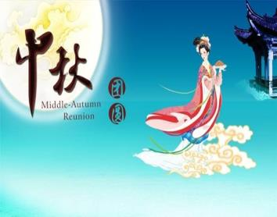
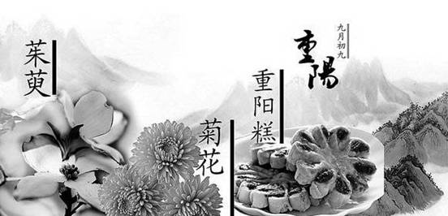
Read and learn
the Mid—Autumn Festival
Month: September/Octorber
Weather: cool
Activities:look at the beautiful moom,eat mooncakes
the Double Ninth Festival
Month:October/November
Weather: cool
Activities: climb mountains,visit old people,eat rice cakes
Notes:
17

Slide 18
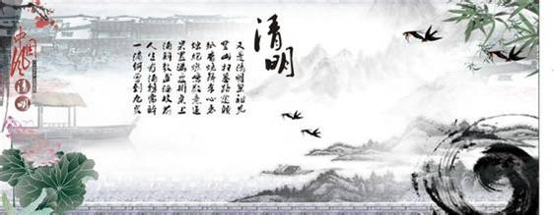
Read and learn
the Qing-ming Festival
Month: on the 4th or 5th of April.
Weather: cool
Activities: sweep the tombs
Notes:
18

Slide 19
My favourite festival
The __________ (festival) is in __________ (month).
It is usually __________ (weather).
At the __________ (festival), people go to __________ (place).
They __________________ (activity).
They eat __________ (food).
I like the __________ (festival) very
much because ___________________.
Notes:
19

Slide 20
Homework
1. Listen to and read Student’s Book pages 74 and 75.
2. Say something about the Spring Festival.
3. Finish Workbook pages 62 and 64.

