Slide 1
Unit 2
I’ll help to clean up the city parks.
R 八年级下册
第1课时
WWW.PPT818.COM

Slide 2
Lead-in
Have you ever been a volunteer? What could you do?

Slide 3
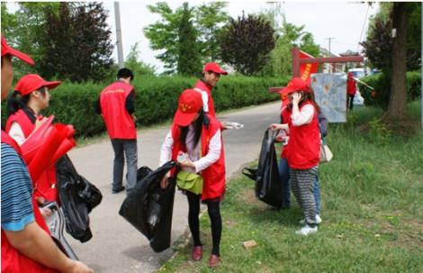
What can we do to help people?
We could help to clean up the parks.

Slide 4
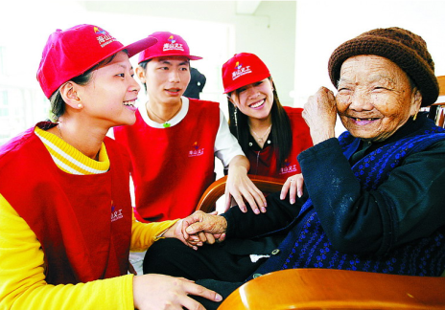
What can we do to help people?
We could help old people.

Slide 5
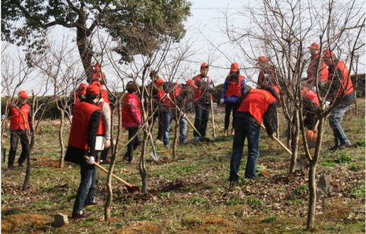
What can we do to help people?
We could help to plant trees.

Slide 6
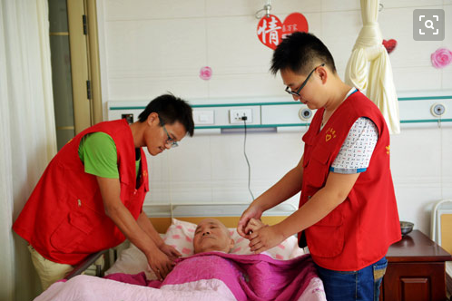
What can we do to help people?
We could help sick people in the hospital.

Slide 7
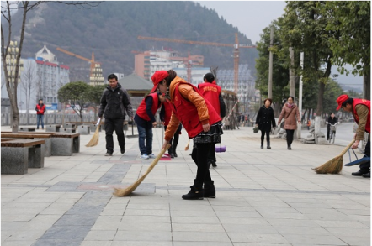
What can we do to help people?
We could help to clean up the streets.

Slide 8
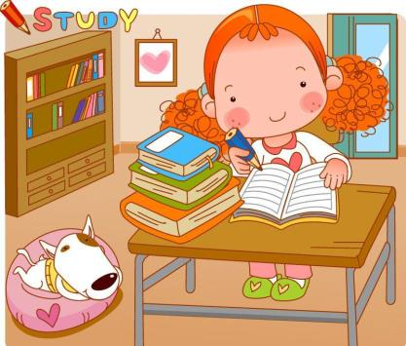

Slide 9
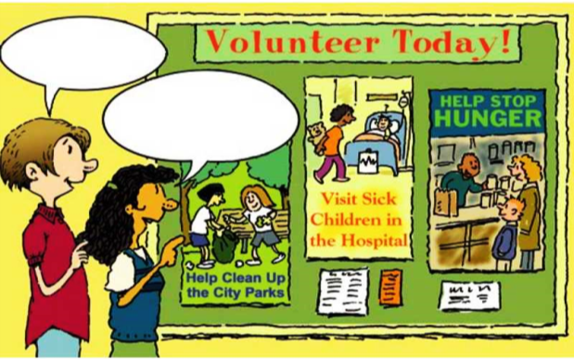
Look at the ways you could help people in the picture. Then list other ways.
1a
I hope to work outside.
You could
help to clean up the city parks.

Slide 10
Other ways you could help people
1. ________________________________
2. ________________________________
3. ______________________________________
4. ________________________________
Help to plant trees by the river
Help to clean up the city park
Visit the old people in the old people’s home
Help young kids to learn English

Slide 11
Listen and number the ways the boy and girl could help others.
1b
___ The girl could visit the sick kids in the hospital to
cheer them up.
___ The boy could give out food at the food bank.
___ The girl could volunteer in an after-school study
program to teach kids.
___ The boy could help to clean up the city parks.
3
2
4
1

Slide 12
Practice the conversation in the picture above. Then make other conversations using the information in 1b.
1c
You could help to clean up the city parks.
I hope to work outside.

Slide 13
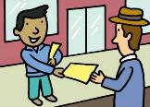
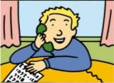
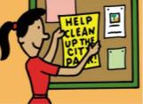
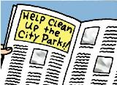
A group of students are planning a City Park Clean-Up Day. Listen and check (√) the things they are going to do to tell people about it.
2a
a
e
c
b
d
√
√
√

Slide 14
2b
Listen again. Fill in the blanks.
1. We need to _____ ____ _____ a plan to tell people
about the city park clean-up.
2. Clean-Up Day is only two weeks from now. We
can’t ____ ____ making a plan.
3. We could ____ ____ signs.
come up with
put off
put up

Slide 15
4. Let’s make some notices, too. Then I’ll ____ them
____ after school.
5. We could each ____ ___ 10 students and ask them
to come.
hand
out
call up

Slide 16
Make a conversation using the information in 2a and 2b.
2c
We need to come up with a plan for the City Park Clean-Up Day.
Let’s have lunch first.
No, we need to start now. Clean-Up Day is only two weeks from now.

Slide 17
2d
Read the conversation and answer the questions.
1. Where’s Helen going to work this summer?
_______________________________________
2. What did Tom do to help the old people?
_______________________________________
_______________________________________
She’s going to work in an old people’s home.
Reading the newspaper or just talking to the old people.

Slide 18
2d
Role-play the conversation.
Helen: Hi, Tom. I’m making some plans to work in an
old people’s home this summer.
Tom: Really? I did that last summer!
Helen: Oh, what did they ask you to help out with?
Tom: Mmm… things like reading the newspaper to the
old people, or just talking to them. They told me
stories about the past and how things used to be.

Slide 19
Helen: That sounds interesting.
Tom: Yeah, a lot of old people are lonely. We should
listen to them and care for them.
Helen: You’re right. I mean, we’re all going to be old
one day, too.

Slide 20
Language points
1.The girl could visit the sick kids in the hospital to cheer them up.
cheer up意为“使振奋；使高兴起来”，是动副短语。若是代词作宾语，代词应放在cheer与up中间。
等我们听到李娜赢得比赛时，我们都欢呼了起来。
We all cheered up when we heard Li Na won the prize.

Slide 21
2.The boy could give out food at the food bank.
give out意为“分发；发放”，相当于hand out,它们都是“动词+副词”结构的短语。
老师分发了我们的考试试卷。
The teacher gave/handed out our test papers.

Slide 22
【拓展】
(1)give out还可表示“发出（光、热、声音、气味等）”。
太阳给大地散发光和热。
The sun gives out light and heat to the earth.
(2)与out相关的短语：
look out 小心 eat out在外面吃饭
break out 发生 break out爆发
work out想出；解决 go out出去

Slide 23
3.We need to come up with a plan for the City Park Clean-Up Day.
come up with意为“（针对问题、方法等）提出或想出（主意等）”，相当于think up/of，其主语通常为人，且不用于被动语态。
这个聪明的男孩通常能提出一些好主意。
The clever boy usually comes up with some good ideas.

Slide 24
4.They told me stories about the past and how things used to be.
used to后跟动词原形,表示“过去常常做某事”.
“used to +动词原形”的各种句式：
（1）肯定句：主语+used to+动词原形+其他.
他们过去住在北京。
They used to live in Beijing.

Slide 25
(2)否定句：“主语+didn’t use to +动词原形+其他.”
或“主语+ usedn’t to + 动词原形+其他.”，在口语
中常用“didn’t use to”。
我过去不留长发。
I didn’t use to have long hair.
I usedn’t to have long hair.

Slide 26
(3)一般疑问句：“Did+主语+use to+动词原形+其他?”
或“Used+主语+to+动词原形+其他?”
你过去经常弹钢琴吗？
Did you use to play the piano?
Used you to play the piano?

Slide 27
5.We should listen to them and care for them.
care for 表示“照顾；照料”，相当于 take care of 或 look after。
孩子们在幼儿园被照顾得很好。
The children are well cared for in the kindergarten.
The children are taken good care of in the kindergarten.

Slide 28
Exercise
Ⅰ. Fill in the blanks.
He helps ____ the classroom.
A. cleans up B. cleaning up C. clean up
2. I took her to the concert to ____.
A. cheer up her B. cheer her up
C. cheer she up
3. Let’s help ___ food at the food bank.
A. to give out B. give up C. giving out
C
B
A

Slide 29
Ⅱ. Complete the sentences.
come up with
1. You’d better _____ ___ ____ (想出) a better plan.
2. Who will ________ ___ ______ (自愿回答) this
question?
3. You could put up a ______ (布告) here.
volunteer to answer
notice

Slide 30
4. With no one to talk to. He _____ very ______ ( 感觉很孤独).
5. The life _____ ___ ___ (曾经是) very
interesting in my school days.
felt
lonely
used to be

