Slide 1
Unit8 Topic 1
How is the weather in winter?
Section B
WWW.PPT818.COM

Slide 2
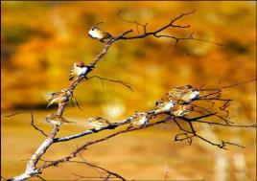
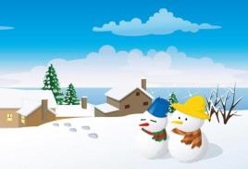
Fast dialogs
A: Which season do you like best?
B: I like…best.
A: Why do you like it?
B: Because …

Slide 3
sun
sunny
I like spring best.
Because it is bright and sunny.
明亮的

Slide 4
rain
rainy
It's rainy.
I don't like summer at all.
Because it's hot and it often rains.

Slide 5
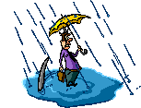
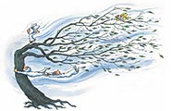
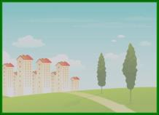
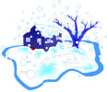
sun
cloud
sunny
rain
rainy
cloudy
wind
windy
fog
foggy
snow
snowy
归纳：名词 形容词
（1）名词+y （2）双写末尾的辅音字母+y

Slide 6
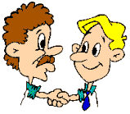
Let’s play a game!
1
6
2
5
3
4

Slide 7
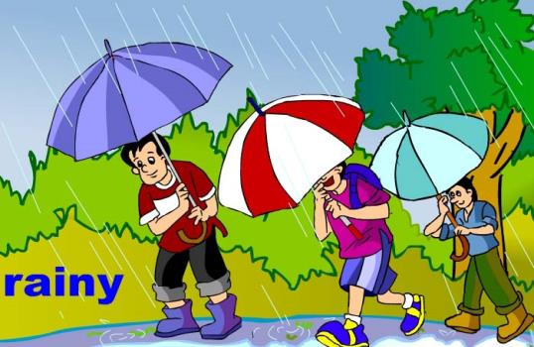

Slide 8
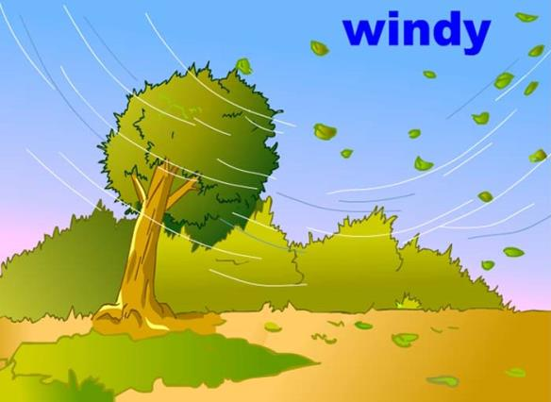

Slide 9
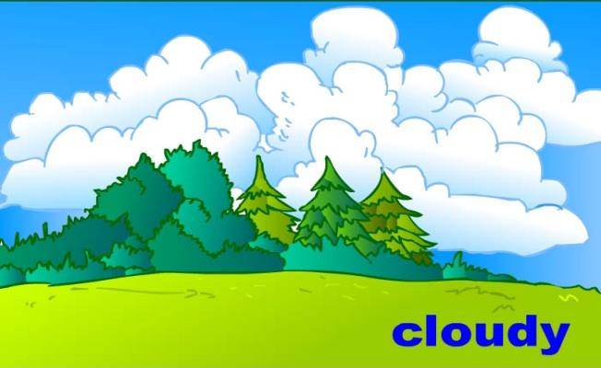

Slide 10
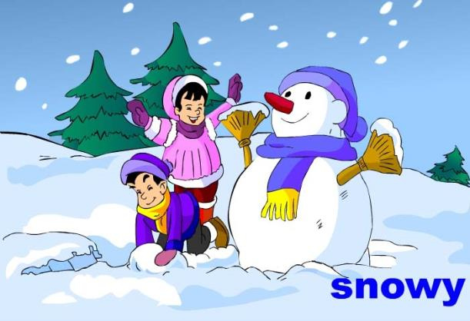

Slide 11
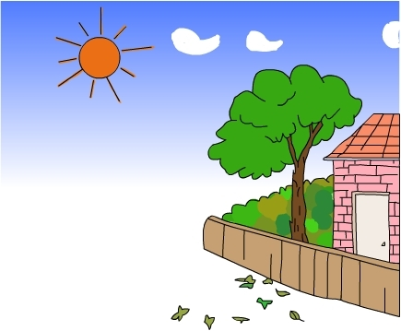
sunny

Slide 12
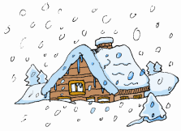
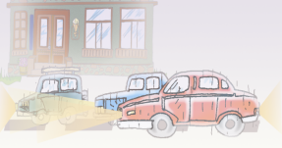
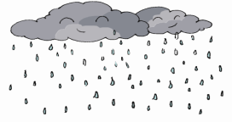
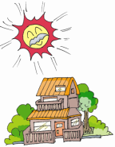
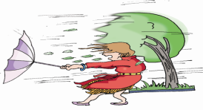
Match the words with the pictures. Pay attention to the changes when you add-y.
a
a
c
b
c
b
e
d
e
d
f
f
1.snowy________ 4.windy________
2.rainy ________ 5.foggy _________
3.sunny ________ 6.cloudy________

Slide 13
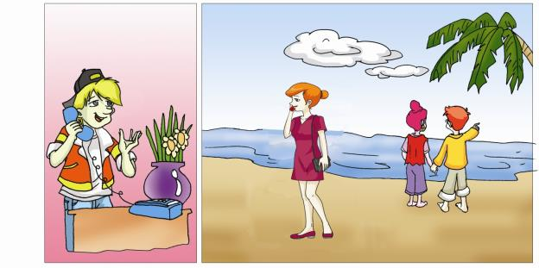
Listen to 1a and answer.
1. What’s the weather like today?
It’s rainy today.
2. How was the weather yesterday?
It was sunny and warm yesterday.

Slide 14
1c. Pair Work
Make conversations that are similar to 1a with the words and phrases in the table.
Weather (today) | Weather (yesterday) | Activity
nice and bright | sunny/ rainy | fly kites
cold | snowy/ windy | make snowmen
very cool | cloudy/foggy | climb hills
… | … | …

Slide 15
Listen, read and say.
A: What’s the weather like today?
degree Celsius/
centigrade
B: It’s very cold.
A: What’s the temperature, do you know?
B: The lowest temperature is -8℃
and the highest temperature is -2℃.
17℃
seventeen degrees Celsius
25℃
twenty-five degrees centigrade
0℃
zero degree centigrade
-1℃
minus one degree centigrade

Slide 16
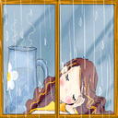
What’s the weather like?
What’s the temperature?
22 ℃

Slide 17
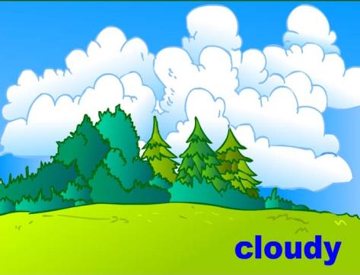
How’s the weather?
What’s the temperature?
13℃

Slide 18
What’s the weather like?
What’s the temperature?
-20℃

Slide 19
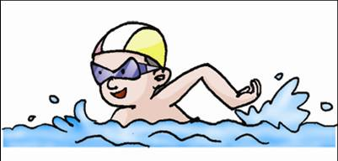
What’s the weather like?
What’s the temperature?
25 ℃ -31℃

Slide 20
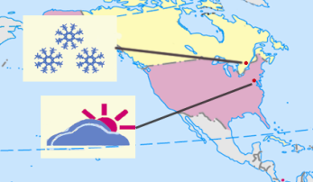
2b. Look at the weather chart of Toronto and Washington,D.C. Then answer the following questions.
1.What is the weather like in Toronto?
It is ________.
2.What’s the temperature?
It is between ____ and _____.
3.How is the weather in Washington, D.C.?
____ ______.
4.What’s the temperature?
It is _______ _____ _______
_______.
snowy
-10℃
-4℃
It’s
cloudy
Toronto(-10 ℃--4 ℃)
between
-8℃
and
-2℃
Washington,D.C.(-8 ℃--2 ℃)

Slide 21
Weather Report
City | Beijing | Harbin | Shanghai
Weather
Temperature
cloudy, windy
rainy
sunny
18℃-25℃
9℃-21℃
23℃-28℃

Slide 22
Summary
Word Formation(构词法）
n. adj.
How are things going?
Remember to put on your raincoat when you go outside.
How was the weather yesterday?
4. What’s the temperature?
5.℃: degree(s) centigrade
+y
Useful expressions:

Slide 23
Homework
Recite 1a and 2a.
Finish Section B in your workbook.
Preview Section C.

