Slide 1
Unit 6
Is it your skirt
WWW.PPT818.COM

Slide 2
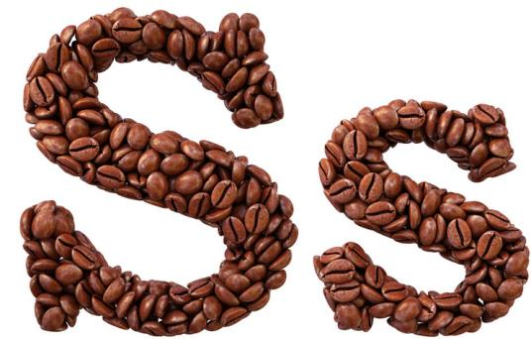
Let’s learn

Slide 4
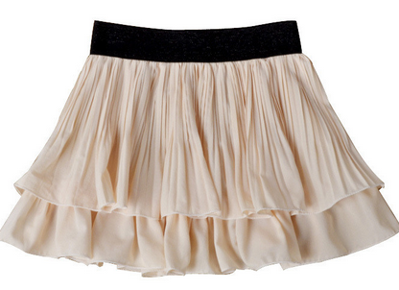
skirt
短裙

Slide 5
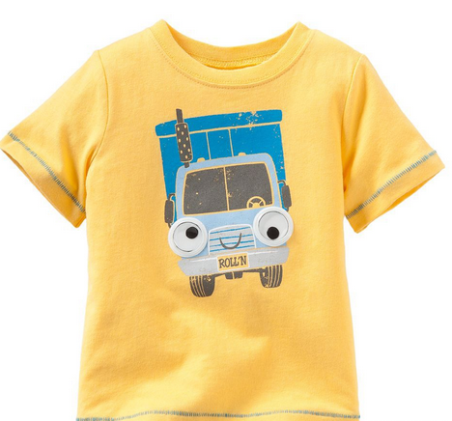
T-shirt
T恤

Slide 6
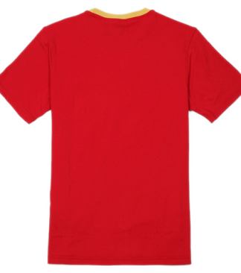
Look and say
This is a __________.
T-shirt

Slide 7
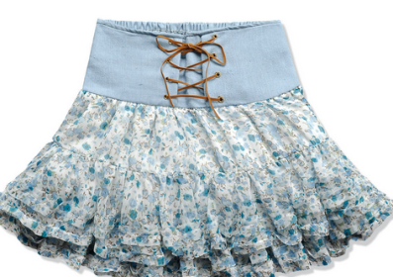
This is a __________.
skirt

Slide 8
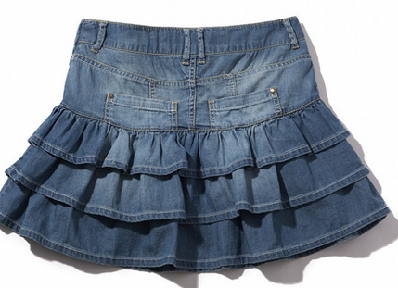
Let’s learn
A: is it your skirt?
这是你的短裙吗？
B: Yes, it is.
是的。

Slide 9
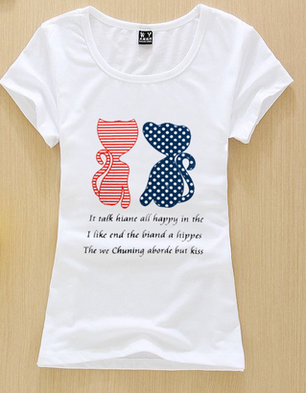
A: is it your T-shirt?
这是你的T恤吗？
B: Yes, it is.
是的。

Slide 10
Is it your ……?
这是你的……吗？
肯定回答: Yes, it is.

Slide 11
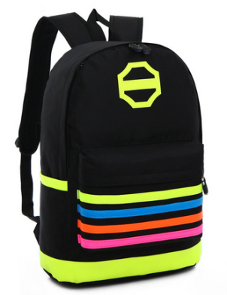
Let’s do
A: _________________?
B: Yes, _____________.
Is it your bag
It is

Slide 12
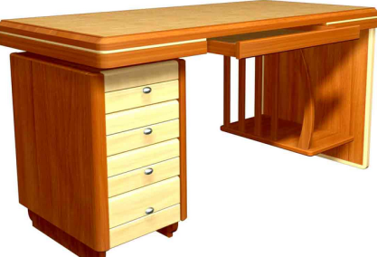
A: _________________?
B: Yes, _____________.
Is it your desk
It is

Slide 13
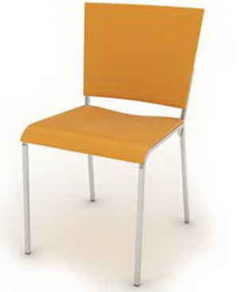
A: _________________?
B: Yes, _____________.
Is it your chair
It is

Slide 14
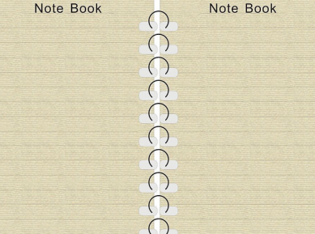
A: _________________?
B: Yes, _____________.
Is it your notebook
It is

Slide 15
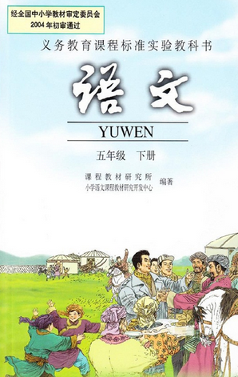
A: _________________?
B: Yes, _____________.
Is it your Chinese book
It is

Slide 16
同桌间就所学句型互相做对话练习。

Slide 17
Let’s read
A: Hi, Li Yan, is it your skirt?
B: Oh, yes, thank you.

Slide 18
Homework:
1.熟读本课对话;
2.抄写本课重点单词3遍。

Slide 19
Thank you

