Slide 1
Section B Using language
外研版高中英语必修二
Unit 2 Let’s celebrate!
WWW.PPT818.COM

Slide 2
Ⅰ
Ⅱ
Ⅲ
indicate
request
fancy
guy
wave
lantern
dessert
attract
decorate
riddle
competition
formal
host

Slide 3
Ⅰ
Ⅱ
Ⅲ
用……代替……
打扮成
核实;了解清楚
保护……的安全
用……装饰
按时
依靠
注意

Slide 4
Ⅰ
Ⅱ
Ⅲ
Ⅱ.释义匹配
1.indicate A.to ask for something in a polite or formal way
2.request B.to move your hand from side to side
3.attract C.a light enclosed in a container which has a handle for holding it
4.wave D.to make someone interested in something
5.lantern E.to show that a particular situation exists,or that something is likely to be true
答案:1.E 2.A 3.D 4.B 5.C

Slide 5
Ⅰ
Ⅱ
Ⅲ
Ⅲ.单句填空
1.There is a road sign here, (indicate) the direction of Taishan.
2.Venice is one of the great tourist (attract) of the world.
3.There is now intense (compete) between schools to attract students.
4.We requested that the next meeting (hold) on Friday.
5.People were outside to welcome him, (wave) flags and applauding.
indicating
attractions
competition
be held
waving

Slide 6
重点词汇
重点语法
随堂练习
1.indicate v.表明,显示
【课文原句】What do the words in bold indicate:an order,a request,ability or possibility?
黑体字表示了什么:命令、请求、能力,还是可能性?
【词汇精讲】句中的indicate是及物动词,意为“表明,显示”。
Research indicates that men find it easier to give up smoking than women.
研究表明,男人比女人更容易戒烟。
The clouds indicate the coming of rain.
云彩预示着即将下雨了。
Usually Englishman or Englishwoman can indicate the road for you on the street.
通常英国人在街上是会给你指路的。

Slide 7
重点词汇
重点语法
随堂练习

Slide 8
重点词汇
重点语法
随堂练习
2.request n. 请求,要求
【课文原句】What do the words in bold indicate:an order,a request,ability or possibility?
黑体字表示了什么:命令、请求、能力,还是可能性?
【词汇精讲】句中的request是可数名词,意为“请求,要求”,request也可作及物动词,意为“请求,要求”。
The meeting was called in response to a request from our manager.
应我们经理的要求召开了这次会议。
The English teacher requests you to do your homework at once.
老师要求你立刻做作业。

Slide 9
重点词汇
重点语法
随堂练习
【词汇拓展】
All members are requested to attend the meeting tomorrow.
要求所有的成员明天参加会议。
Our request is that the performer (should) play in public again.
我们要求演员在公共场合再次表演。
【温馨提示】动词request后的宾语从句以及名词request后的同位语从句都要用虚拟语气,即谓语动词用“(should+)动词原形”。

Slide 10
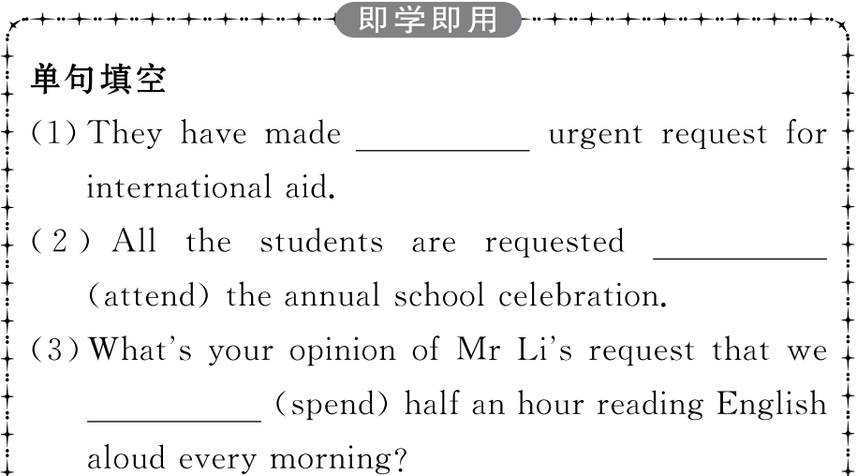
重点词汇
重点语法
随堂练习

Slide 11
重点词汇
重点语法
随堂练习

Slide 12
重点词汇
重点语法
随堂练习
3.attract v.吸引,引起……的兴趣
【课文原句】The lantern fair attracts a lot of people,
so it’s one of the busiest times of year for the traffic police.
灯会吸引了很多人,所以它是交警一年中最繁忙的时刻之一。
【词汇精讲】句中的attract是及物动词,意为“吸引,引起……的兴趣”。
It is not unusual for teenagers of your generation to be attracted to computer games and the online world.你们这一代青少年被电脑游戏和网络世界所吸引是很正常的。
Baidu’s Apollo self-driving bus attracts attention at a park in Beijing.
百度公司的 “阿波罗”号无人驾驶公共汽车在北京的一个公园吸引了人们的注意力。

Slide 13
重点词汇
重点语法
随堂练习
【词汇拓展】

Slide 14
重点词汇
重点语法
随堂练习
The various clubs are attractive to students who want to go to develop their own hobbies.
各种各样的俱乐部吸引着那些想发展自己爱好的学生们。
This kind of film has little attraction to young people.
这种电影对年轻人没有多少吸引力。

Slide 15
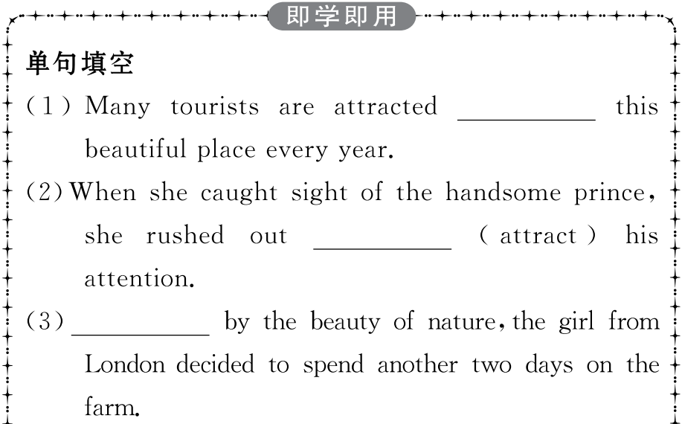
重点词汇
重点语法
随堂练习

Slide 16
重点词汇
重点语法
随堂练习

Slide 17
重点词汇
重点语法
随堂练习
4.competition n. 比赛,竞赛
【课文原句】
We’ll hold a lantern riddles competition,too.
我们也将举行猜灯谜比赛。
【词汇精讲】句中的competition是名词,意为“比赛,竞赛”。
Competition among youths to enter the best colleges is intense.
青年人进名牌大学的竞争十分激烈。
We can compete with students from other schools in the World Adolescent Robotics Competition.
我们可以和来自其他学校的学生在世界青少年机器人技能竞赛中竞争。

Slide 18
重点词汇
重点语法
随堂练习
【词汇拓展】

Slide 19
重点词汇
重点语法
随堂练习
Many students in our class competed in the physics contest.
我们班许多学生参加了物理竞赛。
I am going to compete against/with my old rival in the second round.
第二回合我将与我的老对手竞争。
Class Two and Class Three will compete for the gold medal in the basketball match.
二班和三班在篮球比赛中将争夺金牌。

Slide 20
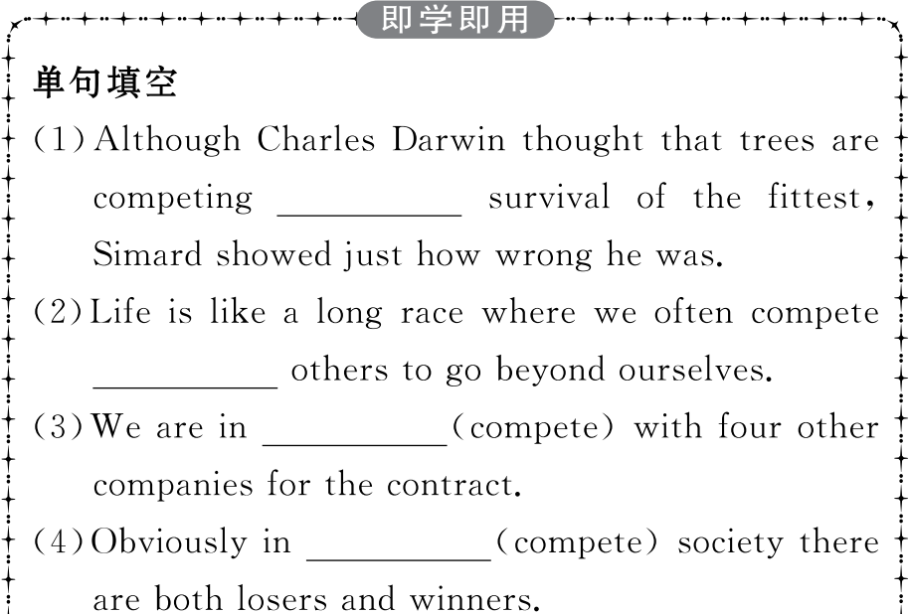
重点词汇
重点语法
随堂练习

Slide 21
重点词汇
重点语法
随堂练习

Slide 22
重点词汇
重点语法
随堂练习
情态动词(Ⅱ)
1.“must have done”表示对过去事情的肯定推测,译成“一定做过某事”,该结构只用于肯定句。在否定句和疑问句中要用can或could。
You must have read widely and put a lot of work into it.
你过去一定进行了广泛阅读并投入了大量的工作。
Mr Smith can’t have gone to Beijing,for I saw him in the library just now.
史密斯先生不可能去北京了,因为我刚才还在图书馆见过他。
There is nowhere to find them.Where can they have gone?
到处找不到他们,他们可能到什么地方去呢?

Slide 23
重点词汇
重点语法
随堂练习
2.“could have done”表示对过去事情的假设,表示本来能够做某事而没有做。
He could have passed the exam,but he was too careless.
本来他能够通过考试,但是他太粗心了。
Jerry did not regret giving the comment but felt that he could have expressed it differently.
杰瑞并不后悔给出这样的评论但是觉得他本可以用一种不同的方式来表达。

Slide 24
重点词汇
重点语法
随堂练习
3.“may/might have done”表示对发生过的事情的推测,意思是“可能已经”或“也许已经”,用于肯定句中。might与may意思相同,但可能性更小。
—What has happened to George?
—I don’t know.He may have got lost.
——乔治发生了什么事?
——我不知道,他可能迷路了。
He might have given you more help,even though he was busy.
他或许会多给你一些帮助,尽管他很忙。

Slide 25
重点词汇
重点语法
随堂练习
4.“should/ought to have done”表示本来应该做某事,而实际没做; “shouldn’t/oughtn’t to have done”表示本来不应该做某事,而实际做了。含有指责对方或自责的含意。
Tom,you are too lazy.The work should have been finished yesterday.
汤姆,你太懒惰了,这项工作本来应该昨天就做完的。
Look!Tom is crying.I shouldn’t have been so harsh on him.
看,汤姆哭了,我本来不应该对他如此严厉。
5.“need have done”表示本来需要做某事而没有做;“needn’t have done”则表示“本来不需要做某事而做了”。
I needn’t have bought so much wine—only five people came.
我本来没有必要买这么多酒,只来了五个人。
He need have hurried to the station.In that case,he wouldn’t have missed the train.
他本来需要快点去车站,那样的话,他就不会误了火车。

Slide 26
重点词汇
重点语法
随堂练习
Ⅰ.介(副)词填空
1.Mr Smith is putting all the balloons and flowers.
答案:up
2.He is often dressed Father Christmas and gives gifts to children.
答案:as
3.Maybe we ought to go down to the library and checked it .
答案:out
4.The Christmas tree was decorated coloured lights.
答案:with
5.Please remember to arrive time if you accept the invitation.
答案:on

Slide 27
重点词汇
重点语法
随堂练习
Ⅱ.完成句子
1.我一定是把我的字典忘在公共汽车上了。
I my dictionary on the bus.
答案:must have left
2.他的外套还在这里,他一定没回家。
His coat is still here.He home.
答案:can’t have gone
3.你本来应该申请那个职位的。
You for the position.
答案:should have applied

Slide 28
重点词汇
重点语法
随堂练习
4.我们不应该借给她那么多钱。
We her so much money.
答案:shouldn’t have lent
5.你本来没有必要乘公共汽车去车站,非常近。
You a bus to the station;it was so near.
答案:needn’t have taken

