Slide 1
Unit 1 Topic 2
Where are you from?
Section D
WWW.PPT818.COM

Slide 2
Work in pairs like this:
A: What’s your name?
B: My name is …
A: Where are you from?
B: I’m from …
A: What’s your telephone number?
B: My telephone number is …

Slide 3
A: Who is he?
B: He is ...
A: Where is he from?
B: He is from ...
A: What’s his telephone number?
B: His telephone number is ...

Slide 4
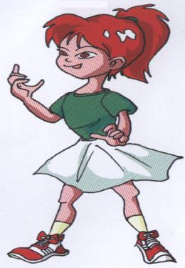
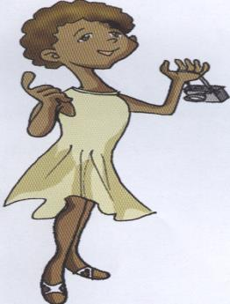
Please introduce yourself.
Hello. Nice to meet you.
My name is …, I am from …,
My telephone number is …

Slide 5
下列每组单词中都有一个相同的音素，
读一读，你能找到吗？
lake make game name
secret Chinese he me
am can cat glad
red bed yes egg

Slide 6
你发现了吗, 红色字母都发什么音呢？
lake name Jane take ————
and thank Canada animal ———
me she he we ————
seven ten help very ————
∕ei∕
∕æ∕
∕i:∕
∕e∕

Slide 7
试着读一读下面的单词吧。
late face same grade
these me be evening
hat at hand black
pen ten seven pencil

Slide 8
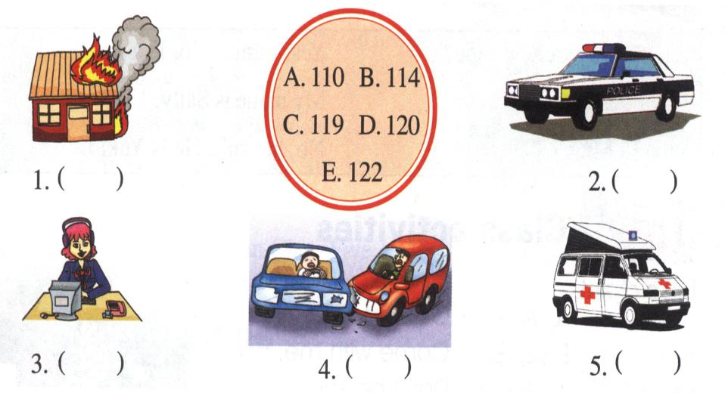
2 Match the numbers with the right pictures. Then listen and check.
C
A
B
E
D

Slide 9
3a
Grammar focus
Subject Pronouns
I | we
you | you
he she it | they

Slide 10
they’re = they are
what’s = what is
isn’t = is not
aren’t = are not
who’s = who is
where’s = where is
he’s = he is
she’s = she is
they’re = they are
he’s = he is
what’s = what is
where’s = where is
who’s = who is

Slide 11
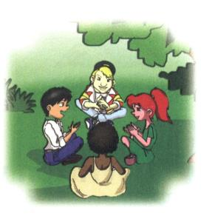
Where are you from?
I’m from Canada.
Is she Jane?
Yes, she is.
Is he Li Ming?
No, he isn’t.

Slide 12
Who are they?
They’re Maria and Jane.
Are you from Japan?
Yes, we are. / No, we aren’t.

Slide 13
3b
Useful expressions
Excuse me, are you Jane? | Yes, I am. / No, I’m not.
What’s your name? | My name is Sally.
What’s your telephone number? | My telephone number is ... / It is ...

Slide 14
人称代词
 | 单数 |  | 复数
 | 主格 | be动词 | 主格 | be动词
第一人称 | I | am | we | are
第二人称 | you | are | you | are
第三人称 | he she it | is is is | they | are

Slide 15
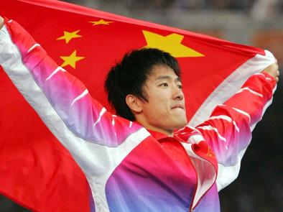
Project
Suppose you are a reporter, and do an interview about Liu Xiang.
What’s your name?
My name is …
Where are you from?
I am from …
What’s your telephone number?
My telephone number is …

Slide 16
用am, is, are填空。
1.Who ______they?
2. I_______John Brown.
3. What_______ his name, Peter?
4.You ________ Tom.
5. Maria and Jane ______from Class 1.
6. Her name ________Kate.
8. It ______my English book.
are
am
is
are
are
is
is

Slide 17
在这个单元里，你学到了什么？
你能帮我总结吗？
音标：
Summary
2.词汇：
3.语法：
4.重点句子：

Slide 18
Homework
（1）仿照制作3个好朋友的个人信
息卡。
（2）假设你是一名记者，你的搭
档是个名人，对他做一个采
访，写一份对话形式的调查
报告。

