Slide 1
Unit 1 Topic 1
Our country has developed rapidly.
Section B
WWW.PPT818.COM

Slide 2
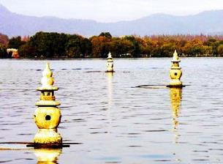
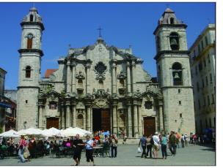
A: Have you been to Beijing?
A: Have you been to Hangzhou?
B: Yes, I have. / No, I haven't.
Has Maria been to her hometown?
Yes, she has.
She has come back from Cuba.
She took part in some volunteer activities during summer holidays.
She is happy because she has learnt a lot from it.

Slide 3
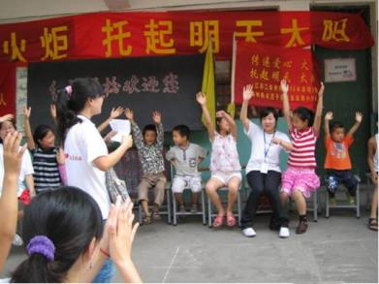
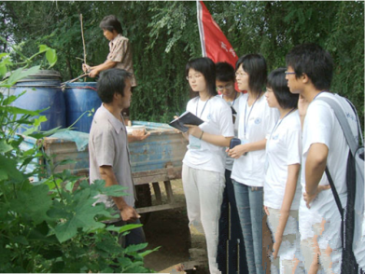
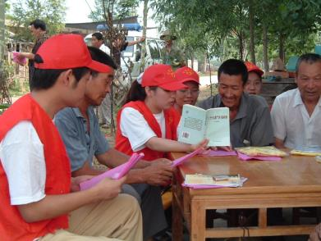
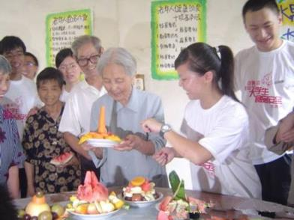
volunteer activities

Slide 4
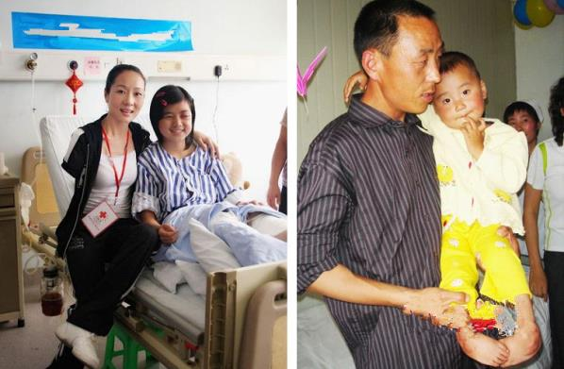
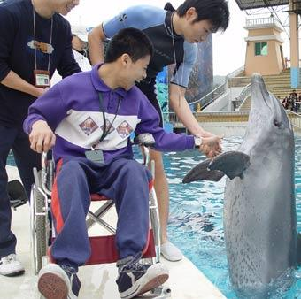
disabled children

Slide 5
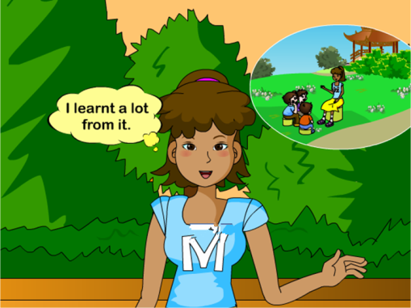
Language points
learn ...from … 从……中学习
e.g. I’ve learnt a lot from the story.
我从这个故事中学到了很多。

Slide 6
Listen to 1a and tick what Maria has done.
P3 1a mp3
Activity |  | clean rooms for the disabled children | feed the disabled children | cook for the disabled children | travel
Maria
be a
volunteer
√
√
×
√
×
been a volunteer?
cleaned rooms for the disabled children?
fed the disabled children?
cooked for them?
traveled
A: Has she
B: Yes, she has.
No, she hasn’t.
现在完成时:
have/has+动词的过去分词
动词的过去分词
Past Participle

Slide 7
2a Fill in the blanks with the different forms of the verbs. Read them aloud and pay attention to the underlined parts. Then listen and check.
The pronunciation of “ed” is “/t/, /d/, or ” when it is added to the verbs ending with different sounds, such as help/jump, play/turn or wait/end.
Verb | Past Tense | Past Participle
clean | cleaned | cleaned
jump | jumped
 | chatted | chatted
fly |  | flown
do | did
am/is/are | was/were
shut |  | shut
… | … | …
jumped
chat
flew
done
been
shut

Slide 8
Please shut the door.
shut v. 关闭，关上
shut up 闭嘴，住口

Slide 9
2b Listen and read the example sentences aloud, paying attention to the pronunciation and intonation. Then make up more based on the table.
Activity Name | clean rooms | jump rope | chat online | fly a kite | do farm work | …
Ann
Zhang Yang
…
Example:
A: Has Ann ever cleaned rooms?
B: Yes, she has.
A: Has Ann chatted online?
B: No, she hasn’t.

Slide 10
1b Listen to 1a and mark T (True) or F (False).
1. Maria helped the disabled children to
clean the rooms and fed them.
2. Maria thinks her experience as a
volunteer was wonderful.
3. Maria felt very happy because she
helped others.
4. Kangkang has been to a summer
school to help the old.
5. Kangkang has made some new friends
in the English summer school.
( )
( )
( )
( )
( )

Slide 11
1c Read 1a and complete the following passage.
Both Maria and Kangkang have done something meaningful. Maria has ____________ some volunteer activities to help some disabled _______. She ________________ a lot from it, and she said ___________ others made her happy. Kangkang __________ an English summer school. He _______ some new friends there, and they also __________ funny shows for a group of old people in a ___________.
taken part in
children
has learned/ learnt
to help/helping
has been to
made
put on
community

Slide 12
Language points
1. You took part in some volunteer activities during summer holidays, didn’t you? 你在暑假参加了一些志愿者活动，是吗？
e.g. It’s a nice day, _______ _______?
Ann didn’t use to live there, ______ _____?
反意疑问句
isn’t it
did she
2. To help others makes us happy.帮助别人使我们快乐。
e.g. To do sports every day is necessary.
动词不定式做主语

Slide 13
3. Though I had no time to travel, I still felt very happy. 虽然我没有时间去旅行，但我仍然感到很开心。
让步状语从句
though/although
even though/even if
e.g. Though/Although it was very late, the workers
went on working.
虽然很晚了，但是工人们继续工作。
虽然，尽管，即使
通常不与but连用
have (no) time to do sth. 有（没有）时间做某事
e.g. He was so busy that he had no time to have lunch.
他太忙了，没有时间吃午饭。

Slide 14
2c Work in groups and survey your group members about their vacation experiences based on 2b. Then report it to the class.
You may begin like this:
Jane has done some farm work… __________
___________________________________________________________________________________________________________________________

Slide 15
Fill in the blanks.
Exercises
1. We should help the d________ people when they are
in trouble.
2. — It’s getting colder now. Would you please s____
the door?
— Sure.
3. He told me that he __________ (take part in) an
English party last night.
4. We were busy at that time, so we had no time
______ (go) shopping.
5. _________ (see) is to believe.
isabled
hut
took part in
to go
To see
眼见为实。

Slide 16
Choose the best answer.
Exercises
1. — _____ you ever _____ to the USA?
— Yes, we have.
A. Have, gone B. Have, been
C. Did, go D. Did, went
2. ______ it rains heavily, ______ farmers are still
working in the fields.
A. Though, but B. Though, still
C. Though, / D. Although, but
3. — I helped a disabled man yesterday.
— ______ wonderful experience!
A. What B. How a
C. How D. What a
4. Jessie learnt a lot ______ the book after
reading it.
A. from B. of
C. at D. with

Slide 17
summary
We learn:
1. Some words:
disabled, shut, ever, rope
2. Some phrases:
learn…from… , have (no) time to do sth. , put on,
jump rope
3. Some sentences:
To help others makes us happy.
We can:
1. Write the different forms of the verbs and pronounce
them correctly.
jump—jumped— jumped
2. Read English with proper pronunciation and
intonation.
3. Use the Present Perfect Tense.

Slide 18
Homework
1. Read 1a aloud.
2. Finish Section B in
your workbook.
3. Preview Section C.

Slide 19
THANK YOU!

