Slide 1
1111111111111111111111111111111111111111111111111111111111111111
Unit 2 Good Health to You!
六年级下册
Lesson 11 Work Hard!
WWW.PPT818.COM

Slide 2
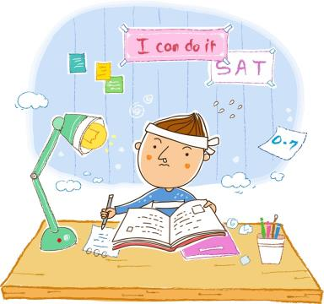
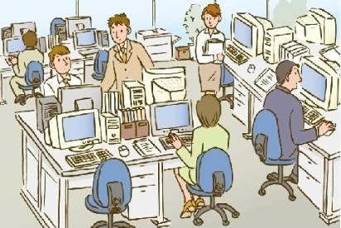
What are they doing?

Slide 3
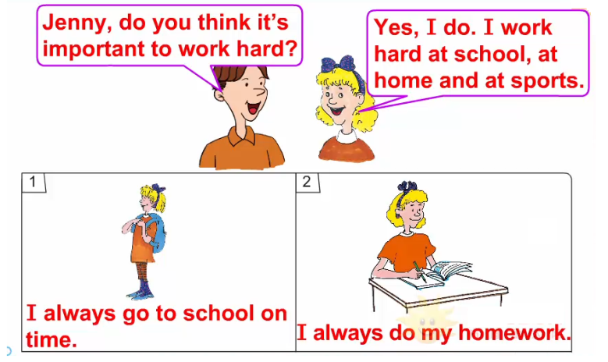
1. You can do it!

Slide 4
讲解来自《点拨》
知识点 1
high /haɪ/ adj.& adv. 高的；在高处
例句：
The big mountain is very high.那座大山很高。(adj.)
Li Ming jumps high.李明跳得高。(adv.)
字母组合igh的发音是/ aɪ/。
发音：
low 低的；低
反义词：
hi int. 嗨
同音异义词记忆法：

Slide 5
讲解来自《点拨》
词语辨析：
high | adj.高的，常用于指物和空间的高度。反义词：low低的 | The wall is two metres high. 那堵墙有两米高。
 | adv.高 反义词：low 低 | I can fly a kite very high in the sky. 我能把风筝在空中放得很高。
tall | adj.高的，常用于指人的身材和细长物的高度。 反义词：short 矮的 | My father is very tall. 我爸爸很高。

Slide 6
讲解来自《点拨》
单项选择。
The boy can jump very ________．
A. tall B. good C. high
典例
C

Slide 7
2. Does Kim work hard?

Slide 8
讲解来自《点拨》
… do you help your family?
……你帮助你的家人吗？
知识点 2
一般现在时的一般疑问句
Do you+动词原形+其他？
句型结构：
用于询问对方是否做某事。
用法：
Do you clean your bedroom?你打扫你的卧室吗？
例句：

Slide 9
讲解来自《点拨》
help /help/ n. & v. 帮助，帮忙
Can you help me with my homework? （v.）
你能帮我做作业吗？
Thank you for your help. (n.) 谢谢你的帮助。
例句：
help sb. (to) do sth.帮助某人做某事
help sb. with sth.在某方面帮助某人
help oneself自取所需
短语：

Slide 10
讲解来自《点拨》
知识点 3
dry /draɪ/ v. 擦干
I help my mother dry the dishes.
我帮助妈妈擦干盘子。
例句：
dry the dishes擦干盘子
短语：
dry还可以作形容词，意思是“干的，干燥的”。
拓展
My dress is dry now. 我的连衣裙现在干了。
例句：

Slide 11
What else do you do at home?
你在家里还做别的什么事情？
讲解来自《点拨》
知识点 4
else /els/ adv. 别的；其他的
易错点
提示
else常用在特殊疑问词(如：who，what，where等)或不定代词(something, anything, someone, anyone)之后。

Slide 12
讲解来自《点拨》
Who else wants to play basketball next Sunday?
还有谁下个星期天想要打篮球？
例句：
other“别的，其他的”，用来修饰名词，放在名词的前面。
例句：I run, ride a bike and do other exercise.
我跑步、骑自行车，还进行其他的锻炼。
拓展

Slide 13
讲解来自《点拨》
单项选择。
—________ did you go last Saturday?
—The Beijing Zoo.
A. What else B. Who else C. Where else
典例
C

Slide 14
3. Let’s chant!
Everyone, everyone, Reach up high!
Everyone, everyone, Touch the sky!
Everyone, everyone, Turn around!
Everyone, everyone, Touch the ground!
Everyone, everyone, Bend down low.
Everyone, everyone, Touch your toes.

Slide 15
习题来自《点拨》
一、从方框中选择合适的介词填空。
1. I always dry dishes ________ dinner.
2. Work hard ________ school.
3. I always go to bed ________ time.
4. I often help my mother ________ the housework.
at， with， after， on
after
at
on
with

Slide 16
二、连词成句我最棒！
1. hard, at, I, sports, work (.)
_______________________________________________
2. the, dry, I, dishes, often (.)
_______________________________________________
3. you, family, do, your, help (?)
_______________________________________________
习题来自《点拨》
I work hard at sports.
I often dry the dishes.
Do you help your family?

Slide 17
习题来自《点拨》
4. Danny, day, does, exercise, do, every (?)
__________________________________________________
5. the, flowers, often, water, home, at, I (.)
_________________________________________________
Does Danny do exercise every day?
I often water the flowers at home.

Slide 18
习题来自《点拨》
三、从括号中选择合适的单词填空。
1. What________ (else, other)do you do at home?
2. Does she________ (help, helps)her family?
3. How often do you do________ (you, your )homework?
4. She always________ (make, makes)her lunch.
5. I don’t go to school ________(in, on) Saturday and Sunday.
else
help
your
makes
on

Slide 19
本节课我们学习了以下知识，请同学们一定加强巩固，以便能和同学们进行灵活交流哦！
重点词汇：high, help, dry,
重点句式：… do you help your family?
What else do you do at home?

Slide 20
1 熟记本节课所学的句型、短语和单词，必须会听、说、读、写。
2 将Does Kim work hard?朗读流利。
3 完成配套的课后作业，见《典中点》P23页或
课后作业课件。

Slide 21
Thank you!

