Slide 1
Module 11 Photos
Unit 2
The photo which we liked best
was taken by Zhao Min.
WWW.PPT818.COM

Slide 2
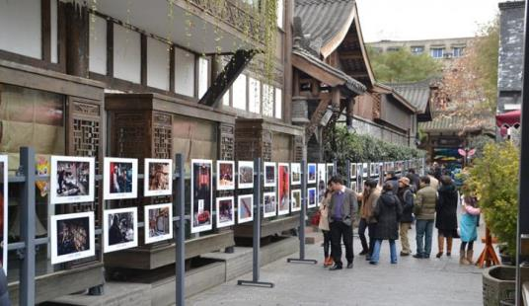
Warming up
Look at the picture and say out the subjects of the photo competition.

Slide 3
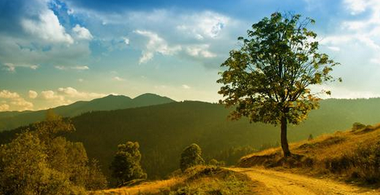
Which subject does this photo belong to?
Nature

Slide 4
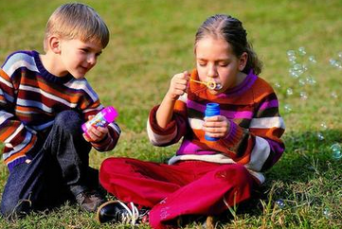
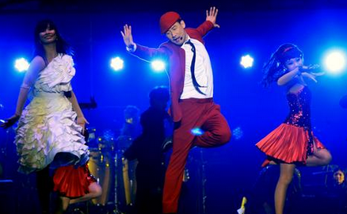
Music
People

Slide 5
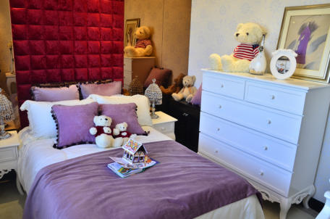
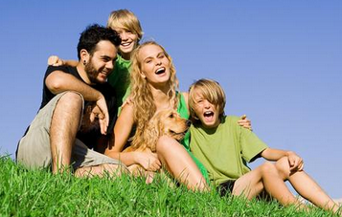
Family
Home

Slide 6
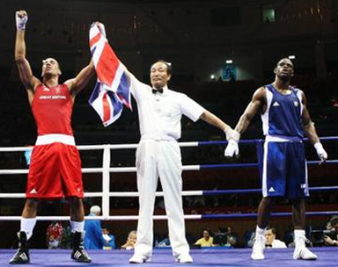
New words
winner n.
获胜者

Slide 7
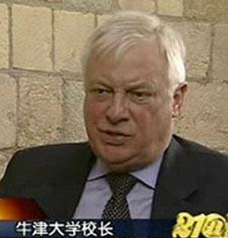
headmaster n.
男校长
singer n.
歌手; 歌唱家

Slide 8
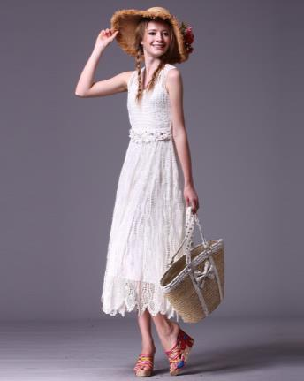
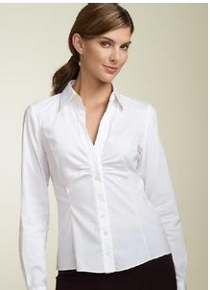
blouse n. 女衬衫
skirt n. 裙子

Slide 9
Reading
Look at the picture and the subjects of the photo competition. Which subject does this photo belong to?

Slide 10
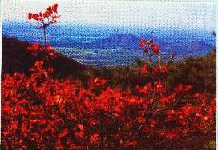
· City and People · Music
· Home and Away · Nature

Slide 11
Read the passage and check your answer to Activity 1. Find out who took the photo.
Li Wei

Slide 12
Complete the table.
Winner | Subject | What the photo shows
Li Wei | Nature
Zhao Min
the trees in Xiangshan Park, the different colours on the hill
A person rushing across the street on a windy evening, a girl wearing a blouse and skirt is protecting her books against the showers
City and People

Slide 13
Winner | Subject | What the photo shows
He Zhong
Tony Smith
the singer Becky Wang and the band playing at a concert, how the group moves and sounds, the good time their fans are having
Music
Home and Away
Cambridge and Beijing, some of the experiences of a young visitor to China, some memories of his home

Slide 14
Language points
1. Tonight I am more than happy to read out the winners of the photo competition.
tonight adv. (在)今晚；(在)今夜
e.g. I hope to sleep better tonight.
我希望今夜睡个好觉。

Slide 15
read out 朗读; 宣读
e.g. The headmaster read out the names of the players before the game began.
比赛开始前，校长宣读了运动 员的名字。

Slide 16
2. Compared with other years, we received many more photos.
compared with 在句中作状语, 意思是 “和……相比”。

Slide 17
e.g. Compared with silk, cotton is cheap.
和丝相比, 棉花更便宜。
Compared with last year, we have had more success this year.
和去年相比, 今年我们取得了更大的 成就。

Slide 18
3. Even though all of the photos are excellent, we are sorry to say that we cannot give prizes to everyone.
even though/if 表示 “即使; 尽管”, 用来引导状语从句。

Slide 19
e.g. Even though it rains, he will come on time.
即使下雨，他还是会准时来的。
We’ll go even if it rains. 即使下雨我们也要去。

Slide 20
4. It is a beautiful girl who is wearing a blouse and skirt, and who is protecting her books against the showers.
protect sth. against sth.
保护……; 使……不受
e.g. Protect children against violence.
保护儿童免遭暴力。

Slide 21
5. Her photo shows a person rushing
across a street on a windy evening.
请仔细观察下面例句中rush的用法，
然后补全结论部分所缺的内容。
【例句】
1. Then three policemen rushed at him.
2. They made a rush for the door.
3. You’d better get to work before the
rush hour.

Slide 22
【结论】
根据例句1. Then three policemen rushed at him.中rush在句中所作成分可知，它是动词，意思是“冲；奔”。从例句2. They made a rush for the door.中的made a rush可知，rush在此的词性为_____，意思是“冲；跑”。例句3. You’d better get to work before the rush hour.
中的rush hour意为“（上下班时的）交通高峰期”。
名词

Slide 23
6. Congratulations to our winners and thanks to everyone who entered the competition.
congratulations to sb. (on sth.)表示 “(因某事)向某人表示祝贺”。
e.g. Congratulations to you on winning the first prize.
祝贺你获得一等奖。

Slide 24
7. Now let’s welcome our headmaster to present the prizes to the winners!
present v. 授予; 呈递
e.g. The ships present a beautiful sight.
船舶呈现一派美丽的景致。
She presents her idea very clearly.
她把自己的观点表达得十分清楚。

Slide 25
Exercises
Complete the passage with the correct form of the words in the box.
blouse present tonight windy winner
The headmaster __________ the prizes to the ________ of the photo competition _________. Li Wei won the prize for the subject Nature.
presented
winners
tonight

Slide 26
In the City and People group, Zhao Min won a prize with a photo of a girl who wears a ________ and skirt rushing across the road, on a ________ evening in the rain. He Zhong won the prize in the Music group, and Tony Smith won the prize for the subject Home and Away.
blouse
windy

Slide 27
Writing
Bring a photo and make a photo display.
Choose a photo from the display. Answer the questions.

Slide 28
What does it show?
2. Where was it taken?
3. Where are the things and/or people in the photo?
4. Why do you like it?

Slide 29
Homework
Write a passage about the photo. Use the answers in Activity 6 to help you.

Slide 30
Thank you!

