Slide 1
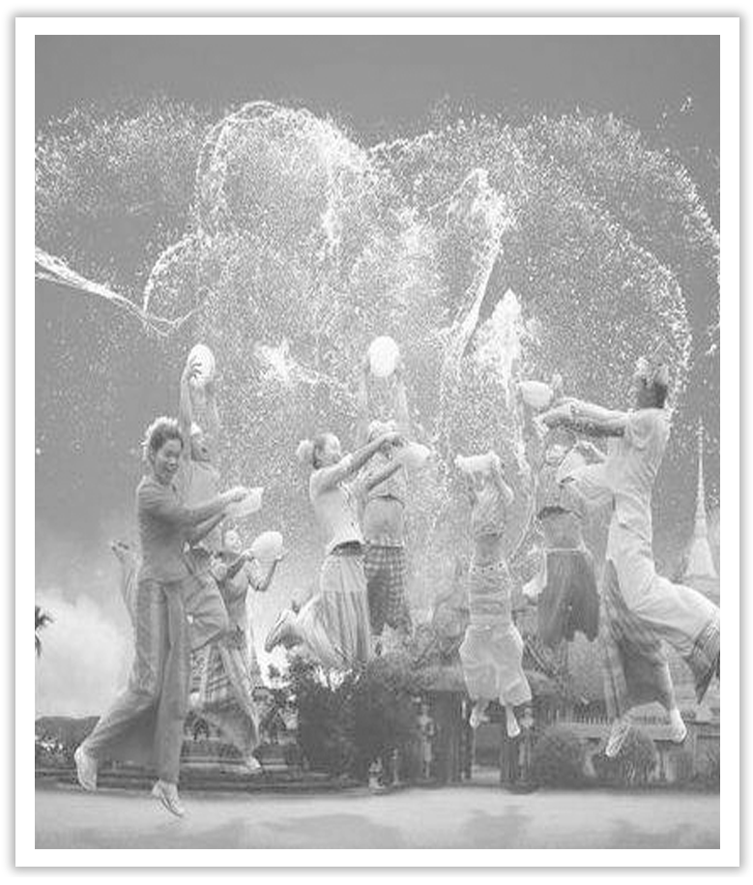
Unit 3 Diverse Cultures
Section Ⅴ Listening and Talking
WWW.PPT818.COM

Slide 2
1.Translate the following words and phrases.
①collection n. __________________________
②accessory n. ___________________
③souvenir n. ___________________
④percentage n. ___________________
作品集；收集物；收藏品
配饰；附件；配件
纪念物；纪念品
百分率；百分比

Slide 3
2.Brainstorming：What do you know about ethnic minorities in China?
________________________________________________________________________
The answer is open.

Slide 4
Finish Ex.2 on Page 31.
Talking—Finish Ex.3 on Page 31.

Slide 5
语言知识积累
表示正在听的常用表达
Exactly!
You’re right!
I see.
I know what you mean.
You’re kidding!

Slide 6
Really?
I can’t believe it!
Great！/Super!
That’s interesting.
Wow!
Tell me about it！

Slide 7
collection n.作品集；收集物；收藏品 collect vt.收集；采集
[合作探究] 体会collection的用法和意义
①A glass-fronted cabinet displayed a collection of china figurines.
玻璃面展柜中陈列了____________瓷质小塑像。
②His workmates made a collection for his leaving party.
他的同事为他的告别晚会____________。
[自主发现]
③make a collection ____________ 为……募捐
④a collection ____________ 一批；一系列
一系列
募捐
for
of

Slide 8
[词块积累]
a collection of rubbish一堆垃圾
a collection of short stories 短篇小说集
collection and delivery 上门取送
[巩固内化] 介词填空
①The class made a collection ____________ the local hospital.
②He published a collection ____________ short stories.
for
of

