Slide 1
Module 9 Life history
Unit 1 He left school and began work at the age of twelve.
WWW.PPT818.COM

Slide 2
Warming-up
Listen to a song.
What is the song about?

Slide 3
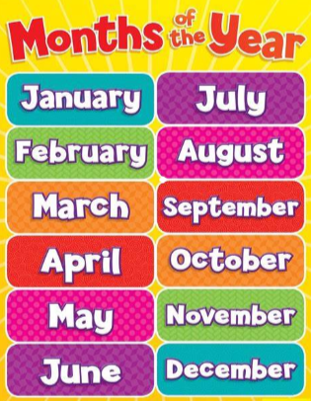
Pre-listening
Think and answer
一月
七月
二月
八月
How many months are there in a year?
What are they?
三月
九月
四月
十月
五月
十一月
六月
十二月

Slide 4
Pre-listening
Think and Discuss
What festivals do you know?
When is it?

Slide 5
Pre-listening
Look and say
May Day
What festival is it?
When is it?
Women’s Day
Children’s Day
Teachers’ Day

Slide 6
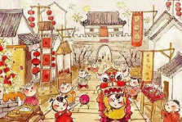
Pre-listening
Look and say.
Spring Festival
What festival is it?
When is it?
National Day
New Year’s Day
Christmas

Slide 7
Pre-listening
1 Match the festivals with the months.
January
February
March
April
May
June
a) Teachers’ Day
b) Women’s Day
c) Christmas
d) National Day
e) Children’s Day
f) New Year’s Day
g) May Day
h) Spring Festival
July
August
September
October
November
December

Slide 8
Pre-listening
Talk about when the festivals are.
Spring Festival is in January or February.
Women’s Day is in _________.
May Day is in _________.
Children’s Day is in _________.
Teachers’ Day is in _________.
National Day is in _________.
Christmas is in _________.
New Year’s Day is in _________.
March
May
June
September
October
December
January

Slide 9
Pre-listening
2 Listen and choose the correct answer.
1) Betty’s grandfather’s life was/wasn’t different from Betty’s.
2) Betty’s grandfather was born in April 1935/1955.
3) Betty’s grandfather went to America/England in October/
November 1941.
√
√
√
√

Slide 10
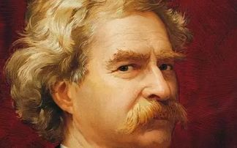
Pre-listening
Look and answer
Who is he?
What do you know about him?

Slide 11
Pre-listening
Look and answer
Do you know this book?
What is it about?

Slide 12
While-listening
Listen and choose the correct answer.
1. Where was Mark Twain from?
A. England. B. America. C. China.
2. When was Mark Twain born?
A. In 1835. B. In 1845. C. In 1855.
3. When did Mark Twain become famous?
A. In the 1840s. B. In the 1850s.
C. In the 1860s.

Slide 13
While-listening
3 Complete the table about Mark Twain.
Time | Facts
In 1835
At the age of twelve
In the 1860s
born in Missouri
left school and began work
took the name Mark Twain and became very famous

Slide 14
Post-listening
4 Find the past form of the verbs in the conversation.
be
become
begin
do
get
go
was/were
know
leave
read
take
write
knew
became
left
began
read
did
took
got
wrote
went

Slide 15
Post-listening
Read and fill
Mark Twain came from ________. He ____ a writer and Tom sawyer was his work. He ________ in 1835. At the age of twelve, he ___________ and ______ work. He _____ for a newspaper and _________on a boat. He ______________ in the 1860s. He ______to Europe. He ___________ to China.
America
was
was born
left school
began
wrote
got work
became famous
went
didn’t come

Slide 16
Post-listening
5 Complete the sentences with the correct form of the words from the box.
age become Europe newspaper real writer
age
1) He began work at the __________ of twelve.
2) His __________ name was Samuel Clemens.
3) He wrote for a(n) __________.
4) He __________ very famous.
5) He went to __________, but he didn’t come to China.
6) He is a great __________.
real
newspaper
became
Europe
writer

Slide 17
Post-listening
Language points
1. Tom Sawyer, by the famous American writer, Mark
Twain.
by在此处表示“由……创作”。
e.g. Hamlet is a play by Shakespeare.
《哈姆雷特》是莎士比亚写的戏剧。

Slide 18
Post-listening
Language points
【辨析】find out, find与look for
find out | 发现；查明；弄清 | 多指通过调查、询问、分析等搞清楚、弄明白某种情况或事实。 | 强调结果。
find | 找到； 发现 | 指通过寻找，发现某人或某物；有时也指偶然发现。 | 强调结果。
look for | 寻找 | 指有目的地寻找某人或某物。 | 强调动作。

Slide 19
Post-listening
Language points
Complete the sentences with the correct form of the words from the box.
find find out look for
Jim couldn’t __________ his mother.
We need to __________ how much it will cost.
She is __________ her son in the park.
find
find out
looking for

Slide 20
Post-listening
Language points
3. He left school and began work at the age of twelve.
at the age of是介词短语，意为“在……岁时”，常在句中作时间状语。
John went to Beijing at the age of 18.
约翰18岁时去了北京。

Slide 21
Post-listening
Language points
4. But he took the name Mark Twain and became very
famous in the 1860s.
took the name原形是take the name，意为“起名；取名”。
in the 1860s不是具体时间，而是指“19世纪60年代。
“in+the+整数年+s/’s”是表达年代的固定用法。表示
“……世纪……年代”。
e.g. in the 1990s 20世纪90年代

Slide 22
Post-listening
6 Listen and repeat.
/ɑː/ March Mark market
/eɪ day May stay
/iː/ read teacher
/uː/ food school too
/ʊ/ book good

Slide 23
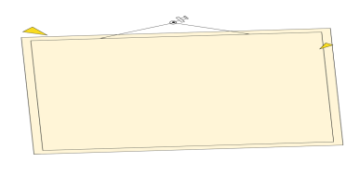
Post-listening
The rules of pronunciation of ar, ay, ea, oo.
字母组合ar通常读长音/ɑː/；字母组合ay通常读长音/eɪ/，也就是第一个元音字母的名称音；字母组合ea通常读长音/iː/，也就是第一个元音字母的名称音；字母组合oo在多数情况下读长音/u:/，少数读短音/ʊ/。
字母组合 | ar | ay | ea | oo
音标 | /ɑː/ | /eɪ/ | /iː/ | /uː/ | /ʊ/
单词 | party farm dark | stay play May | teach tea beach | zoo food room | cook wood look
Have a Try!
She had a dream to eat meat every day.
The fool goose looks at the shiny moon in the sky.
The cook takes a book and finds it good.
A smart boy sat in the park.
He looked at the sky far far away.
My hen likes to lay ten fresh eggs everyday.

Slide 24
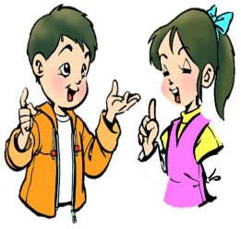
Post-listening
7 Work in pairs. Ask and answer questions about Mark Twain.
e.g. —Did Mark Twain stay in Missouri?
—No, he didn’t.
1) Was Mark Twain his real name?
2) Did Betty read Tom Sawyer?
3) Did Mark Twain leave school at sixteen?
4) Did Mark Twain become a newspaper writer?
5) Did Mark Twain come to China?

Slide 25
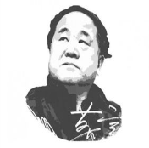
Post-listening
Make a report about Mo Yan.
Time | Facts
In 1955 | was born in Gaomi, Weifang
At the age of 12 | left school
At the age of 21 | joined the PLA (中国人民解放军)
In 1981 | began writing
At the age of 28 | took the name Mo Yan
In 2012 | won the Nobel Prize in Literature

Slide 26
Post-listening
Test
根据汉语意思完成英语句子，每空一词。
1. 你可以在网上找到这个作家的资料。
You can _______ _______ about the _______ _______ the Internet.
2. 琳达在十五岁时离开学校开始工作。
Linda _______ school and _______ work _______ the _______
_______ fifteen.
find out
writer on
left
began
at
age
of

Slide 27
Post-listening
Test
3. 在19世纪80年代，他为一家报刊写文章。
_______ _______ _______, he _______ _______ a newspaper.
4. 他何时获得了一份在船上的工作？没有人知道确切的日期。
When _______ he _______ work on a boat? Nobody knows
the _______ _______.
5. 后来，他在欧洲变得很出名。
Later, he _______ very _______ in _______.
In the 1880s
wrote for
did
get
exact
date
became
famous
Europe

Slide 28
Summary
Words and expressions:
National Day, writer, find out, real, newspaper, date, become, in the 1860s.
Sentence patterns:
1. I read Tom Sawyer.
2. He left school and began work at the age of twelve.
3. He took the name Mark Twain and became very famous in the 1860s.
4. I knew that.

Slide 29
Homework
1. Review the useful words and sentences in the unit.
2. Read and try to recite the dialogue fluently.

Slide 30
Goodbye!

