Slide 1
Don't eat in class.
Section A 第1课时
WWW.PPT818.COM

Slide 2
sorry
outside
important
quiet
rule
hallway
uniform
arrive
fight
wear
bring
(be) on time
dining hall
listen to
have to

Slide 3
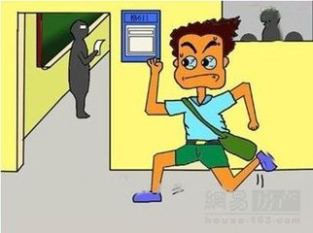
---What rules do you have at school?
---We must arrive at school on time.
rule /ruːl/ 规则、规章
arrive /ə'raɪv/ 到达
arrive at + 小地方 / arrive in + 大地方
arrive at the library / arrive in Beijing
(be) on time 准时

Slide 4
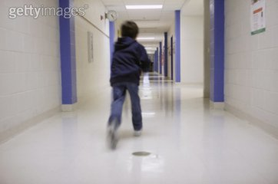
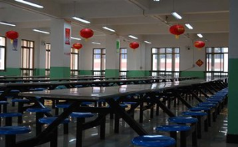
We can't run in the hallways.
And we must eat in the dining hall.
These rules are very important.
hallway /'hɔːlweɪ/ 走廊、过道
hall /hɔːl/ 大厅、礼堂
dining hall 餐厅
important /ɪm'pɔːtnt/ 重要的

Slide 5
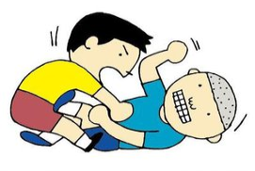
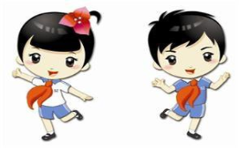
fight /faɪt/ 打架、战斗
We can't fight.
And we have to wear uniforms at school.
have to 必须、不得不
have to强调客观需要 / must强调主观要求
wear /weə(r)/ 穿、戴（描述穿的状态）
uniform /'juːnɪfɔːm/ 校服、制服
wear uniforms 穿校服

Slide 6
I'm sorry, you can't listen to music here.
You must be quiet.
sorry /'sɒri/ 抱歉的、难过的、惋惜的
listen /'lɪsn/ 听
listen to... 听......
quiet /'kwaɪət/ 安静的

Slide 7
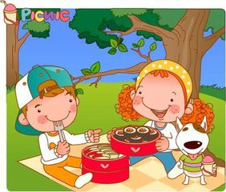
Bring some food and drink.
Let's eat outside.
bring /brɪŋ/ 带来、取来
outside /ˌaʊt'saɪd/ 在外面

Slide 8
单项选择
( )1. We have ________ school uniforms at school.
A. wear B. to wear C. wears D. wearing
( )2. Linda ______ school at 7:30 in the morning.
A. arrives in B. arrives C. arrives at D. arrives to
B
C

Slide 9
完成句子
1. We must __________ Shanghai on time.
我们必须准时到达上海。
2. Jim is ____________ music.
吉姆正在听音乐。
arrive in
listening to

Slide 10
动 词
arrive fight
wear bring
名 词
词 组
rule
hallway
uniform
(be) on time
dining hall
listen to
have to
key words
形容词 / 副词
sorry outside
important quiet

