Slide 1
Unit 1 Hello!
字母学习课件
WWW.PPT818.COM

Slide 2
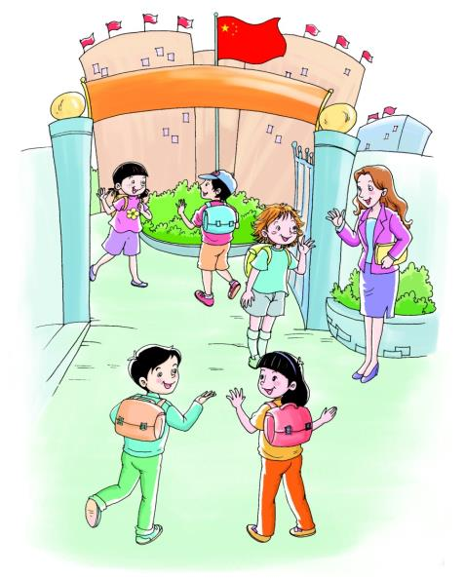
Part A- Let's talk
1. - Hello! I' m ...
- What's your name?
2. - What's your name ?
- My name is...

Slide 3
Part A- Let's learn
- A a
This is A , it's Name is A .
A is in "apple" , A sounds ... in apple.

Slide 4
Part A- Let's learn
- B b
This is B , it's Name is B .
B is in "boy" , B sounds ... in boy.

Slide 5
Part A- Let's learn
- C c
This is C , it's Name is C .
C is in "cat" , C sounds ... in cat.

Slide 6
Part A- Let's learn
- D d
This is D , it's Name is D .
D is in "dog" , D sounds ... in dog.

Slide 7
Part A- Let's learn
- E e
This is E , it's Name is E .
E is in "egg" , E sounds ... in egg.

Slide 8
Part A- Let's learn
- F f
This is F , it's Name is F .
F is in "fish" , F sounds ... in fish.

Slide 9
Part A- Let's learn
- G g
This is G , it's Name is G .
G is in "girl" , G sounds ... in girl.

