Slide 1
Unit2 I’m in Class One, Grade Three.
人教精通版三年级下册
WWW.PPT818.COM

Slide 2
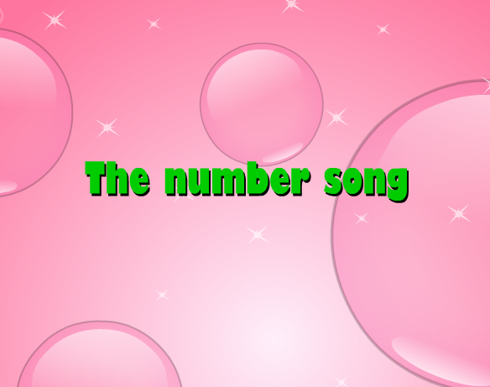
Review
Let’s sing
（单击图片可播放动画）

Slide 3
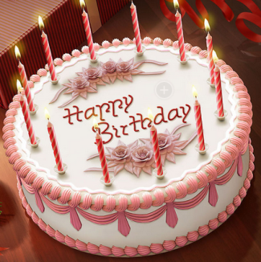
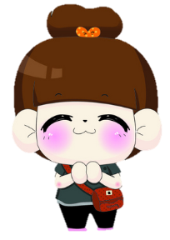
Lead-in
Look and guess
How old is the girl?
She is twelve.

Slide 4
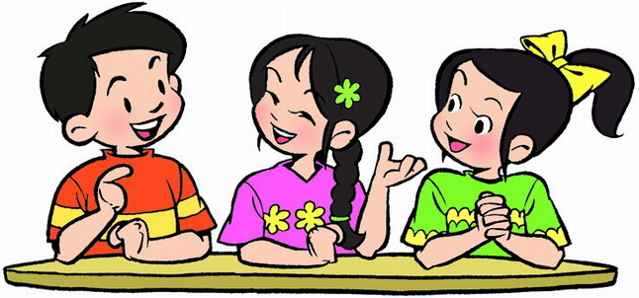
Lead-in
Free talk
How old are you?
I’m ...

Slide 5
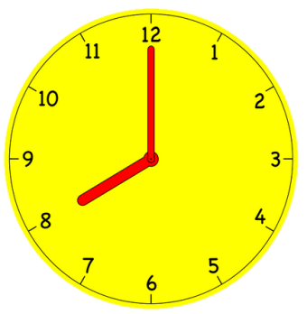
Presentation
Look and say
What time is it?
It’s eleven o’clock.

Slide 6
Presentation
Look and say
What time is it?
It’s twelve o’clock.

Slide 7
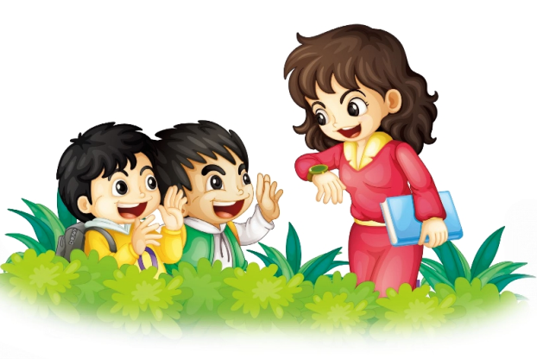
Presentation
Listen and say
Who are they?
What are they talking about?

Slide 8
Presentation
Look and read
It’s twelve
o’clock.
Excuse me, Miss Liu. what time is it?
Excuse me, Miss Liu. what time is it?
Oh, twelve o’clock! Thank you. Goodbye!
Oh, twelve o’clock! Thank you. Goodbye!
Bye-bye!

Slide 9
Practice
Listen and follow
录音 | 课文句子
Excuse me, Miss Liu. What time is it?
It’s twelve o’clock.
Oh, twelve o’clock! Thank you. Goodbye!
Bye-bye!

Slide 10
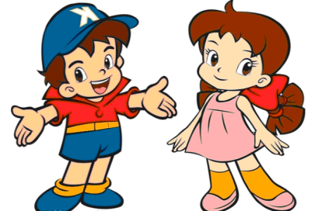
Practice
Role play
三人一组，练习Just talk部分对话，随后表演出来吧！

Slide 11
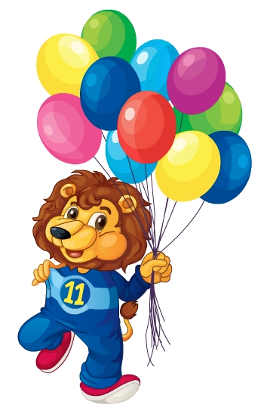
Presentation
Let’s learn
eleven

Slide 12
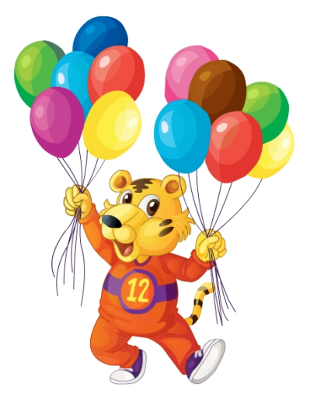
Presentation
Let’s learn
twelve

Slide 13
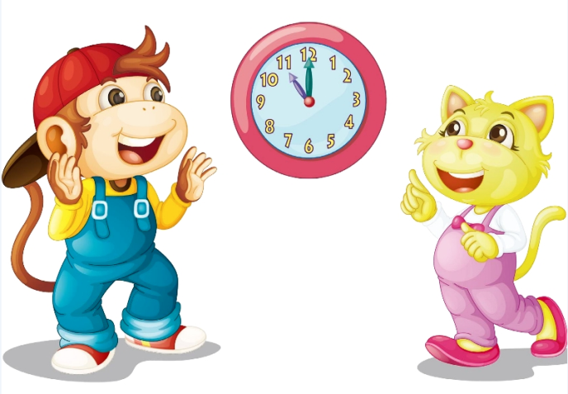
Practice
Let’s paly
What time is it?
It’s eleven o’clock.

Slide 14
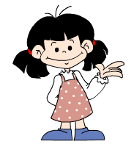
Practice
趣味练习：算一算
one
two
three
four
five
six
seven
eight
nine
ten
eleven
twelve
seven
five
+
two
=

Slide 15
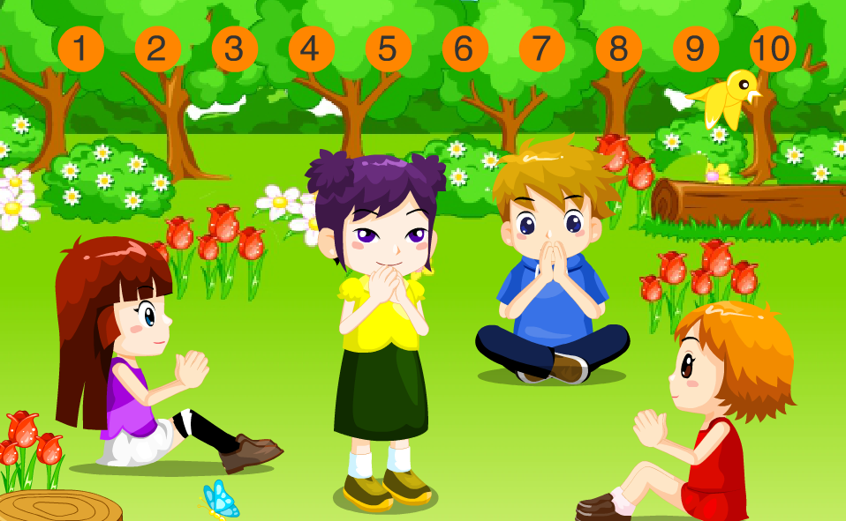
Practice
活动
拍拍手
11
12
One…

Slide 16
Summary
1. 本课学习的数字有哪些？
eleven
twelve
2. 本课的重点句型是什么？
What time is it?
It’s twelve o’clock.

Slide 17
Homework
跟读课文Just talk部分的录音，注意语音、语调。
模仿本课对话，编写一段新的对话（不少于4句）。
预习Lesson 12。
Close

