Slide 1
Unit 4 After-School Activities
A Dinner Date
WWW.PPT818.COM

Slide 2
Learning Targets
★ Key words :
activity, volleyball, practice, chess, club, volunteer,
bingo, both, nothing
★ Key phrases :
come over, how about, be (not) good for...,
be going to, lots of, tell stories, do well in...,
plant trees, take care of, borrow sth. from...,
go on a trip, next week, in the future,
enjoy sth. so much

Slide 3
★ Key sentences:
1. What day is it today?
2. Would you like to come over for dinner tomorrow?
3. I have volleyball practice tomorrow.
4. Wednesday is not good for me.
5. I usually volunteer at the Old Age Home on
Thursdays.
6. I'm not doing well in math this year.
7. We're both busy all week.
8. Nothing!

Slide 4
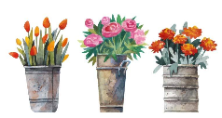
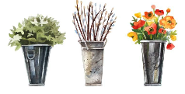
Objectives
1. To learn to make an invitation and talk about after-school activities
2. To learn the new words and expressions

Slide 5
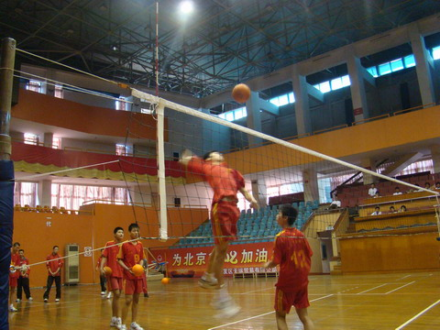
Lead in
Let’s talk about some after-school activities.
volleyball practice
排球训练

Slide 6
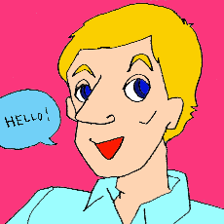
What does he often do after school?
practice English

Slide 7
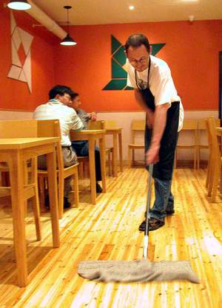
What are/is …going to do
this weekend?
He is going to play
computer games this weekend.
He is going to clean the floor this weekend.

Slide 8
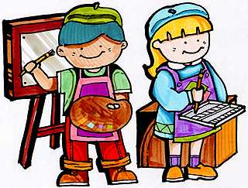
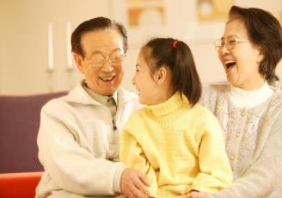
What are/is … going do this weekend?
paint
They are going to paint this weekend.
visit grandparents
She is going to visit her grandparents this weekend.

Slide 9
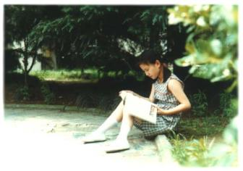
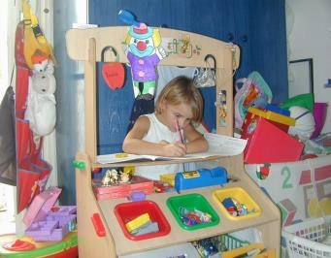
What is she going to do this weekend?
do some reading
She is going to do some reading this weekend.
do one's homework
She is going to do her homework this weekend.

Slide 10
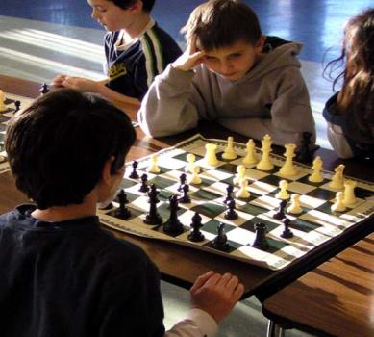
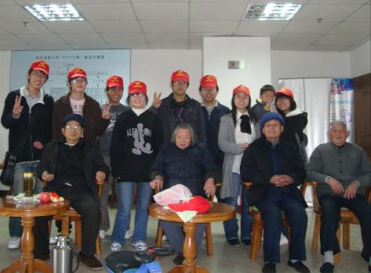
chess club
国际象棋俱乐部
Volunteer at the
Old Age Home
在老年之家志愿服务

Slide 11
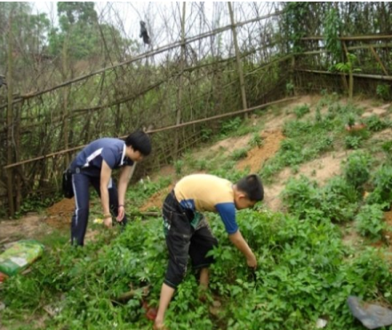
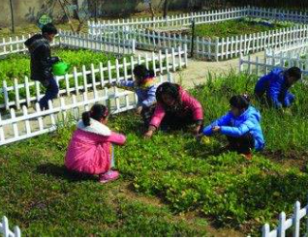
go to the countryside
and
plant vegetables

Slide 12
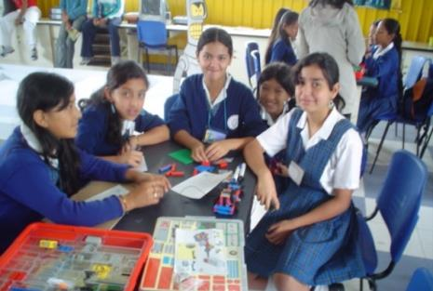
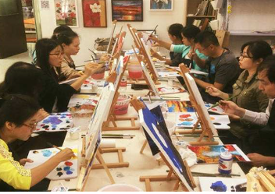
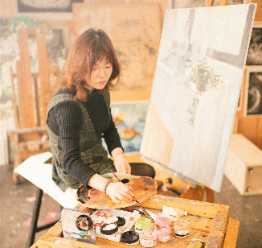
Drawing club
美术俱乐部

Slide 13
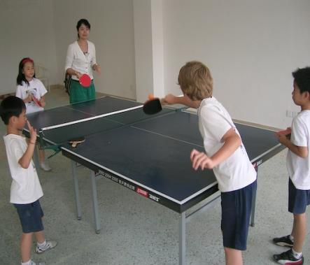
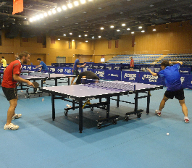
Pingpong practice
乒乓球训练

Slide 14
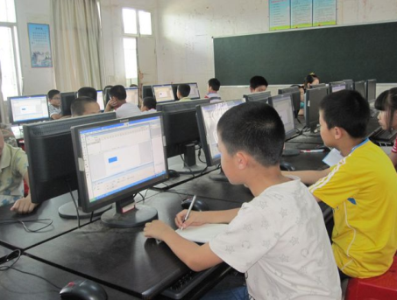
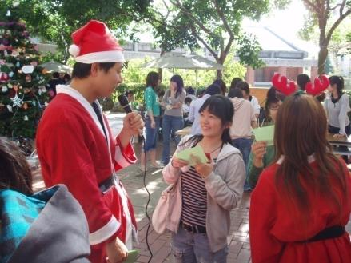
Computer training
电脑培训
English corner
英语角

Slide 15
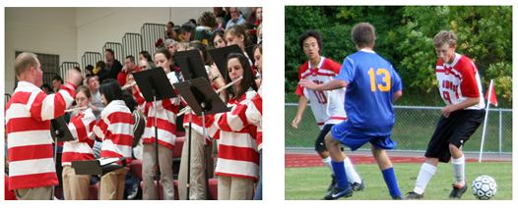
Music club
音乐俱乐部
Football practice
足球训练

Slide 16
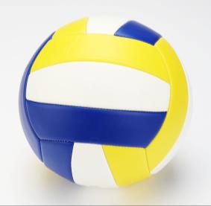
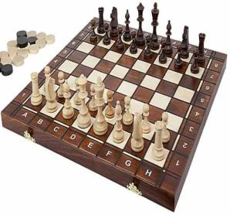
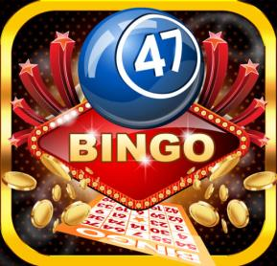
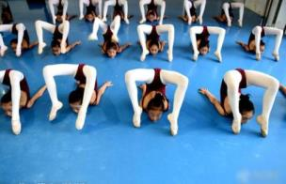
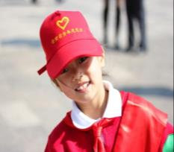
Words and expressions
volleyball
chess
bingo
practice
volunteer

Slide 17
activity
volleyball
practice
chess
club
volunteer
bingo
n. 活动
n. 排球；排球运动
n.&v. 练习
n. 国际象棋
n. 俱乐部；社团
v. 自愿帮助；n. 志愿者
n. 宾戈游戏

Slide 18
both
nothing
come over
how about
be (not) good for...
be going to
lots of
tell stories
adj.&pron. 二者(的)
n.&pron. 无事；无物
过来
怎么样；如何
对……（不）好
打算；将要
许多；大量
讲故事

Slide 19
do well in...
plant trees
take care of
borrow sth. from...
go on a trip
next week
in the future
enjoy sth. so much
……（方面）做得好
植树
照顾；照料
从……借来某物
去旅行
下周
在将来
非常喜欢某物

Slide 20

Presentation
Listen and fill in the blanks.
J: Would you like to ___________ for dinner tomorrow?
S: Sorry, Jim. I can’t. I have ___________
_________ tomorrow. How about
Wednesday?
J: Hmm, Wednesday is not ________ for me.
I’m _________ to the ___________ after school.
How about Thursday?
come over
volleyball
practice
good
going
chess club

Slide 21
volunteer
S: I usually _________ at the ______________
on Thursdays. They often tell me lots of
________________. And sometimes we play ______.
J: Maybe Friday?
S: I have ______ classes on Fridays. I’m not _____
well in math this year. What are
you _______ to do this weekend?
J: I’m ______ to the countryside with my dad.
We are going to ______ trees.
Old Age Home
interesting stories
bingo
math
going
doing
going
plant

Slide 22
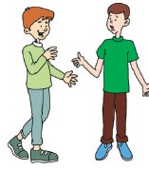
S: Hmm…We’re _______ busy all week.
J: Well, what are you going to do this evening?
S: __________!
J: ____________ coming over for dinner this
evening?
S: Sure!
both
Nothing
How about

Slide 23
Read and answer.
1. What is Steven’s schedule for tomorrow?
2. What’s Jim’s schedule for Wednesday?
3. What’s Steven’s schedule for Thursday?
He has volleyball practice tomorrow.
He is going to the chess club after school.
He usually volunteers at the Old Age Home on Thursdays.

Slide 24
4. What’s Steven’s schedule for Friday?
5. What is Jim going to do this weekend?
6. What is Steven going to do this evening?
He has math classes on Fridays.
He is going to the countryside with his dad. They are going to plant trees.
He is going to have dinner with Jim.

Slide 25
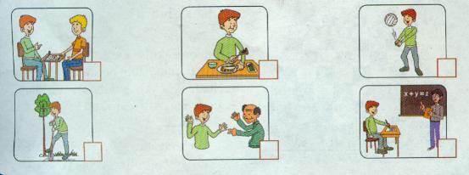
1
What is Jim going to do this week?
Listen and tick the pictures.

Slide 26
2
What is Steven going to do? Read the lesson and write down his schedule for the week.
nothing
Monday
Tuesday
Wednesday
Thursday
Friday
Saturday
Sunday
volleyball practice
volunteer at the Old Age Home
math classes

Slide 27
3
Fill in the blanks with the correct form of “be going to”.
are going to have
We _________________ (have) a party for
Mum’s birthday tomorrow.
2. Alice __________________ (borrow) some books
from the library after school.
3. My family _________________ (go) on a trip to
Beijing next week.
is going to borrow
is going

Slide 28
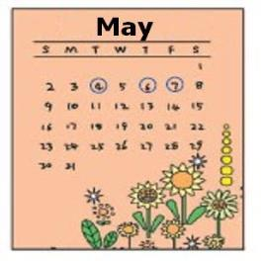
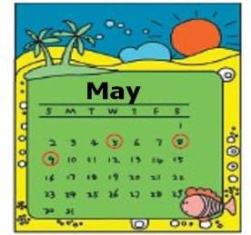
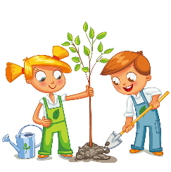
are going to make
4. Tom and Jim _________________ (make) a model
plane together this weekend.
5. I ________________ (be) a volleyball player in the
future. I enjoy volleyball so much!
am going to be

Slide 29
4
Work in pairs. What are you going to do after school this week? Make up a dialogue.
Example:
A: What are you going to do after school on Wednesday?
B: I’m going to see a movie with my friends. What are you going to do on…?
A: I’m going to …

Slide 30
初步了解“be going to” 结构
“be going to +动词原形”结构用来表示将来的动作或状态。
例：明晚你打算看一场电影吗？
Are you going to see/watch a movie tomorrow night?
下周她不打算和我们一起去北京参观长城了。
She isn't going to Beijing to visit the Great Wall with us next week.

Slide 31
“be going to +动词原形” 的 几种常用句式。
陈述句 | 主语+be (not) going to +动词原形 + 其它. eg. I am(not) going to watch a movie tonight.
一般疑问句 | Be + 主语 + going to + 动词原形 + 其它？ eg. Is Eric going to visit his grandparents next month?
特殊疑问句 | 特殊疑问词 + be + 主语 + going to + 动词原形 + 其它？ eg. What are you going to do this Sunday? Where is she going to have fun this Friday?

Slide 32

Language points
1. What day is it today？
这个句子主要用来询问星期几，回答时，要用 “It is ... today.”或“Today is...”
【注意】表示“星期几”的单词首字母都要大写。例：—What day is it today？今天星期几？
—It's Friday. 星期五。

Slide 33
2. Would you like to come over for dinner tomorrow？
(1)“Would you like...？”中的like后面常接名词、代词和动词不定式，表示“你想要……吗？” 它与 “Do you want...？” 意思相近，但前者语气更委婉，用来礼貌地提出请求、征求对方的意见或委婉地提出建议。
例：—Would you like to meet Emily and Carol?
“你想见见艾米丽和卡罗尔吗？”
—Of course.I hear they are twins and play the
piano well. “当然。我听说她们是双胞胎，
而且很会弹钢琴。”

Slide 34
【拓展】① “Would you want...？”的肯定回答常用Yes，please.或 Yes，I would love/like to. 。否定回答常用No，thanks. ②“Do you want...？”的肯定回答用：Yes，I do. 否定回答用：No，I don't.
(2) come over是动词短语，意为“过来，顺便来访”。其后可接for sth.表示“过来做某事”；接“to＋地点
名词”表示“到某地来”。例：Please come over to my house and have a nice dinner with us tonight. 今晚请到我家来， 并吃一顿不错的晚餐。

Slide 35
3. I have volleyball practice tomorrow.
(1 )volleyball是名词，意为“排球”。当其与动词play搭配使用时，volleyball前面不能加定冠词the。注意：所有球类运动名词与play连用时，都不加定冠词the。例：It is fun to play volleyball. 打排球很好玩。
(2)practice是不可数名词，意为“练习”，强调经常性或系统性的重复练习。
例：How much piano practice do you have this week？这一周你有多少钢琴练习？

Slide 36
4. How about Wednesday？
“How about...？”这个句型常用来询问消息、征求意见或者建议，其后跟名词、代词或者动名词。
它相当于：What about...？
例：How/What about this red scarf？这条红围巾如何？
【拓展】用于询问意见/建议的句型还有：① What do you think of… ② What's your opinion\suggestion?
③ Shall we...？ ④ Let's do sth.

Slide 37
5. Wednesday is not good for me.
be good for 意为 “对……合适，对……有益”。
其中good是形容词，意为“合适的”，for意为“对于”。其反义短语为：be bad for对……不利; 对……有害；例：Vegetables is good for your health，but junk food is bad for your health. 蔬菜对你的健康有好处，但是垃圾食品对你的健康有害。
【学以致用】翻译句子。
吃太多盐对我们的健康不利。(no good for)
________________________________________
Eating too much salt is no good for our health.

Slide 38
6. I usually volunteer at the Old Age Home on
Thursdays.
volunteer 作动词，意为“自愿帮助; 做志愿工作 ”。
常用短语：volunteer to do sth. 自愿做某事。
例：Do you volunteer to help others？你能自愿帮助其他人吗？
【拓展】volunteer 还可以作可数名词，意为“志愿者”。例：Volunteers from different backgrounds is like part of one big family. 来自不同背景的志愿者感觉就像是一个大家庭中的一部分。

Slide 39
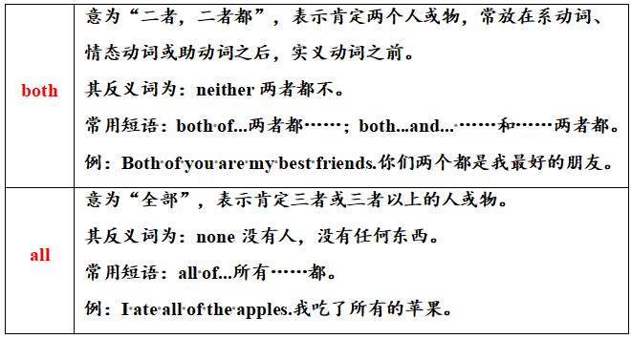
7. We're both busy all week.
辨析 both与 all

Slide 40
8. Nothing！
nothing 是不定代词，意为 “没事，没什么，无物”。其用法有以下几点：
①当其作主语时，谓语动词要用单数形式。如：Nothing is more important than health.没有什么比健康更重要。②当它被形容词修饰时，形容词要放在它的后面。③当询问“打算做某事”时，如果没有什么安排，则可以用“Nothing！”作答；
例：—Do you have anything to do？你有什么事要做吗？—Nothing！没事！

Slide 41
Exercises
一、单项选择。
1. —Would you like to join me in making cakes
tomorrow?
— ________. (2017·上海)
A．It doesn't matter. B．Don't worry.
C．You're welcome. D．I'd love to.
2. She often practices ________ on weekends.
A．sing B．sings C．singing D．to sing
D
C

Slide 42
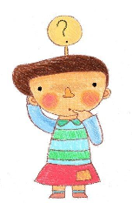
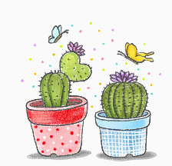
A
3. There are many tall trees on ________ sides of the
river. (2017·湖南郴州)
A．both B．all C．either
4. He lives happily with his three dogs. ________of
them are part of his family.
A．Both
B．All
C．None
D．Neither
B

Slide 43
5. —Doctor，what's wrong with me?
— ________serious.You have just got a cold. (2017·江苏宿迁)
A．Something B．Nothing
C．Everything D．Anythin
6. —Which of the two subjects do you like，P.E. or
music?
— ________. They are really interesting.
A．Neither B．Both C．None
B
B

Slide 44
二、根据汉语提示完成句子,一空一词。
1. 我要把这张照片放在我的书桌上。
I ____ ______ ____ ____ this picture on my desk.
2. 明天李婷会骑自行车去书店吗？
_____ Li Ting ______ ____ ____ a bike
to the bookshop tomorrow?
3. 城市里没什么有趣的，为什么不去乡下野餐呢？
There's ________ __________ in the city. Why not
have a picnic in the countryside?
am going to put
Is
going to ride
nothing interesting

Slide 45
4. 越来越多的年轻教师自愿去农村教书。
More and more young teachers __________ to
teach in the countryside.
5. 吃太多垃圾食品对我们的健康不好。
Eating _______ _______ junk food is not ______
______ our health.
6. 海伦希望我们尽可能多说英语，因为熟能生巧。
Helen hopes us to _______ _______ as much as
possible because practice ________ perfect.
volunteer
too much
good
for
speak English
makes

Slide 46
三、用“be going to” 的适当形式填空。
are going to have
1. We _______________ (have) a party
for Mum’s birthday tomorrow.
2. Alice _________________ (borrow)
some books from the library after school.
3. My family ____________ (go) on a trip
to Beijing next week.
4. Tom and Jim _________________ (make) a
model plane together this weekend.
is going to borrow
is going to go
are going to make

Slide 47
四、 根据括号中所给的汉语用适当的词语填空。
1. How many _______ （活动） did they take part in last weekend?
2. There is ______ （无物） but a table in the room.
3. My brother enjoys playing ______ （国际象棋）, but I don’t.
4. Look! The girls are playing ________ （排球） on the playground.
5. Danny joined two ______ （俱乐部） at the same time.
activities
nothing
chess
volleyball
clubs

Slide 48
Summary
1. We learned some useful words and phrases
such as: activity, volleyball, practice, club,
volunteer, bingo, both, nothing，
be (not) good for..., be going to, lots of,
tell stories, do well in..., take care of,
borrow sth. from......
2. We learned “be going to” structure.

Slide 49
Homework
1.复习Lesson 19 的单词、短语以及重要句
子。
2.
3.
Write a short passage to describe your after-school activities.
What are you going to do after school this week? Make up a dialogue with your classmates.

