Slide 1
Unit5 It’s a parrot.
人教精通版三年级下册
WWW.PPT818.COM

Slide 2
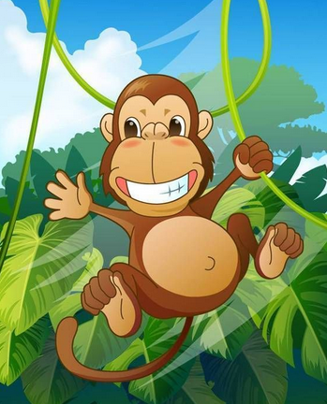
Review
Look and say
What’s that?
It’s a monkey.

Slide 3
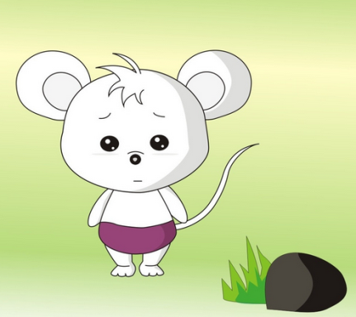
Review
Look and say
What’s that?
It’s a mouse.

Slide 4
Review
Look and say
What’s that?
It’s a nest.

Slide 5
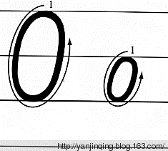
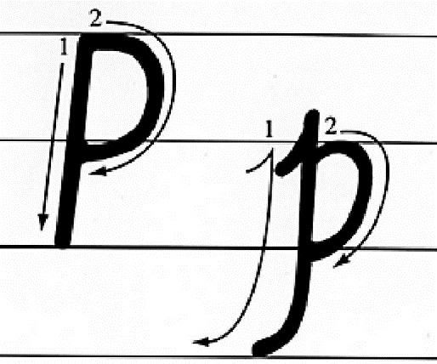
Presentation
Let’s learn

Slide 6
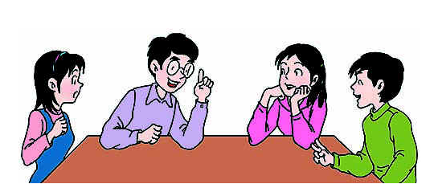
Presentation
Discussion
我们学过的哪些单词含有字母o或p呢？
one, mango, son, four, book, grandpa ……

Slide 7
Presentation
Let’s learn
What’s this?
owl

Slide 8
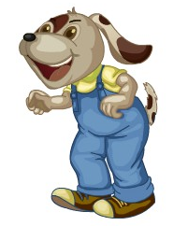
Presentation
Let’s learn
What’s this?
dog

Slide 9
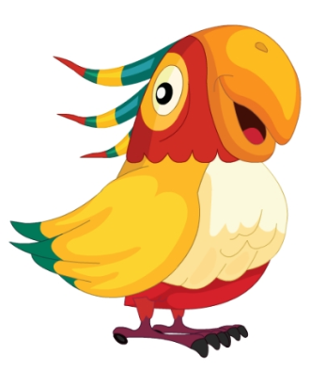
Presentation
Let’s learn
What’s this?
parrot

Slide 10
Presentation
Let’s learn
What’s this?
panda

Slide 11
Practice
Game 1
大小声
owl
dog
parrot
panda

Slide 12
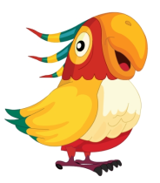
Practice
Game 2
What’s missing?

Slide 13
Presentation
Listen and say
What are they talking about?

Slide 14
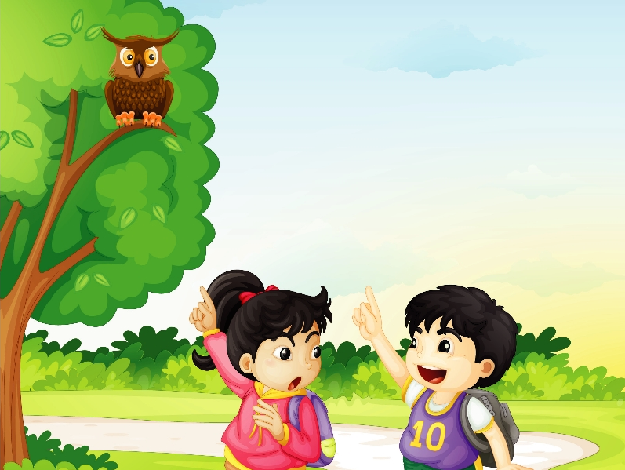
Presentation
Let’s learn
1
4
Look, Gao Wei. What’s that?
What is it then?
2
It’s a cat.
3
A cat? No!
6
Oh, yes. It’s an owl.
5
It’s an owl.

Slide 15
Practice
Read it by groups for one minute .
小组读对话一分钟。
一分钟倒计时
60
Learning tip :
50
10
10
四人一组，比赛读句子，看谁能在一分钟内读完，并且读得准确、流利！
20
20
40
30
30
开始

Slide 16
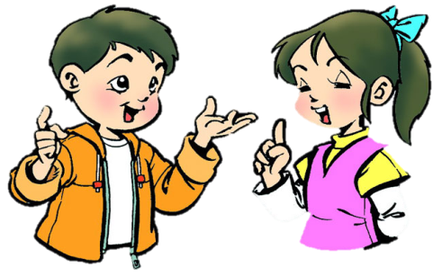
Practice
Role-play
分角色朗读对话，注意模仿语音语调。
两人一组，试着表演出来吧。

Slide 17
Practice
Let’s sing

Slide 18
Summary
本课学到的重点单词：
owl dog parrot panda
本课学到的重点句型：
—What’s this/that?
—It’s a/an …

Slide 19
Homework
1. 跟读课文Just talk部分的录音，注意语音、语调。
2. 制作本课的字母和单词卡片，并能熟练背诵出字母Aa至Pp 。
3. 唱歌曲What is this? What’s that?给家人听。
4. 预习Lesson 28。
Close

