Slide 1
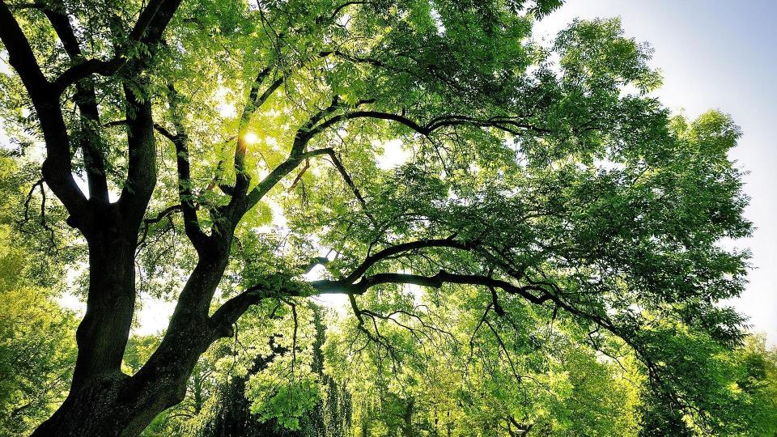
Unit 2 Wildlife Protection
Period One
WWW.PPT818.COM

Slide 2
单元主题语境：人与自然
The protection of wild animals is to care for human beings.
保护野生动物就是关爱人类自己。

Slide 3
话题导入
As we all know¹，animals are humans’ best friends.Animals are valuable resources(资源) that are helpful to us all through our history.However，many kinds of animals are in danger now！Animals have been killed for their fur and feathers，for food，for entertainment，or simply because they are in the way. Thousands of kinds of animals have disappeared from the earth forever so far.Hundreds more are on the danger list today.About 170 kinds in the United States alone are considered in danger.It is high time that we should pay more attention to how to protect these animals on the earth.

Slide 4
Why should we care about the animals in danger？Because animals help us a lot and we need animals.Once they are gone，there will never be any more. Animals are more than just beautiful or interesting.They are more than just a source(来源) of food.Every animal has its place in the balance of nature. Destroying one kind of animal can create many problems².
Luckily，some people are working to help save the animals³.Some groups raise money to let people know about the problem³.And they try to get the governments to pass laws protecting animals in danger.Quite a few countries have passed laws.These laws forbid(禁止) the killing of any animal.Slowly，the number of some animals in danger is growing.Everyone should try to protect animals and treat them well.

Slide 5
靓句运用于写作
1.As we all know，most of the ratings are based on others’ judgment on the product or service concerned.(2018·江苏，书面表达)
2.To be frank，studying for a degree in a different culture is never easy.
(2018·北京，书面表达)
3.To help them better understand our tea-drinking culture，we took them to the tea room in our school，where I introduced the history of tea-making and different kinds of tea and so on.(2018·北京，书面表达)

Slide 6
Period One Listening and Speaking & Reading and Thinking—Comprehending
PART 1
读前清障
PART 2
语篇理解

Slide 7
PART
1
读前清障
识记单词 快速顺畅阅读

Slide 8
匹配左边的单词与右边的汉语意思
[第一组]
1.antelope A.牧群；兽群
2.reserve B.平原
3.plain C.保护区；预订；预留
4.herd D.观察；注视；遵守
5.observe E.羚；羚类动物

Slide 9
[第二组]
6.fur A.利润；利益
7.sacred B.攻击；抨击
8.profit C.毛(皮)；毛皮衣服
9.attack D.恢复；康复
10.recover E.神圣的；受尊敬的

Slide 10
[第三组]
11.remove A.威胁
12.threat B.生物；动物
13.exist C.存在；生存
14.harmony D.去除；移开
15.creature E.和谐；融洽

Slide 11
PART
2
语篇理解
精读精练 萃取文本精华

Slide 12
Step 1 Fast-reading
1.What’s the main idea of the passage?
A.Antelopes are being killed for their valuable fur and their number is decreasing rapidly.
B.It’s important for us human beings to protect antelopes and learn to exist in harmony with nature.
C.Many nature reserves have been set up to protect antelopes in Tibet，Xinjiang and Qinghai.
D.The writer with a group of visitors went to Tibet to see the endangered antelopes.
√

Slide 13
2.Match each paragraph with its topic sentence.
Para.1 A.The Changtang National Nature Reserve has been set up to
protect the animals and plants of northwestern Tibet.
Para.2 B.The Chinese government took measures to keep antelopes from
attacks.
Para.3 C.The purpose of the writer to Tibet.
Para.4 D.After a day’s visit，the writer thought a lot in the evening.
Para.5 E.Antelopes are being hunted illegally for their fur.
Para.6 F.The result of the Chinese government’s measures is great.
Para.7 G.During the 1980s and 1990s，antelopes were killed badly，
causing their number to drop sharply.

Slide 14
Step 2 Careful-reading
Ⅰ.Judge whether the following statements are true(T) or false(F).
1.Antelopes mainly live on snow-covered mountains.( )
2.The Changtang National Nature Reserve is a shelter for the animals and plants of southwestern Tibet.( )
3.During the 1970s and 1990s，a large number of antelopes were hunted and their habitats became smaller for heavy pollution.( )
4.Many parks and gates were added to let the antelopes move easily and keep them safe from cars and trains.( )
5.Only when we human beings learn to exist in harmony with nature can we stop being a threat to wildlife and to our planet.( )
F
F
F
F
T

Slide 15
Ⅱ.Choose the best answer.
1.What’s the purpose of the writer to Tibet?
A.To go camping.
B.To experience the life in mountains which have thin air.
C.To observe Tibetan antelopes.
D.To protect Tibetan antelopes.
√

Slide 16
2.What can we conclude from what Zhaxi said?
A.Protecting the wildlife is only his job.
B.If the wildlife is endangered，the life of human beings will come to an end.
C.He is too worried about antelopes.
D.Antelopes will be protected in the reserve and live there comfortably.
√

Slide 17
3.What caused the number of antelopes to drop sharply in the 1980s and 1990s?
A.People wanted to make profits.
B.Some new roads and railways were built，making their habitats too small.
C.Antelopes were a danger to local people.
D.Both A and B.
√

Slide 18
4.What does “national protection” in the fifth paragraph mean?
A.Being protected by the whole nation.
B.Being protected only by the local people.
C.Belonging to the government.
D.Being killed with the permission of the government.
√

Slide 19
5.What’s the attitude of the writer to the wildlife protection?
A.Negative. B.Supportive.
C.Doubtful. D.Unclear.
√

Slide 20
Step 3 Post-reading
After reading the passage，please fill in the following blanks.
We went to Tibet to observe Tibetan antelopes with Zhaxi as our guide. Luckily，on the plain in front of us，we saw a herd of antelopes 1. (move) slowly across the green grass.These beautiful animals reminded me 2. their danger because every year many of them are hunted 3. (legal) for their valuable fur.Especially in the 1980s and 1990s，their population dropped 4.____
more than 50 percent.In order 5. (save) this species from extinction，
moving
of
illegally
by
to save

Slide 21
the Chinese government placed it 6. national protection and set up the Changtang National Nature Reserve where Zhaxi works.These measures were
7. (effect) and the antelope population has recovered.However，the government doesn’t intend 8. (stop) the protection programmes，since the threats to the Tibetan antelopes 9. (disappear).Only when we learn to exist in harmony with nature 10. we stop being a threat to wildlife and to our planet.
under
effective
to stop
haven’t disappeared
can

Slide 22
Step 4 Sentence-learning
1.To our left，snow-covered mountains disappear into clouds that seem almost close enough to touch.
[句式分析] 本句话是复合句。that引导定语从句，修饰先行词 。主句中snow-covered作定语，修饰 。To our left为 状语。
[自主翻译] _________________________________________________________ __________________
clouds
mountains
地点
在我们的左面，雪山消失在云层中，这些云层离我们很近，好像伸手就能碰到。

Slide 23
2.Watching them move slowly across the green grass，I’m struck by their beauty.
[句式分析] 本句是一个简单句，Watching them move slowly across the green grass为现在分词作 ，表伴随，与句子的主语 为主动关系。
[自主翻译] ______________________________________________________
状语
I
看着它们慢慢地穿过绿色的草地，我被它们的美丽打动了。

Slide 24
3.The government，however，does not intend to stop the protection programmes，since the threats to the Tibetan antelope have not yet disappeared.
[句式分析] 本句话是复合句，since因为，引导 状语从句。however放在了主句中，表示 关系。
[自主翻译] _________________________________________________________ ______________
原因
转折
然而，政府并没有打算停止这些保护项目，因为对藏羚羊的威胁依然存在。

Slide 25
4.Only when we learn to exist in harmony with nature can we stop being a threat to wildlife and to our planet.
[句式分析] 本句话是复合句，when引导 状语从句，放在了置于句首的Only后面，所以主句要部分倒装。
[自主翻译] _________________________________________________________ _________
时间
只有学会和大自然和谐共处，我们才不会成为野生生物和地球的威胁。

