Slide 1
Unit 7 Lesson 2
Did you have a big dinner?
WWW.PPT818.COM

Slide 2
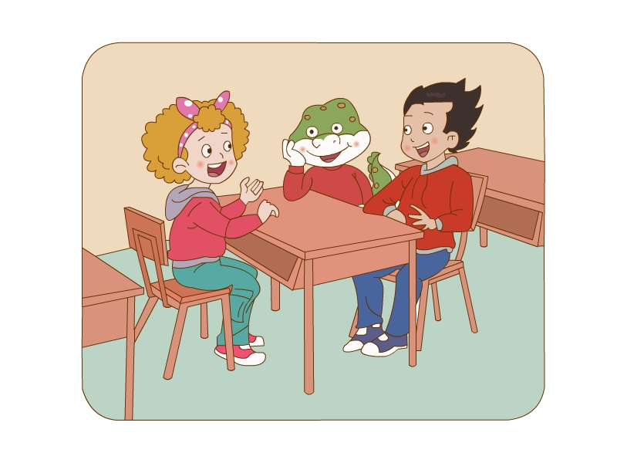
Li Ming, Danny and Jenny were talking about
the Spring Festival.
Jenny asked many questions to Li Ming.
So can you find them?
珍妮问了李明许多问题，你能找到吗？

Slide 3
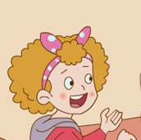
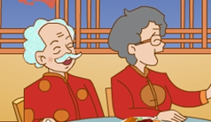
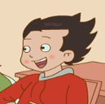
Did you go to your grandparents’ house?
No, we didn’t.
My grandparents came to my home.

Slide 4

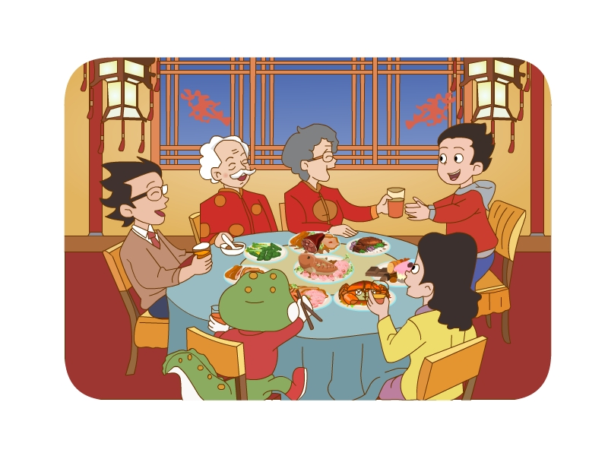

Did you have a big dinner?
Yes, we did.

Slide 5
Did you eat at home?
No. We didn't. We ate out.

Slide 6

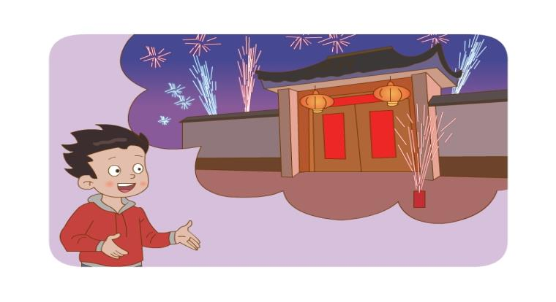
Did you set off fireworks?
Yes, we did. It was fun.

Slide 7
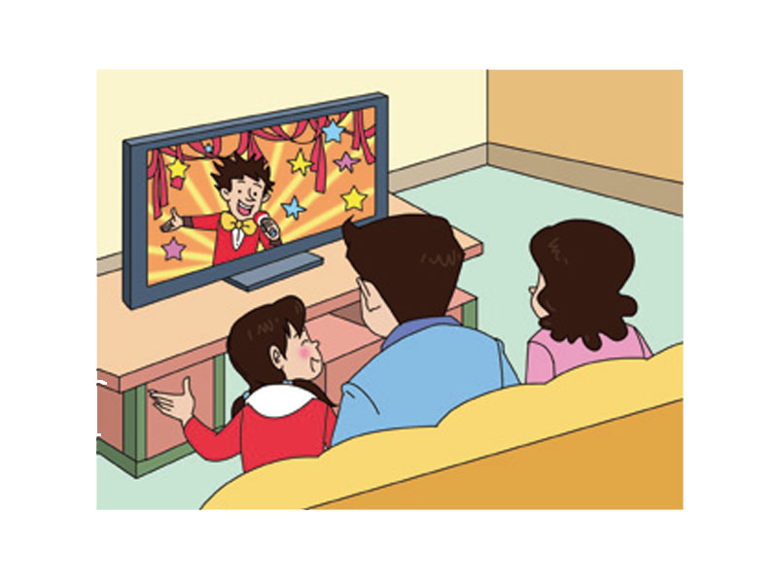
Then we watched TV at home.

Slide 8
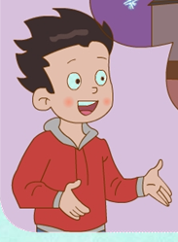
How will Li Ming spend the Spring Festival
this year? 李明今年打算如何度过春节呢？
This year, we’ll go to my grandparents’ house
in the country.

Slide 9
Read and match:
We went to my grandparents’
house and had a big dinner.
We visit relatives and say
“Happy Spring Festival”.
They are very excited
at the Spring Festival.
Did you set off the fireworks?
—Yes, we did. It was fun.

Slide 10
Homework:
1、Listen and repeat.
2、Introduce Spring Festival in English to your parents and relatives。

