Slide 1
Unit 4
Don’t eat in class.
R 七年级下册
第2课时
WWW.PPT818.COM

Slide 2
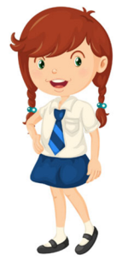
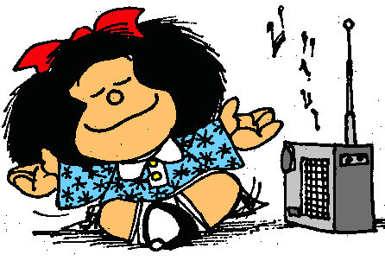
Lead-in
Tell others about your school rules. (You can finish it by yourself/ with your partner)
In our school, we can’t listen to music in class, but we can listen to it after class.
listen to music

Slide 3
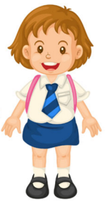
Role-play
What are the rules in your school?
In our school, we can’t listen to music in class, but we can listen to it after class.

Slide 4
Grammar Focus
Don’t run in the hallways. | Don’t fight.
We must be on time for class.
What are the rules?
No, we can’t, but we can eat in the dining hall.
Can we eat in the classroom?

Slide 5
Can we wear a hat in class?
Does he have to wear a uniform at school?
What do you have to do?
Yes, we can./ No, we can’t.
Yes, he does./
No, he doesn’t.
We have to be quite in the library.

Slide 6
祈使句的用法
1.祈使句的概念
(1)祈使句是指用来表示请求、命令、叮嘱、建议等的句子。
祈使句没有主语，谓语动词用原形，句末使用感叹号或者句号。
例：站起来！
一定要按时。
Stand up!
（命令）
Be sure to be on time.
(叮嘱)

Slide 7
(2)如果祈使句表示客气地请求，一般要加上please。
please可以放在句子前面也可以放在句子的后面。
（请求）
例: 请跟我读。
Please read after me.
= Read after me, please.

Slide 8
2. 祈使句的形式
(1)let开头的祈使句的肯定句：Let’s + not + v.（原形）.
例: 咱们别那样做了。
Let’s not do that again.
否定形式为：Don’t + let + 第三人称代词 + v.（原形）.
例: 不要让他们进来。
Don’t let them come in.

Slide 9
(2)非let开头的祈使句的肯定句和否定句：
Do 型
v.原形（+宾语）+其他成份.
肯定句
例：Listen to me, please.请听我说。
Be 型
Be+表语(名词或形容词）+其他成份.
例：Be quiet, please. 请安静。

Slide 10
Don’t + 行为动词 + 其他.
例: Don’t play computer games. 不要玩电脑游戏。
否定句
Don’t + be + 其他.
例: Don’t be late again. 不要再迟到。
No + n./v.-ing.
例: No photos. 不许拍照。
No swimming.不许游泳。

Slide 11
3.祈使句的用法
主语是you常省去，动词原形开头记。
否定形式要注意，句首要把don’t加。
要讲客气用please,句首、句末没关系。

Slide 12
情态动词must与have to
1.情态动词must的用法
(1)表示有做某一个动作的必要和义务，它的意思是“必须、应该”。
例: 你必须做你的作业。
You must do your homework.
(2)表示有很大把握的判断或者推测，它的意思是“一定、准是”。

Slide 13
例: 那个高个子男人一定是你的爸爸。
The tall man must be your father.
(3)以must开头的一般疑问句，它的否定回答用needn’t (不必要),不用mustn’t(不允许) ,mustn’t常用于否定句中，表示“不允许，禁止”。
例: 你的车不允许停在这儿。
You mustn’t park your car here.
Notes:
13

Slide 14
2.情态动词have to的用法
have to表示客观需要做的事情，意思是“必须，不得不”。
(1)have to后接动词原形，意为“必须做……；不得不做……”。
例: 我不得不离开了。
I have to leave.

Slide 15
(2)have to有人称、数和时态的变化，其第三人称单数形式为has to。
例: 她不得不做作业。
She has to do her homework.
(3)含有have to, has to的句子变疑问句或否定句需分别借助助动词do, does 。
例: 他们必须早起吗？
Do they have to get up early?

Slide 16
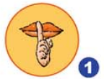
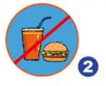
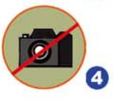
3a
Write the rules for the school library.
Library Rules
1.__________________ 2.__________________
3.__________________ 4.__________________
Don’t talk
Don’t eat or drink
Don’t listen to music
Don’t take photos

Slide 17
Use the words to make questions about the rules. Then write answers according to your school.
3b
Be quiet? (she/have to /in the library)
Q: Does she have to be quiet in the library?
A: Yes, she does.
2. Eat? (he/have to/in the dinning hall)
Q: _________________________________________
A: _________________________________________
Does he have to eat in the dining hall?
Yes, he does.

Slide 18
3. Listen to music? (we/can/in the dining hall)
Q: _________________________________________
A: _________________________________________
4. Wear a hat?(we/can/in the classroom)
Q: _________________________________________
A: _________________________________________
Can we listen to music in the dining hall?
No, you can’t.
Can we wear a hat in the classroom?
No, you can’t.

Slide 19
Make up five cool rules for your dream school. Share your rules with the class. Your classmates vote for the Coolest School!
3c
1. We can eat in class.
2. We don’t have to come to school every day.
3. …

Slide 20
At my dream school, we don’t have to come to school every day. We can eat in class. We …

Slide 21
Language points
1. We don’t have to come to school every day.
我们不必每天来学校。
have to为固定短语，意为“不得不，必须”，其后接动词原形，有时态和人称的变化。
have to的否定形式是：主语+ don’t + have to+动词原形+其他.（一般现在时，当主语是第三人称单数时，用doesn’t to，—般过去式用 didn’t have to)

Slide 22
Exercise
一.单项选择
( )1. ______ with fire. It’s very dangerous. A. Playing B. Play
C. Don’t play D. Doesn’t play ( )2.The children _____ play football on the road. A. can B. must C. mustn’t D. may
C
C

Slide 23
( )3.My sister ______ be at school by seven o’clock. A. has to B. have to
C. had to D. must to
( ) 4. It’s raining all day, so my brother ______ stay
at home. A. must B. have to C. must to D. has to
A
D

Slide 24
( )5. It’s very warm outside. You ______ wear the coat.
A. have to B. hadn’t to
C. don’t have to D. mustn’t
( )6.Mary, ______ in bed.
A. not read B. don’t read
C. no reading D. doesn’t read
C
B

