Slide 1
Unit 4 lesson 2
I have a face.
WWW.PPT818.COM

Slide 2
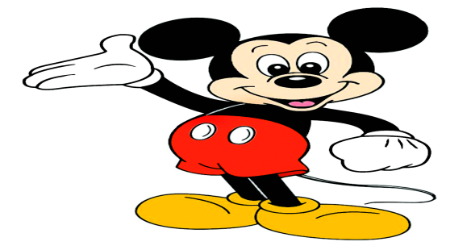
Let’s learn new words!

Slide 3
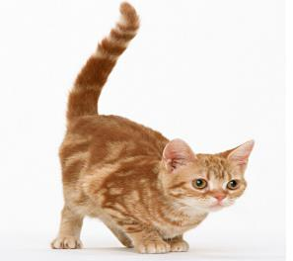
tail

Slide 4
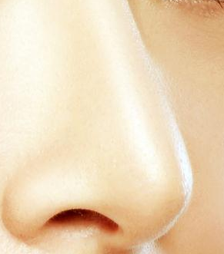
nose

Slide 5
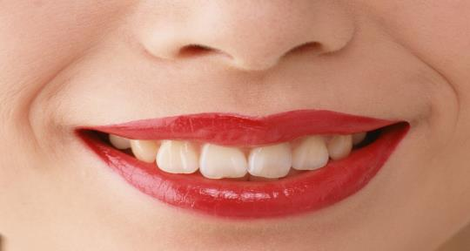
mouth

Slide 6
face

Slide 7
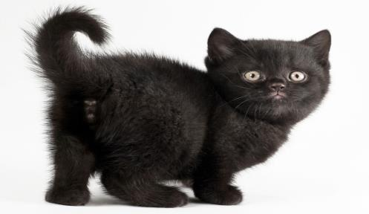
face
tail
nose
mouth

Slide 8
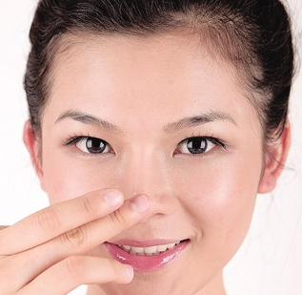
Touch your nose.
practice

Slide 9
Touch your face.
practice

Slide 10
practice
Touch
______ your mouth.

Slide 11
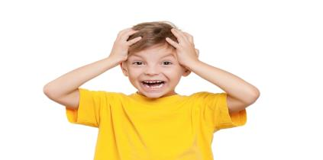
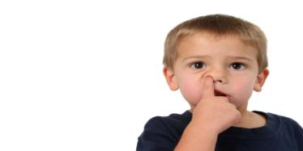
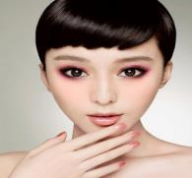
Touch your…
let’s do!
head
nose
face
mouth

Slide 12
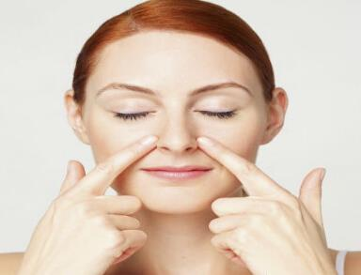
practice
I have a nose.

Slide 13
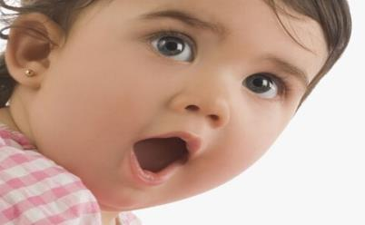
practice
I have a mouth.

Slide 14
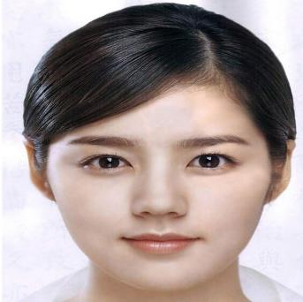
practice
I have a face.

Slide 15
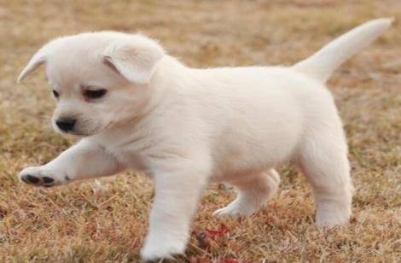
practice
I have a tail.

Slide 16
Let’s check!
I have a…?
nose
face
mouth
?

Slide 17
Thank you!

