Slide 1
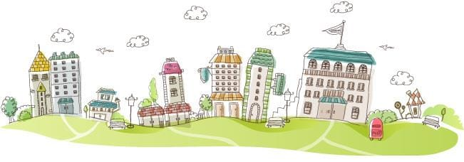
Unit 4 Neighbourhood
Is there a gym around ?
WWW.PPT818.COM

Slide 2
Play a game.
There is a desk.
There is a computer.
There are teachers.
There are windows.

Slide 3
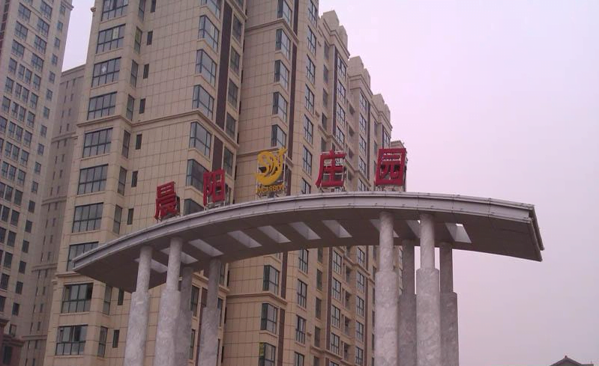
neighbourhood

Slide 4
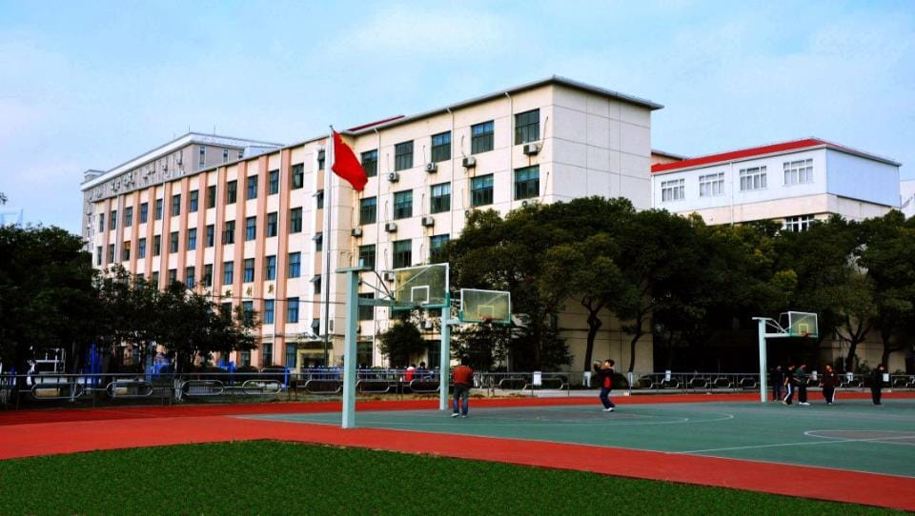
school

Slide 5
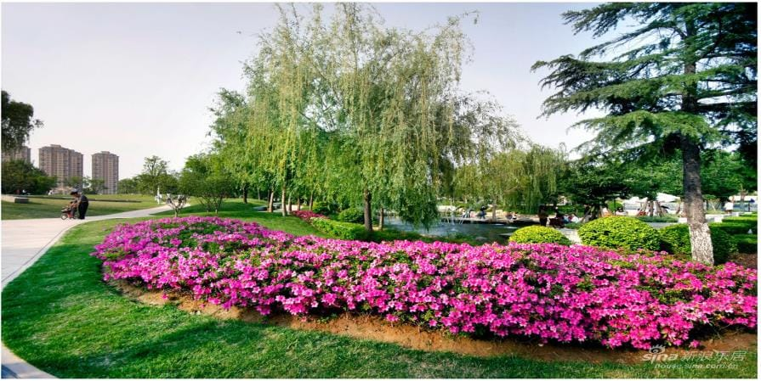
garden ['ɡɑ:dn]

Slide 6
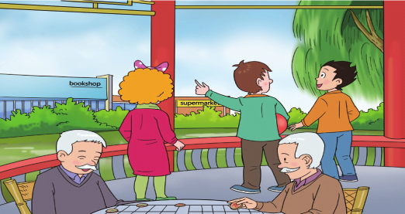
Watch and choose.
1. The men are playing ______.
men
A. Chinese chess
B. chess
2. The blue building is a_____.
A. supermarket
B. bookshop

Slide 7
Do you know?
man
men

Slide 8
Watch and choose.
1. The men are playing ______.
A. Chinese chess
B. chess
2. The blue building is a_____.
A. supermarket
B. bookshop

Slide 9
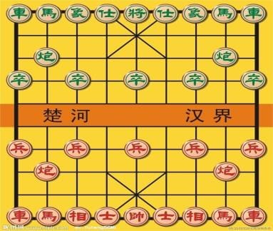
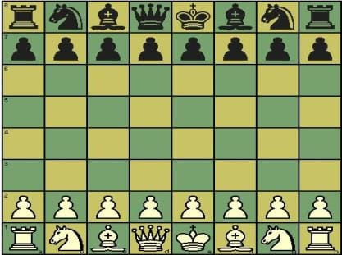
Chinese chess
chess
Chinese chess is different from chess.
（不同于）

Slide 10
Watch and choose.
1. The men are playing ______.
A. Chinese chess
B. chess
2. The blue building is a_____.
A. supermarket
B. bookshop

Slide 11
beside

Slide 12
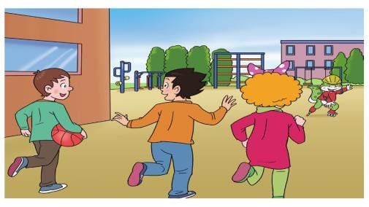
Read and answer.
A: Is there a gym around?
B:

Slide 13
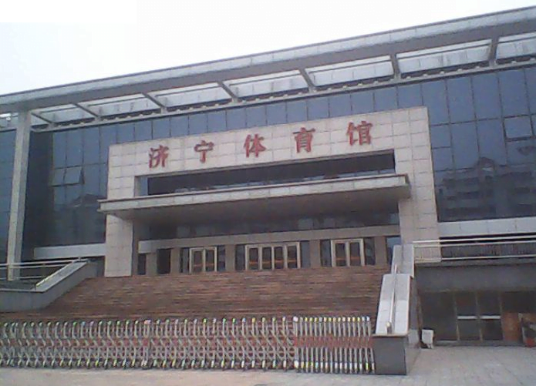
gym

Slide 14
Read and answer.
A: Is there a gym around?
B:
No.

Slide 15
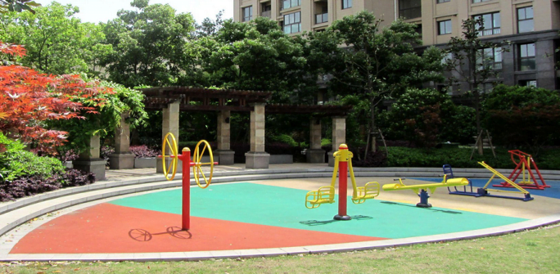
sports centre

Slide 16
Let’s read.
Pay attention to your pronunciation and intonation. 请注意你的语音语调。

Slide 17
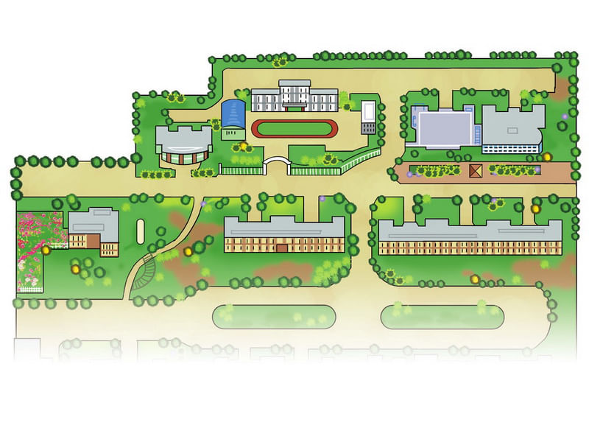
Let’s talk.
sports centre
hospital
school
bookshop
supermarket
garden
Is there a ... in the neighbourhood?

Slide 18
Let’s talk.
sports centre
hospital
school
bookshop
supermarket
garden
A: Is there a ... in the neighbourhood?
B: Yes. It's beside(near/behind) the... .
（No.）

Slide 19
Let’s sing.
Is there a bookshop in your neighbourhood?
Is there a sports centre in your neighbourhood?
Is there a supermarket in your neighbourhood?
Is there a garden in your neighbourhood?

Slide 20
Let’s do.
(小组合作，设计一个漂亮，干净，舒适的社区，并向他人介绍。)
This is our neighbourhood.
There is/are... .
The...is beside(near/bihind) the... .
We like our neighbourhood.

Slide 21
Homework.
1. Listen and repeat. Try to introduce Li Ming’s neighbourhood.(听读课文，向他人介绍李明的社区。)
2. Share your beautiful neighbourhood with your friends.(和朋友分享自己设计的社区。)

