Slide 1
Unit 1 Topic 1
I’m going to play basketball.
Section B
WWW.PPT818.COM

Slide 2
Review
How many sports names do you know? Please say as many as you can.
Please tell your friends’ favourite sports to the class.

Slide 3
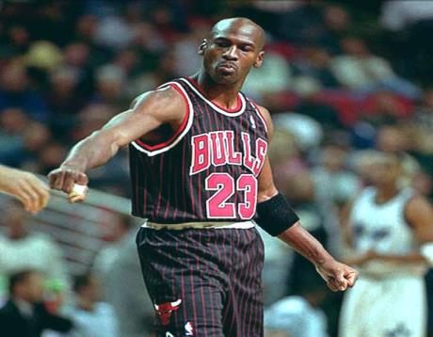
Do you know him?
He is Michael Jordan.
He is my favorite sportsman.

Slide 4
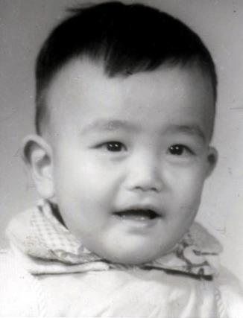
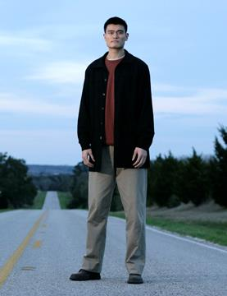
Do you know him?
grow up

Slide 5
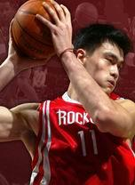
When and where was
he born?
2. How tall is he?
3. When did he join the NBA?
4. Which team is he playing for in the NBA now?
Yao Ming

Slide 6

Yao Ming’s card
Birth Date: 1980. 9. 12
Birth Place: Shanghai
Height: 2.26m
Weight: 141kg
Nationality: Chinese
Date to join NBA: 2001. 5. 9
Team to play for:
Houston Rockets in the NBA
Position: center

Slide 7
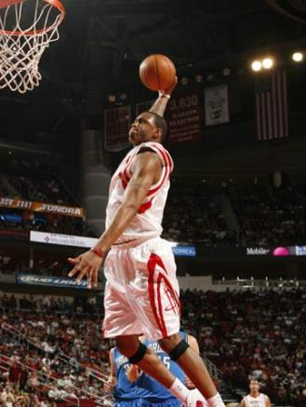
When and where was he born?
2. How tall is he?
3. When did he join the NBA?
4. Which team is he playing for in the NBA now?
Tracy Mc Grady

Slide 8
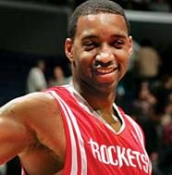
Tracy’s card
Birth Date: 1979. 5. 24
Height: 2.03m
Weight: 95.3kg
Nationality: American
Date to join NBA: 1997. 10. 31
Team to play for:
Houston Rockets in the NBA
Position: back

Slide 9
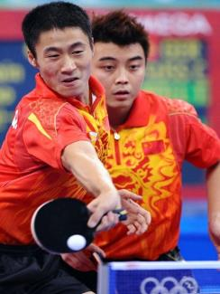
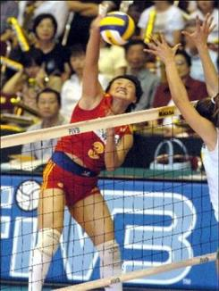
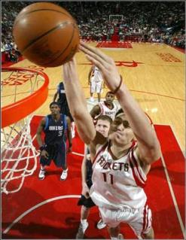
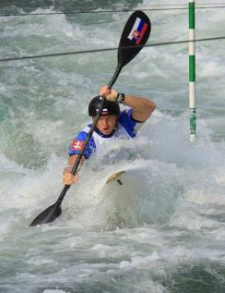
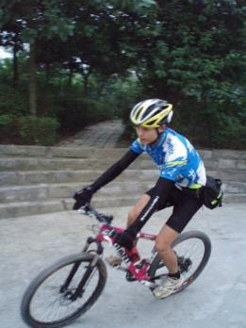
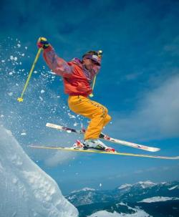
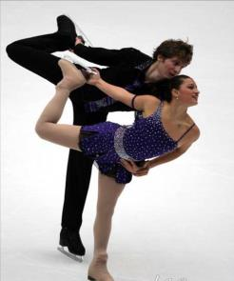
What’s your favorite sport ?
My favorite sport is …

Slide 10

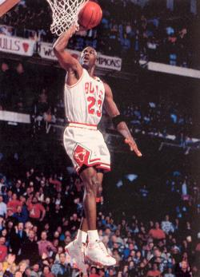
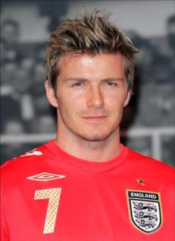
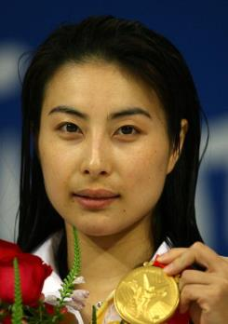
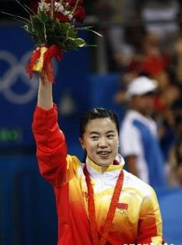
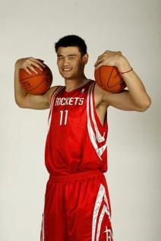
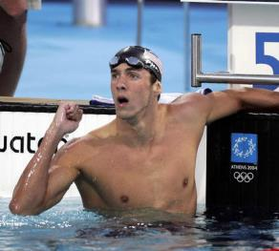
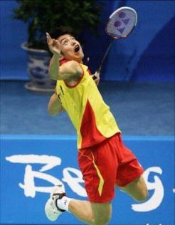
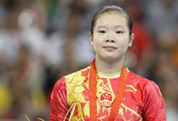
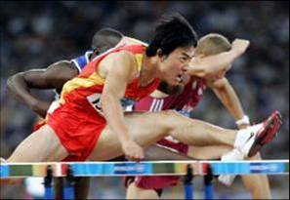
运动员，选手
Who’s your favorite player ?
My favorite player is …

Slide 11
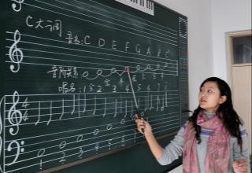

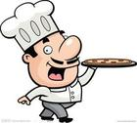
What are you going to be when you grow up ?
长大成人
梦想
I’m going to be a/an … That’s my dream.

Slide 12

1a Look, listen and say.
Michael: what’s your favorite sport, Maria?
Maria : basketball, of course.
Michael: me, too. And what’s your favorite player?
Maria : LeBron James. And yours?
Michael: I like Yao Ming best.
Maria : do you know anything about him?

Slide 13
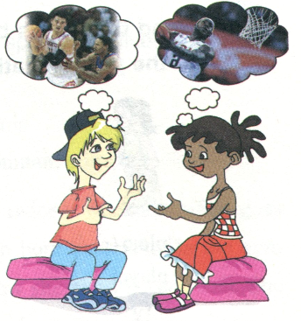
Michael: yes. He’s 2.26 meters tall. He played for the Houston Rockets in the NBA. I'm going to be a basketball player like him. That’s my dream. What are you going to be when you grow up?
Maria: I'm going to be a scientist.

Slide 14

1b Listen and complete the table.
Name | Favorite sport | Favorite player | Dream job
Maria
Michael
basketball
LeBron James
a scientist
a basketball player
basketball
Yao Ming

Slide 15
1c Rewrite the conversation based on the information in 1b.
Maria’s favorite sport is __________.
Her favorite player is ______________,
but she is going to be _____________
in the future. It’s her dream.
Michael’s _________________________. His _______________________, and he’s _________________________________.
It’s ____________.
basketball
LeBron James
a scientist
favorite sport is basketball, too
favorite player is Yao Ming
going to be a basketball player like him
his dream

Slide 16
What about you?
What’s your favorite sport?
Who’s your favorite player?
What are you going to be when you grow up?
Write down your answers:
My ______________________
_____________________________
_____________________________
__________.

Slide 17
1d Make a survey to complete the table. Then report the results to your class.
Name | Favorite sport | Favorite player | Dream job
S₁
S₂
S₃

Slide 18
You can report like this:
He/she is going to be a ________________ in the future. It’s his/her dream job. He/she likes sports very much because it is important to him/her. His favorite sport is __________. His/Her favorite player is __________.
basketball player
basketball
Yao Ming

Slide 19
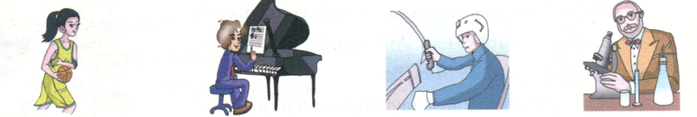
2 Read the words and match, paying attention to the pronunciation.
player
/pleIər/
musician
/mju zIʃn/
pilot
/ paIlət /
scientist
/ saIəntIst/

Slide 20
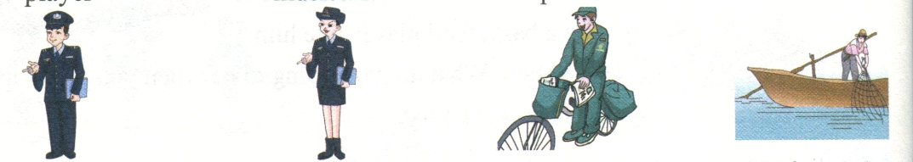
policeman
/pə li:smən /
postman
/ pəʊstmən /
policewoman
/pə li:swʊmən /
fisherman
/fIʃəmən/

Slide 21

Jobs
Reviewing is a kind of learning
厨师
医生
护士
农民
cook
farmer
doctor
nurse
办公室人员
工人
教师
司机
worker
teacher
driver
office worker

Slide 22

3a Read the pairs of words and pay attention to the difference between /e/ and / eI /.
/e/-- / eI /
wet----wait
let----late
get----gate
said----say

Slide 23

3b Read the phrases and the conversation, paying attention to the incomplete plosion.
baske(t)ball game favori(t)e sport
nex(t) weekend agains(t) Class Three
2. A: What’s your favori(t)e sport?
B: Table tennis, of course.
A: An(d) who’s your favori(t)e player?
B: Wang Hao.
Notice that the consonant in bracket sounds very light when it is before another consonant.

Slide 24
Key points
2.26 读作 two point two six.
play for a team 为某球队效力；in a team (英式英语)/ on a team (美式英语)在某球队打球。
e.g. He is going to be on the team this year.

Slide 25
dream n. 梦；梦想 v. 做梦；梦想
e.g. Her lifelong dream was to be a famous writer.
I dreamt about you last night.
grow up 长大；成长
e.g. He left his hometown when he grew up.

Slide 26
Summary
We learn:
Jobs:
scientist, musician, pilot, policeman,
policewoman, postman, fisherman
2. Phrases: grow up, in the future
We can:
1.Talk about the favorite sports, players and dream jobs.
2. Notice that the consonant in bracket sounds very light when it is before another consonant.

Slide 27
Exercises
根据中文意思，完成句子。
I am going to be a scientist _____________ (像我爸爸一样).
What is your son going to be when he __________ (长大成人)?
Who’s your _______________ (最喜欢的运动员)?
She wants to be a musician __________ (在将来).
What’s your _____________ (梦想的工作)?
like my father
grows up
favorite player
in the future
dream job

Slide 28
用所给单词的正确形式填空。
1. What _____they ____________(do) next Sunday?
2. He is going to be a _________(teach) when he grows up.
3. There ______________(be) an English film next week.
are
going to do
teacher
is going to be

Slide 29
单项选择
1. Zhao Ming ______ in a poor country. At that time he wanted to live in a big city.
A. grow B. grew
C. grow up D. grew up
2. We are leaving _____ Shanghai. We want to see our friends.
A. to B. for C. from D. in
D
B

Slide 30
Homework
Please make a card about your favorite sports player.
Name: | Weight:
Age: | Hobby:
Sex: | Favorite color:
Nationality: | Favorite food:
Height: | Birthday:

