Slide 1
Unit 3 Is this your pencil?
Self Check
WWW.PPT818.COM

Slide 2
一、单项选择。
1.—What's this?
—It's ______ eraser，and that's ______ ID card.
A．a，an B．a，a
C．an，an D．an，a
2．—______ this her ruler?
—Yes，it is.It's ______．
A．Is，her B．Is，hers
C．Are，her D．Are，hers
3．My notebook is ______ Classroom 5E.
A．on B．of C．at D．in
C
B
D

Slide 3
4．—Is this ______ watch?
—No，______ isn't.
A．you，this B．your，this
C．your，it D．you，it
5．Ask the teacher ______ your lost schoolbag.
A．of B．for C．to D．in
6．—______ do you spell “ring”？
—R­I­N­G.
A．How B．Can C．Who D．What
7．This is Ann，and this ruler is ______．
A．his B．my C．you D．hers
C
B
A
D

Slide 4
8．—Your schoolbag is nice.
—______．
A．Thank you B．Yes
C．No D．OK
9．Please call Jenny ______ 267­8950.
A．in B．at C．under D．on
10．—Is this your watch?
—Yes.______．
A．Thank you B．Excuse me
C．Good D．Thank
A
B
A

Slide 5
二、词汇运用。
A)根据句意及汉语提示写单词完成句子。
11．That is his ______________(字典)．
12．My ________(教师)is Mr. Zhang.
13．That isn't my computer _________(游戏)．
14．The book isn't mine，it's _________(她的)．
15．We _________(必须)help him.
16．He is in ___________(教室)6B.
17．Is this your ____________(笔记本)?
18．___________ (一些)books are Bob's.
19．His ID card is in the school ____________(图书馆)．
20．I must _________(找到) my notebook.
dictionary
teacher
game
hers
must
Classroom
notebook
Some
library
find

Slide 6
B)用所给单词的正确形式填空。
21．This is a watch.Is it ________(you)?
22．My pen is blue._________ (her)is yellow.
23．Are those pencils _______(he)?
24．I lost a set of _________(key)．
25．That schoolbag is __________(Gina)．
yours
Hers
his
keys
Gina's

Slide 7
三、根据汉语完成句子，每空一词。
26．这是他的钢笔。我的是蓝色的。
This is _____pen._________ is blue.
27．这支红色铅笔是你的吗？
Is this _______ _________yours?
28．请问，你是张磊吗？
_______ _______，are you Zhang Lei?
29．谢谢你的书。
__________you _______your book.
30．你可以拨021­3506找王艳。
You can ______Wang Yan _____021­3506.
his
Mine
red
pencil
Excuse
me
Thank
for
call
at

Slide 8
四、完形填空。
Hello！My 31. __ is Tony Brown.This is my 32. __．It's a green schoolbag.My ruler，dictionary and watch are 33. __ it.My ruler is red.My dictionary is 34. __ English dictionary.It is blue and red.35. _ is the watch？It is yellow.36. __ nice，isn't it？An ID card is in 37. __ schoolbag，too.It 38. __ my ID card.I 39. __ it in the morning.It's Bill Brown's.His name is on it.I will(将会) 40. __ him.His telephone number is 164­1580.
C
C
A
B
C
B
A
B
B
B

Slide 9
31．A.pencil B．eraser C．name
32．A.dictionary B．book C．schoolbag
33．A.in B．to C．at
34．A.a B．an C．the
35．A.What B．How C．What color
36．A.She's B．It's C．I'm
37．A.my B．his C．your
38．A.is B．isn't C．not
39．A.spell B．found C．lost
40．A.thank B．call C．excuse

Slide 10
五、阅读理解。
A
Lost：My new(新的) bike.
It is red.
My name is Jimmy.
Please call 6784­2190.
Found：Is this your ring?
Please call Betty.
Call 8920­2311.

Slide 11
Lost：My baseball.
I must find it.
My name is Bruce.
Please call 7085­2097.
Found：Is this your schoolbag?
Please call David.
My phone number is 2912­0845.

Slide 12
41．Who lost a bike？_______
A．Betty. B．Jimmy. C．Bruce.
42．Is the ring Betty's？____
A．Yes，it is. B．No，it isn't. C．Yes，this is.
43．What color is Jimmy's new bike？____
A．Green. B．White. C．Red.
44．You can call ____ for the schoolbag.
A．David B．Jimmy C．Bruce
45．What is Bruce's phone number？____
A．6784­2190. B．8920­2311. C．7085­2097.
B
B
C
A
C

Slide 13
B
Alan is in Class Two，Grade Seven.He is 12.He is English.His English teacher is Mr.Smith.Mr.Smith's daughter is Helen.She is 13.Alan and Helen are good friends.They like English.This is Helen's school ID card.Its number is A­270789.Is that Alan's school ID card？No.He can't find his school ID card.If you find it，please call Alan at 346­2828.Thank you!
46．Alan and Helen are ____．
A．in Class Seven B．in Grade Two
C．friends
47．Alan is ____．
A．Chinese B．English C．a teacher
C
B

Slide 14
48．Mr.Smith is ____．
A．Alan's father B．an English teacher
C．Helen's friend
49．Alan can't find ____．
A．his school ID card B．Helen
C．his friend
50．Alan's ____ number is 346­2828.
A．phone B．QQ
C．school ID card
B
A
A

Slide 15
六、任务型阅读。
下面几个同学的东西不见了，你能根据他们的描述帮他们找到吗？
51．Jane：My watch is pink.
52．Lucy：My ring is white.
53．Bob：My bag is lost.It's blue.
54．John：My ID card is lost.My name is John Brown.
55．Alice：My book，Harry Potter，is lost.

Slide 16
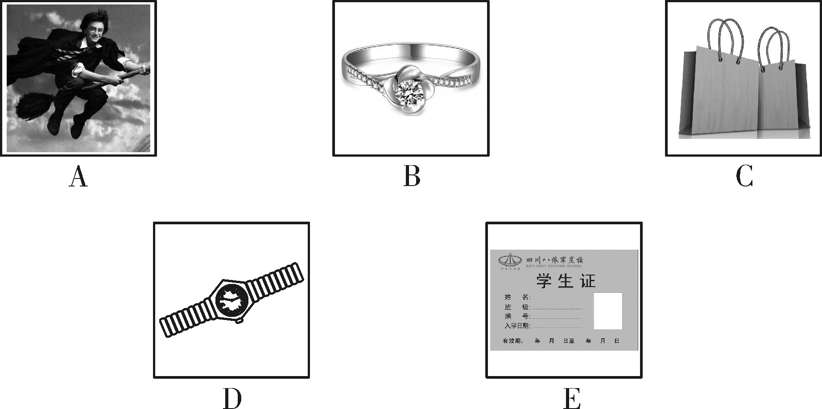
51．____ 52.____ 53.____
54．____ 55.____
D
B
C
E
A

