Slide 1
Unit 8 Natural disasters
第1课时
WWW.PPT818.COM

Slide 2
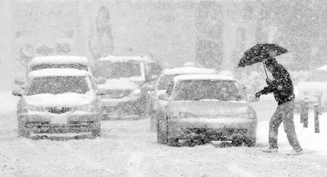
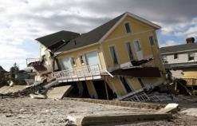
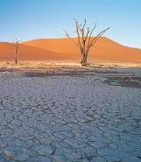
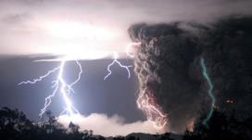
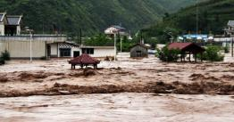
Natural disasters

Slide 3
Comic strip
1 —It's raining. My house is all wet. Can I come in, Eddie?
—Sure, come in.
2 —I was sleeping when it started to rain.
3 —Didn't you hear the rain?
—No. When I woke up, there was water everywhere! Come with me, Eddie.
4 —Why?
—Who will mop up the water if I go home without you?

Slide 4
知识点
mop up “把……拖干净”。
1
eg：She mopped up the water on the floor.
她拖去了地板上的水。
mop up后接代词作宾语时，要放在中间。
eg: mop it up把它拖干净
考向
【重点】

Slide 5
Welcome to the unit
A)Sandy is reading some newspaper headlines. Look at them. Which are about natural disasters? Put a tick (√) in the correct boxes.
1 School football team loses
final
2 Earthquake kills thousands
of people
3 Car accident kills three men
4 Coach crashes into tree
5 Flood washes away village
6 Lightning starts big fire in classroom building
7 Young boy falls from tree
and hurts legs
8 Big storm kills 20 people
√
√
√
√

Slide 6
B)Sandy and Millie are chatting online about natural disasters and accidents. Work in pairs and discuss the topic with your partner. Use the conversation below as a model.
Sandy: Did you hear about the fire at a school in the UK last week?
Millie: No. What happened?
Sandy: It was at my friend Vivien's school. She told me about it. There was a heavy storm with thunder and lightning.

Slide 7
Millie: Oh, really?
Sandy: Yes. It was terrible .Lightning hit a classroom building and it caught fire.
Millie: Was anyone hurt?
Sandy: No. Nobody was hurt. It happened at night.

Slide 8
知识点
thousands of... 成千上万的......
2
eg: Thousands of people are planting trees on the hill.
成千上万的人正在山上种树。
考向
它已经不是确切地要表示“千”的意思了，如thousand前有具体的数字修饰时，则thousand后就不加­s。
如：two thousand 两千
【重点】

Slide 9
拓展
有类似用法的词还有hundred, million等。
On June 2nd this year，________people celebrated the Dragon Boat Festival near the Songhua River. To our joy, there was little rubbish left.(哈尔滨)
A. thousands of B. thousand C. two thousands
典例
A
【点拨】考查数词的用法。 thousand前有具体的数字时，thousand后不加­s。若thousand前没有具体数字，其后要加­s，并与of连用，thousands of＋名词复数形式。

Slide 10
知识点
wash away 冲走
3
eg: Many people became homeless because the floods washed away their houses.
许多人变得无家可归，因为洪水冲走了他们的房子。
拓展
如果代词作宾语，放在wash和away中间。

Slide 11
知识点
hear about 听说
4
eg：I was sorry to hear about your accident.
获悉你遭遇意外，我很难过。
考向
辨析：hear about，hear of与hear from
【易错点】
词条 | 含义 | 示例
hear about | 表示“听说”。 | I've just heard about his promotion. 我刚刚听说了他被提升的事。

Slide 12
词条 | 含义 | 示例
hear of | 表示“听说”。 | I have never heard of the place. 我从来没有听说过这个地方。
hear from | 表示“收到某人的来信”。 | I haven't heard from him for a long time. 我好长时间没有收到他的来信了。

Slide 13
一、根据首字母或汉语提示完成单词
1. The traffic a________ killed two people.
2. —Shall we go out for a picnic this weekend?
—We'd better not. The weather report says there will be a ________(暴风雨) this weekend.
3. The young man looks forward to the life in a small ________ (村庄)．
ccident
storm
village

Slide 14
4. In 2013, a big ___________(地震) hit Ya'an, Sichuan and many people died in it.
5. During the National Day holiday, my parents and I went to Nanjing for a trip by ________(长途汽车)．
earthquake
coach

Slide 15
二、根据汉语意思完成句子
6．昨天晚上下了一夜的雨，洪水冲走了很多庄稼和房屋。
It rained the whole night yesterday and the flood __________ ________ many crops and houses.
7．刚才一辆汽车撞到了路边的一棵树上。
Just now a car ________ ________ a tree by the road.
washed away
crashed into

Slide 16
8．好几个星期过去了，我们还没听到他们的音讯。
Several weeks passed, and we still ______ _______ ______ them.
9．妈妈刚才拖干净了地板上的牛奶。
Mum ______ ______ ______ ______ on the floor just now.
10．由于昨晚外面太吵，我们都发现很难入睡。
Because it was too noisy outside last night，we all found it difficult ________ ________ ________．
heard nothing about
mopped the milk up
to fall asleep

Slide 17
本节课主要学习了以下知识点，请同学们及时巩固练习：
mop up
thousands of...
wash away
hear about

