Slide 1
Unit 8 Countries around the World
Lesson 45 China
WWW.PPT818.COM

Slide 2

教材原文
1 A map of China
Mr.Jones:This is a map of China. ^{①}What do you know about China, Jenny?
Jenny:^{②}I know a lot about China.My friends Li Ming and Wang Mei live in China.
Mr.Jones:^{③}What language do people speak in China?
Jenny:They speak Chinese.

Slide 3
Mr.Jones:Good! What is the capital city of China, Jenny?
Jenny:Beijing.
Mr.Jones:Yes! Beijing is the capital of China.What countries are east of China? Do you know, Jenny?
Jenny:Yes, I know.Canada and the U.S.are east of China.
2 ^{④}What else do you know about China?
China’s flag is red.It has five yellow stars.
This is the Palace Museum.It is famous around the world.
This is the Great Wall of China.It has a long history.
This is a lovely panda.Pandas live in China.

Slide 4
Let’s Do It!
1 Read the sentences and match them with the correct pictures.
It is a lovely animal.It lives in China.
It is a wall.It is long and great.
It is east of China.Jenny and Danny are from that country.
It is a museum.It has a long history. It is famous around the world.

Slide 5
It is a lovely animal.It lives in China.—图3
It is a wall.It is long and great.—图4
It is east of China.Jenny and Danny are from that country.—图1
It is a museum.It has a long history. It is famous around the world.—图2

Slide 6
2 Complete the dialogue with the words in the box.
famous history country lovely
language Chinese
Lisa:Look! This is a map of China.What do you know about China, Tom?
Tom:It is a very big_______ .The capital is Beijing.
Lisa:What _______ do they speak?
Tom:They speak _______.
Lisa:What else do you know?
country
language
Chinese

Slide 7
Tom:The Great Wall and the Palace Museum are in China.
Lisa:Are they _______?
Tom:Yes.They have a long _______ .And China also has pandas.They are so _______ .
famous
history
lovely

Slide 8
3 Rewrite the sentences into questions.
1.It’s January 15th.→What’s the date today?
2.My name is Wang Mei.→
3.It’s a map of China.→
4.Beijing is the capital city of China.→
5.Canada and the U.S. are east of China.→
2.What’s your name?
3.What is it?
4.What is the capital city of China?
5.What countries are east of China?

Slide 9
4 Work in groups.What else do you know about our country? Draw or bring pictures and write about them.Then make a poster about China.
This is Tian’anmen Square.It’s a very big square.People come from all over the world to see it.

Slide 10

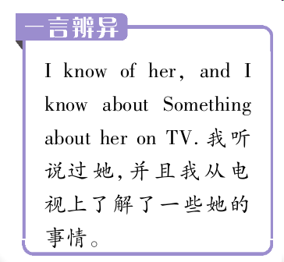

01What do you know about China, Jenny?詹妮，关于中国你知道些什么？(教材P118)
know的用法

Slide 11
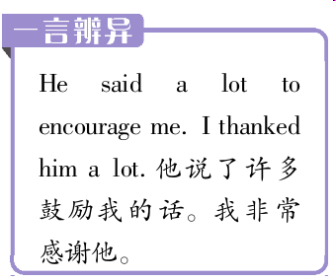
02I know a lot about China.我知道很多关于中国的情况。(教材P118)
a lot的用法

Slide 12
03What language do people speak in China？在中国，人们说什么语言？(教材P118)
【析句式】
What language do people speak in China?
特殊疑问词+n.
助动词
状语

Slide 13
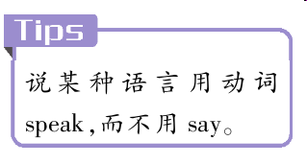
“What language do/does sb. speak？”的用法
“What language do/does sb. speak？”这一句型用来询问使用的语言，回答时使用“主语+speak+语言类名词.”。
—What language do you speak？
你说什么语言？
—I speak Chinese.
我说汉语。
＊

Slide 14
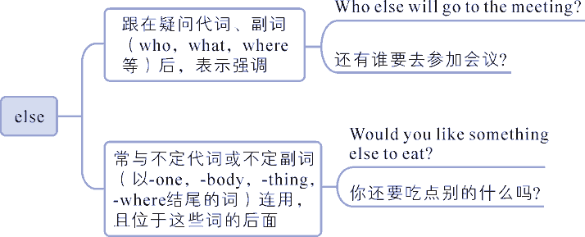
04What else do you know about China?关于中国你还了解其他的什么? (教材P118)
else的用法
else作副词，意为“其他；别的”，其用法如下：

Slide 15
【易混辨析】 else和other
else | 修饰不定代词或疑问代词，且必须放在被修饰词之后 | Do you have something else? 你还有一些别的东西吗？
other | 修饰名词，且位于名词之前 | I have no other books. 我没有其他 的书了。

