Slide 1
Unit 1
Do you like fish?
WWW.PPT818.COM

Slide 2
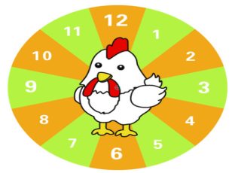
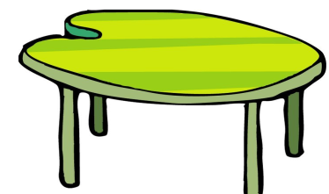
have lunch

Slide 3
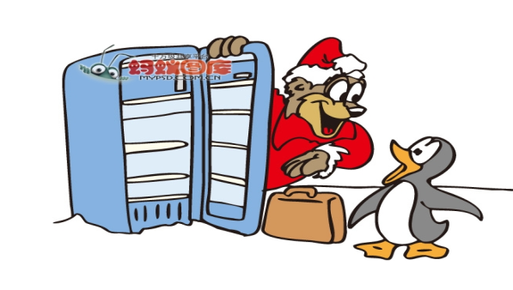
What’s for lunch?

Slide 4
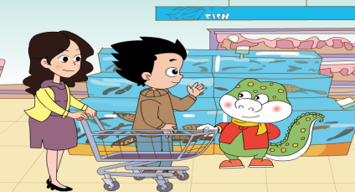
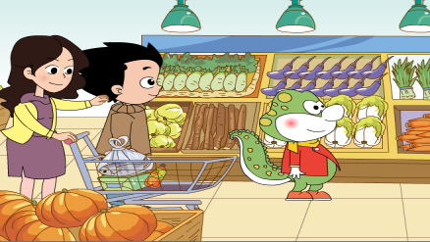
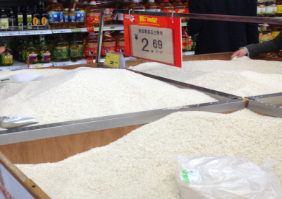
看图找食材

Slide 5
Do you like...
fish
I like…
I don’t like...

Slide 6
Do you like…
vegetables
I like…
I don’t like...

Slide 7
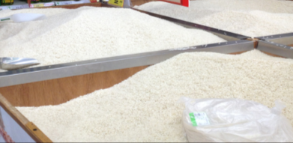
Do you like…
rice
I like...
I don’t like...

Slide 8
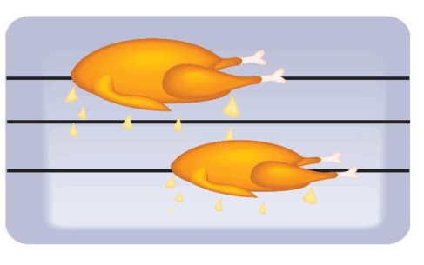
chicken

Slide 9
Do you like...
Yes, I do.
No, I don’t.

Slide 10
Do you like…
了解一下同桌的爱好

Slide 11
Food and drinks Name | Eggs | Bread | Milk | Juice | Rice | Fish | Chicken | Vegetables
小小记者

Slide 13
vegetables
chicken
fish
rice
Do you like…?
Yes, I do.
No, I don’t.

Slide 14
和小伙伴一起设计逛超市的场景，进行会话表演，了解一下他们都喜欢什么食物。

Slide 15
Thank You

