Slide 1
Unit 1
He looks like a cook
WWW.PPT818.COM

Slide 2
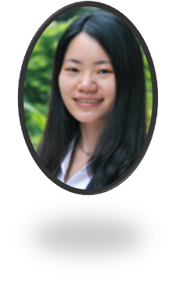
Who’s that woman ?
She is Miss Chen , our teacher.

Slide 3
Who’s that woman ?
She is Cai Yilin . She is a singer.

Slide 4
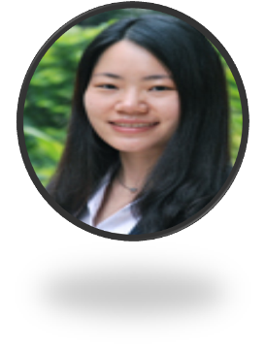
We know these two women.

Slide 5
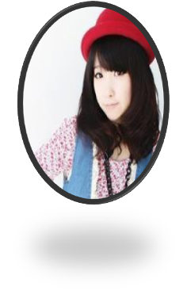
Do you know that woman in a white hat？
No ,we don’t know her.
She looks like a nurse.

Slide 6
in + (a/an)+颜色+衣服
the boy in blue jeans
the girl in a yellow sweater
the man in a brown shirt
the woman in purple shorts

Slide 7
look like+ 名词：看起来像
She looks like a reporter.
He looks like a builder.
The man looks like a doctor.
The woman looks like a doctor.

Slide 8
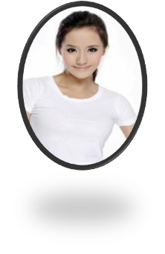
Do you know that woman in a white T-shirt？
No ,we don’t know her.
She looks like a teacher.

Slide 9
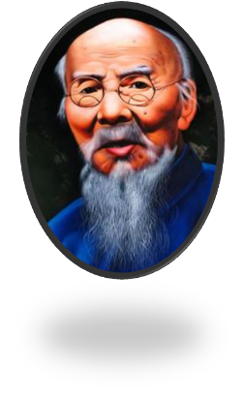
Who’s that man with glasses？
He is Qi Baishi .He is a painter.

Slide 10
with 后面一般跟身体部位或者帽子、眼镜等配件、饰物。
a girl with big eyes
a man with glasses
a lady with a hat

Slide 11
Who’s that man with a hat？
No, we don’t know him.
He looks like a worker

Slide 12
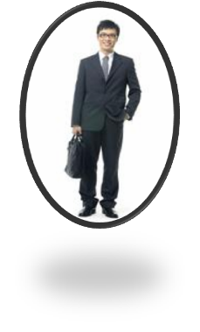
Who’s that man with a bag？
He wears a uniform.
No, we don’t know.
He looks like doctor.

Slide 13
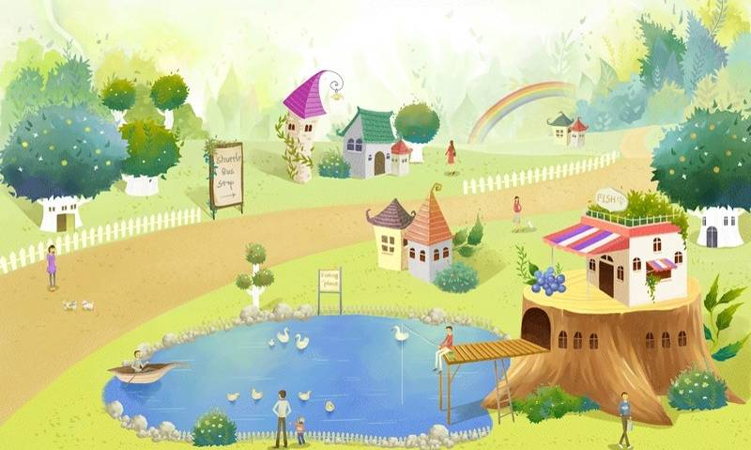
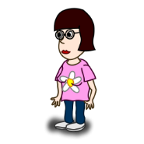
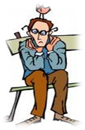
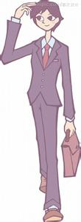
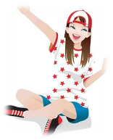
Can you see him/her?

Slide 14
The man in a black uniform looks like a doctor

Slide 15
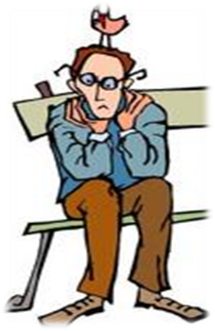
The man with black glasses looks a painter.

Slide 16
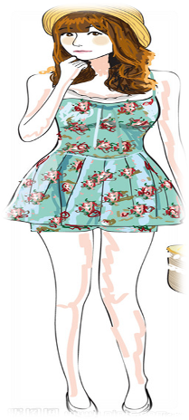
The girl in a yellow hat looks like a nurse.
The girl in a blue dress looks like a nurse.

Slide 17
The girl with glasses looks like a reporter.
The girl in a pink T-shirt looks like a painter.

Slide 18
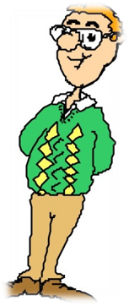
The man with glasses looks like a teacher.
The man in a green sweater looks like a teacher.

Slide 19
Exercise
一.选择正确的答案。
1.---- ______ is that woman?
---- She is my mother.
What. B . Which C . Who
2.The girl with a white dress ____ a nurse .
A . looks like B . like C. looks

Slide 20
一.选择正确的答案。
3.---- Do you want to be a farmer____ your mother?
A. like B. look C. look like
4. Sally with a hat________ a nurse.
A. Looks B . looks like C . likes

Slide 21
二.根据中文意思完成英文句子。
1.那个穿蓝色牛仔裤的女孩是谁?
Who is that girl ____blue jeans.
2.那个大嘴巴男孩是我哥哥。
The boy ______a big mouth is my brother.
3.Sandy 带着 个包在她旁边。
Sandy ______a bag beside her.
4.那个穿绿色短裤的男孩是我弟弟?
The boy _____ green shorts is my brother.
in
with
with
in

Slide 22
三.用 适当的词填空，是对话成立。
Who
Mike : _______ is that man? Jim.
Jim : _______man?
Mike : The _______ in a white coat and with glasses.
Jim : He’ s Mr.Zhang , our new science teacher.
Mike: ______ that lady beside him?
Jim : I don’t ______. She looks like a teacher_____.
Which
one
Who’s
know
too

Slide 23
Homework:
记忆Unit 1 单词，明天听写。
抄写单词，句子各4遍，汉语1遍。

