Slide 1
Module 12 Save our world
Unit 2 Remember three words:
reduce, reuse and recycle.
WWW.PPT818.COM

Slide 2
Learning Aims
1.Knowledge aims
1) To learn something about protecting the environment.
2)To know more about the ways to save the world.
3)To learn the grammar: word-building---- suffixes and prefixes
2.Ability aims
The students will be able to grasp the key words and expressions about the environment and can use corrected patterns to communicate with others in both oral English and written English.
3.Emotional aims
Help the students learn how to communicate with others, and let the students realize the responsibility of protecting the environment. It’s time to save our world.

Slide 3
reduce
reuse
necessary
plastic
repair
care
Instead
instead of
cloth
sort
harm
do harm to
difference
减少,减小
重新利用
有必要的
塑料制的，塑料
修复
在意,关心;担心
代替
代替,而不是
布
挑拣
伤害
对...造成伤害
差别,差异

Slide 4
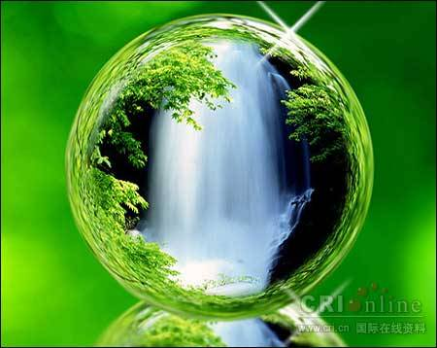
The beautiful earth is our home.
Do you love to live here?

Slide 5
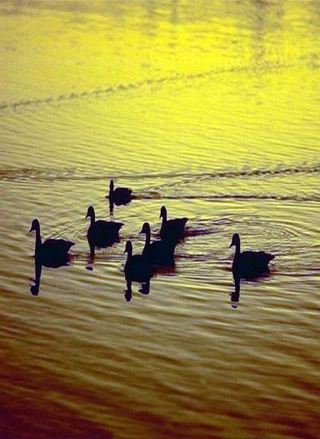
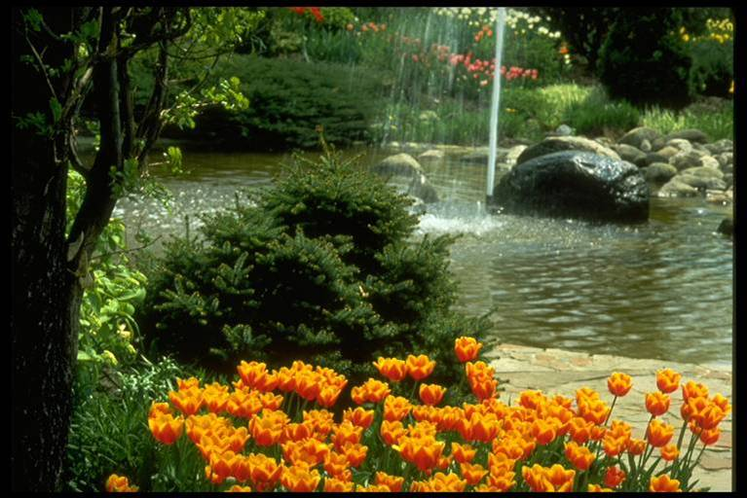
Green environment

Slide 6
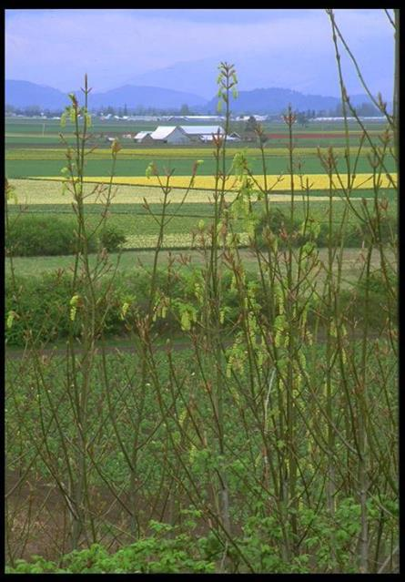
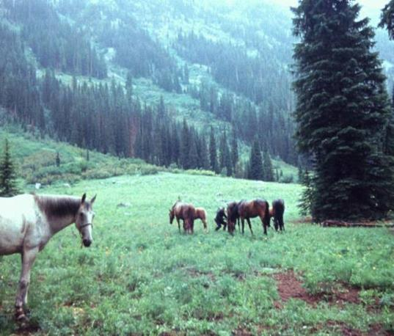

Slide 7
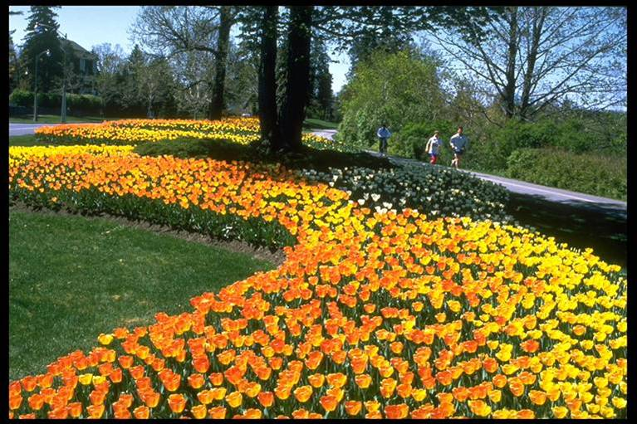

Slide 8
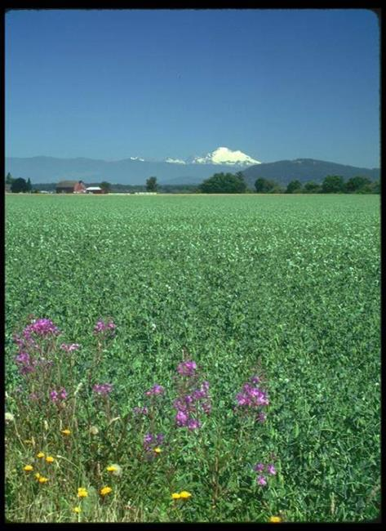
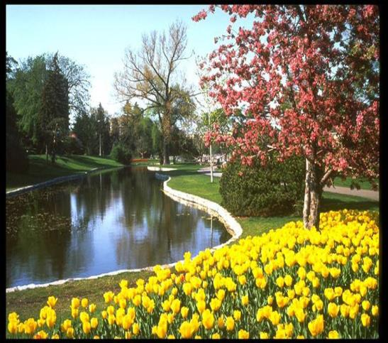

Slide 9
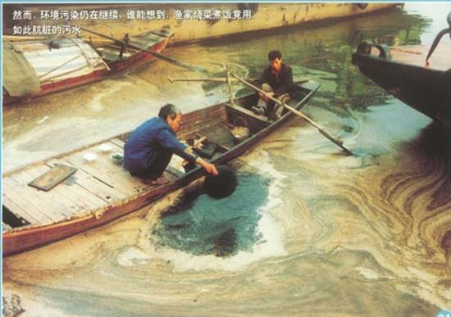
Can you imagine that this is the water
they drink every day?
Water pollution

Slide 10
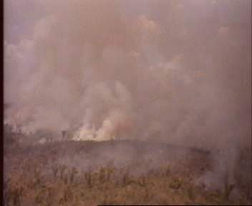
Air pollution

Slide 11
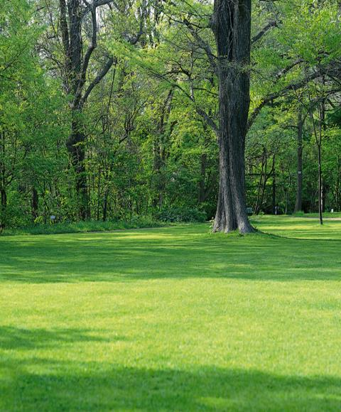
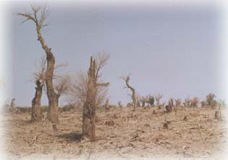
Wood cutting

Slide 12
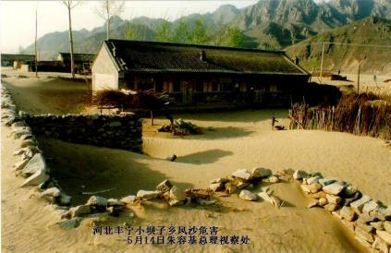
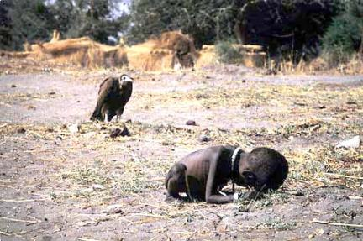
Deforestation采伐森林
garbage
desertification
沙漠化
starvation饥饿

Slide 13
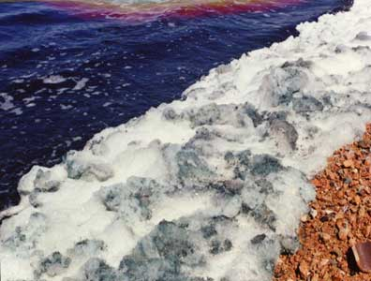
most serious
problems

Slide 14
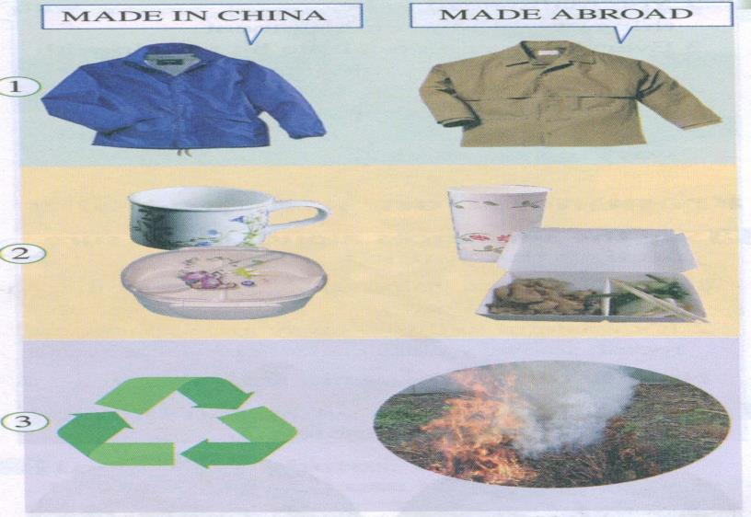
Which ways are good for the environment and why?

Slide 15
It is better for Chinese people to buy Chinese products than products from abroad.
It is better to use a lunch box and china cup than a paper bag and paper cup, because
they are reusable, paper cups can only be used once and have to be thrown away.
It is much better to recycle used things
than burn them. In this way, we can use
less energy; also, burning pollutes the air.

Slide 16
Let's see
If you're green?
Do you try to walk or ride a bike to school?
Do you buy new clothes just because they are the latest fashions?
Do you open a window instead of turning on air conditioning?
Do you buy things produced locally instead of made aboard?
Do you take your own cloth bag when shopping instead of using plastic bags?
Do you sort the waste before throwing it away?

Slide 17
1.What can we reuse?
We can reuse a lot of things ,such as paper,water and so on.
2.What can be recycled?
Paper,cloth,batteries and glass can be recycled.

Slide 18
3. What can’t we throw away?
4. What takes a lot of energy to make?
5. What pollutes the air and water?
If things can be used for a longer time, we shouldn’t throw them away.
New things take a lot of energy to make.
Things made out of plastic and rubber.

Slide 19
Check (√) the things you Should do.
( T ) 1. Order food that you can finish.
( F ) 2. Use less electricity at home.
( T ) 3. Learn ways to recycle at home.
( F ) 4. Use paper cups and paper bags
( T ) 5. Repair things.
( T ) 6. Divide rubbish into different groups.
( F ) 7. Collect waste or rubbish to raise money.
( F ) 8. burn things to save energy.

Slide 20
Careful reading
Fill in the tables.
Reduce=
use less
In order to reduce:
We should | We shouldn’t | reason
1.save
1.waste things
2.buy something new only when necessary.
2.buy anything that is unnecessary.
This saves money and reduces pollution and waste going into the environment.
3.choose local products if possible.
3.buy too many things from abroad

Slide 21
Reuse=
use again
In order to reuse:
We should | We shouldn’t | reason
1.Use things for as long as possible.
2.When we buy things, make sure that they last a long time.
3.Look after things so that they will last, repair them if we can.
1.Throw broken things and buy new ones
We can use them again
4.Use a china cup and a lunch box.
2.Use a paper cup or a paper bag.

Slide 22
Recycle =
change things into something else
In order to recycle:
We should | We shouldn’t | reason
1.Find out what can be recycled in your neighbourhood and take
part in recycling programmes.
It saves energy
Throw things away
or burn them.
2.Buy products made from recycled materials, such as recycled paper, to help save trees.

Slide 23
We throw away _____ of rubbish every year. If we want a clean world for our grandsons and ______,we have to _____, _______ and _____._____these three words every day. The first ____is to use less. The second is to use things as long as possible. Then _____your rubbish into _____, paper, rubber and glass. Finally, draw up a recycling _____for your community. We cannot hope for ____change, but every little bit helps.

Slide 24
1.protect the environment 保护环境
environmental education 环境教育/保护
2.stop sb. (from) doing sth. 阻止某人做某事
3.care about 关心，在乎，在意
care for 喜欢，照顾
4.the latest fashion 最新的款式
5.turn on air conditioning 打开空调（不可数）
6.instead of doing sth. 代替做某事（放于句中）
7.things produced locally 本地产品
8.made in China 中国制造
made abroad 国外制造

Slide 25
9.when doing sth. 当做某事的时候
before doing sth. 在做某事以前
10.sort the waste 分类垃圾
11.be bad for=do harm to=be hamful to 对……造成伤害
be good for=do good to 对……有好处
12.the simplest everyday activities 最简单的日常活动
13.make a/no/some/much difference to
对……产生重大（没有、一些、许多）影响
14.if possible=if sb. can 如果可能的话
15.try not to do sth. 尽力不做某事
16.too many+复数
too much+不可数 太多的……

Slide 26
17.things from abroad 来自国外的东西
18.as long as possible=as long as sb. can 尽可能长一点
19.It’s better to do sth. 最好做某事
You’d better do sth 你最好做某事
20.a china cup 一个陶瓷杯
22.change sth. into sth. 把某物变成某物
23.join+组织/人/俱乐部 参加组织/人/俱乐部
join in+某个活动 参加某个活动
take part in+活动/会议/聚会等 参加活动/会议/聚会等
join sb. in doing sth. 与某人一起做某事
24.recycled materials 可回收的材料

Slide 27
Language points

Slide 28
1. be careful /about of 小心/谨慎地对待
如：
Be careful of /about the ice on the road.
当心马路上的冰。
Be careful of /about your health.
注意你的健康；请多保重。

Slide 29
2. throw away 扔掉
Don’t throw away those boxes. 不要把那些箱子扔掉。
Do not throw that plastic bag away,
it may come in handy. 别把那个塑料袋扔了，会用得着的。

Slide 30
3. care about 关心，介意，在乎
I care about you a lot. 我对你很关心。
I don’t care about money. 我不在乎钱。

Slide 31
4. do harm to 对……有害
The trials show that smoking will do harm to people.
试验显示抽烟对人体有害。
It wouldn't do him any harm to work
a bit harder. 工作努力点对他没什么害处。

Slide 32
5. do good to 对……有好处
Exercise will do good to your health. 锻炼将对你的健康有益。
A holiday will do good to you.
休假会对你有好处。

Slide 33
6. everyday 是形容词，“每日的，每天
的”,它用来修饰后面的名词。
every day 是两个单词，后面不能有
名词被它修饰，只能在句中作状语。
It rained practically every day. 几乎天天下雨。
He reads the Bible everyday. 他每天读圣经。

Slide 34
7. change into 把...变成
They are changing desert into
farmland.
他们正在使沙漠变为农田。
The ugly caterpillar will change into
a beautiful butterfly. 丑陋的毛虫会变成美丽的蝴蝶。

Slide 35
5 Give reasons for what you should or shouldn't do.
1.You shouldn't buy the latest fashion
because it wastes energy to make them.
2.You should choose local products
because that saves energy.
3.You shouldn't waste energy because
it’s dear(宝贵的）.

Slide 36
4.You shouldn't buy things from abroad because its costs a lot of energy to bring them to you.
5.You should repair things because it
saves resources.
6.You shouldn't use paper bags and
cups because they have to be recycled.
7.You shouldn't throw things away
because they should be recycled..

Slide 37
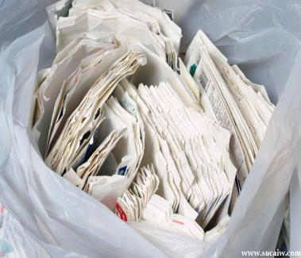
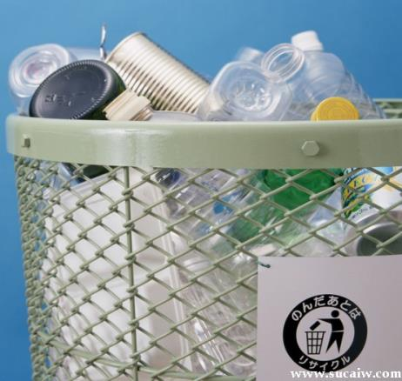
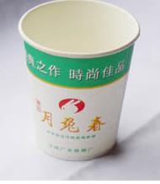
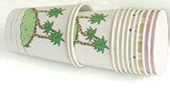
Reuse
Recycle
Reuse
Recycle
Reduce
Reuse

Slide 38
Work in pairs. Make a poster about how to be green.
1.Make a list of things you use every day that you could recycle.
glass bottles, newspapers, old clothes ....
2.Make a list of the things that use
electricity in your home.
lights, car, fridge ...
3.Make a list of green products --things
that have already been recycled.
Paper,glass,plastic bottles.....

Slide 39
Make suggestions about how to be green. Give reasons using because, so and so that.
1.Don't throw bottles away because it's
better to recycle them.
2.Do turn out lights so that you use
less energy.
3.Try to use recycled paper because it
saves energy.

