Slide 1
Unit 2 Let's play sports!
Reading
WWW.PPT818.COM

Slide 2
Period 2 Reading
课前自主预习
单 词 闯 关 | 1. 运动员 / 'pleɪə(r)/ ________ 2. 俱乐部 /klʌb/ ________ 3. 空闲的 /friː/ ________ 4. 梦想；梦 /driːm/ ________
player
club
free
dream

Slide 3
Period 2 Reading
短 语 互 译 | 1.in one's free time _______________ 2.a member of…_______________ 3.实现 ____________ 4.听音乐____________
在某人的业余时间
……的一名成员
come true
listen to music

Slide 4
Period 2 Reading
句 型 在 线 | 1.He is ________ ________ ________ ________ Huanghe Football Club. 他是黄河足球俱乐部的一名新成员。 2.He ________ ________ and plays football ________ ________． 他看起来强壮，足球也踢得很好。
a new member of
looks strong
very well

Slide 5
Period 2 Reading
句 型 在 线 | 3．It ________ him________． 这使他高兴。 4．I ________ his dream ________ ________． 我希望他的梦想实现。
makes happy
hope comes true

Slide 6
Period 2 Reading
课 文 初 探 | 判断正误：正确的写“T”，错误的写“F”。 ( )1. Li Hua plays basketball well. ( )2. In Li Hua's free time, he studies English. ( )3. Li Hua likes reading very much. It makes him happy.
F
T
F

Slide 7
Period 2 Reading
课堂互动探究
词汇点睛
1 player n. 运动员
[观察] He is my favourite football player.
他是我最喜欢的足球运动员。

Slide 8
Period 2 Reading
[探究] player作名词，意为“运动员”，是由“动词play＋名词后缀­er”构成的。“________＋名词后缀­er或­or”构成的名词通常是该动词所表示的动作的“执行者”。如：work—worker(工人), swim—swimmer(游泳者), run—runner(跑步者), visit—visitor(参观者)。
动词
[拓展]有些单词既可用作动词，也可用作名词。如：work, study, water等。

Slide 9
Period 2 Reading
活学活用
(1)Beckham is my favourite football ________(play)．
(2)Jim is a good _______ (swim). He often goes swimming in summer.
player
swimmer

Slide 10
Period 2 Reading
2 hope vt. 希望
[观察] I hope his dream comes true.
我希望他的梦想实现。
We hope to visit England some day.
我们希望有一天能够参观英格兰。

Slide 11
Period 2 Reading
[探究] hope有以下几种用法：
(1)接动词不定式：hope to do sth
I hope to be your friend. 我希望成为你的朋友。
We hope to visit the Great Wall. 我们希望去参观长城。
注意：没有hope sb to do sth结构。
(2)接句子：hope＋(that)从句
I hope I can be a doctor like my father.
我希望我能成为一位像我父亲一样的医生。

Slide 12
Period 2 Reading
[拓展] I hope so.我希望如此。
I hope not.
我希望不是这样。

Slide 13
Period 2 Reading
活学活用
(1) 2016·邵阳改编 She said she hoped________ her daughter.
A. to see B. you to see
C. seeing D. to seeing
A
【解析】考查hope的用法。句意：她说她希望看一看她的女儿。hope to do sth意为“希望做某事”，没有hope sb to do sth这一用法。表达“希望某人做某事”时，用“hope＋that引导的从句”。故答案为A。

Slide 14
Period 2 Reading
(2)2016·重庆—Maybe you can catch the last bus.
—________. If not, I'll have to walk home.
A. Good job B. Just so­so
C. Not at all D. I hope so
D
【解析】考查情景交际。“Good job.”意为“干得不错”；“Just so­so.”意为“如此而已”；“Not at all.”意为“不客气”；“I hope so.”意为“我希望如此”。句意：“或许你能赶上最后一班公交车。”“我希望如此。否则，我将不得不步行回家。”故答案为D。

Slide 15
Period 2 Reading
3 come true 变为现实，成为事实
[观察] I hope his dream comes true.
我希望他的梦想实现。
I will make any of your dreams come true.
我要让你的任何一个梦想成为现实。
[探究] ____________表示愿望、梦想、计划等“变为现实，成为事实”。
come true

Slide 16
Period 2 Reading
[拓展]

Slide 17
Period 2 Reading
活学活用
If we Chinese work hard together, China Dream will ________．
A．come out B．come true
C．come in D．come on
B
【解析】考查动词短语辨析。句意：如果我们中国人齐心协力，中国梦将会实现。come out意为“出版”；come true意为“实现”；come in意为“进来”；come on意为“加油，快点儿”。由句意可知选B。

Slide 18
Period 2 Reading
句型透视
1 He looks strong and plays football very well.
他看起来强壮，足球也踢得很好。
[探究] (1)look作系动词，意为“看起来”，后接形容词作表语。
Your sister looks very beautiful.你姐姐看起来很漂亮。
(2)well作________，意为“好，令人满意地”，修饰行为动词。
The little girl speaks English very well.
这个小女孩英语讲得很棒。
副词

Slide 19
Period 2 Reading
[拓展] 类似look的系动词：taste意为“尝起来”；feel意为“感觉，摸起来”；smell意为“闻起来”；sound意为“听起来”，后面都可接形容词作表语。
[辨析] well与good
well | 作副词，意为“好”；作形容词，意为“身体好”，只能作表语。
good | 作形容词，意为“好的”，可以作定语和表语。

Slide 20
Period 2 Reading
活学活用
2017·重庆 There are so many fish swimming in the pool. They ________ very happy.
A．taste B．smell C．sound D．look
D
【解析】考查连系动词。句意：池塘里有如此多的鱼在游。它们看起来很开心。taste意为“尝起来”；smell意为“闻起来”；sound意为“听起来”；look意为“看起来”。根据句意及生活常识可知，鱼是“看起来”很开心。故选D。

Slide 21
Period 2 Reading
2 It makes him happy. 这使他高兴。
[探究] make 用作使役动词，意为“使”。
(1)“make sb/sth＋adj.”意为“使某人/某物……”。
The news makes him very happy. 这则消息使他非常高兴。
Your help made the job easy. 你的帮助使这项工作容易了。
(2)make sb ________ sth意为“使某人做某事”。
She always makes me laugh. 她总是让我发笑。
do

Slide 22
Period 2 Reading
[拓展] make的相关短语：
make friends with sb与某人交朋友
make faces/a face做鬼脸
make mistakes/a mistake犯错误
make (a) noise 制造噪声

Slide 23
Period 2 Reading
活学活用
Sometimes I listen to music. It makes me ________ great.
A．feels B．to feel
C．feel D．feeling
C

Slide 24
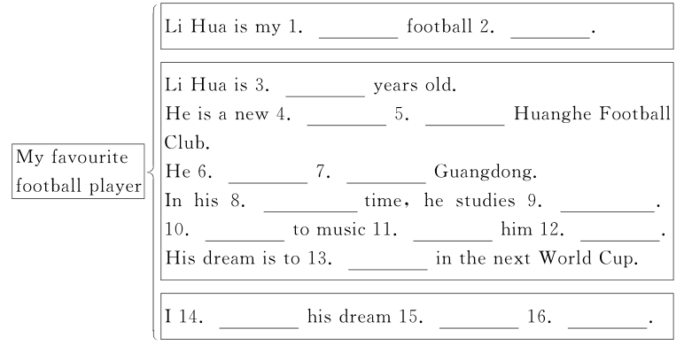
Period 2 Reading
课文回顾
favourite
star/player
22
member
of
comes/is
from
free
English
Listening
makes
happy
play
hope
comes
true

