Slide 1
Unit 5
Amazing things
Grammar
WWW.PPT818.COM

Slide 2
一、什么情况下使用一般过去时?
We use the simple past tense to talk about things in the past.

Slide 3
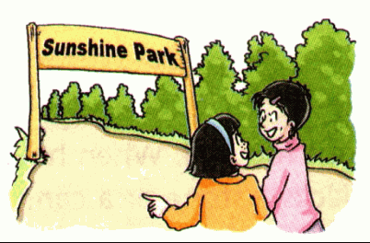
went是go在一般进去时中所用的动词形式, 是go的过去式。
A month ago, Millie and Amy went to Sunshine Park.
一个月前，米莉和艾米去了阳光公园。

Slide 4
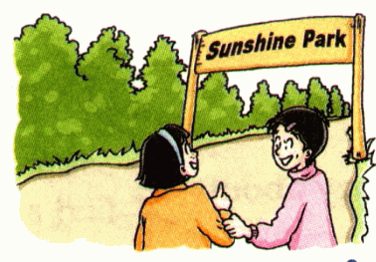
Last Sunday, they went to the park again.
上个星期天, 她们又去了那儿。

Slide 5
2. We form the simple past tense by adding ‘-ed ’ to regular verbs.
提示：一般过去时常与表示过去的
时间状语连，如：yesterday, last night, a month ago, yesterday afternoon, last week, ten years ago

Slide 6
二、规则动词过去式的构成方法
1 | 绝大多数动词 | +ed | walk—walked
2 | 以e结尾的动词 | +d | live—lived
3 | 以辅音字母+y结尾的动词 | 变y为ied | cry—cried
4 | 以一个元音字母+一个辅音字母结尾的短动词 | 双写末尾的辅音字母+ed | stop—stopped

Slide 7
提示: 以元音字母+y结尾的动词
按第一条规则，即：+ed,
如: stay —stayed

Slide 8
写出下列动词的过去式。
want— talk —
like — worry —
try — stop —
wanted
talked
liked
worried
tried
stopped

Slide 9
三、不规则动词的过去式不是加ed 构成的, 需要我们记住它们。不规则动词的过去式归纳起来有这样几种类型(见下表)：

Slide 10
1 | 与原形一样, 没有变化 | cost-cost put-put
2 | 改变了元音 | write-wrote know-knew
3 | 改变了辅音 | make-made spend-spent
4 | 元音和辅音都变化了 | leave-left teach-taught

Slide 11
不规则动词表
Infinitive Past tense
am is was
are were
begin began
break broke
bring brought
build built
buy bought
can could
Infinitive Past tense
catch caught
come came
do did
draw drew
drink drank
drive drove
eat ate
fall fell

Slide 12
四、谓语动词为实义动词的一般过去时的句子结构
肯定句
主语+谓语动词过去式……
He heard a whisper.
They went to the park again last Sunday.

Slide 13
2) 否定句
主语 + didn’t +谓语动原形 ……
I didn’t go to the park yesterday morning.
He didn’t hear a whisper.
They didn’t find anything in the bushes.

Slide 14
3)一般疑问句
Did +主语+谓语动原形……?
Yes, 代词+did. / No, 代词+ didn’t.
Did you go to the park yesterday morning?
Yes, I did.
Did he hear a whisper?
No, he didn’t.

Slide 15
PRACTISE
Finish Part A on page 62.
start ______
love _________
play ______
plan ______
replied
left
started
5. reply _____
6. say ________
7. meet _____
8. hear ______
9. leave _____
10. tell _____
11. stand _____
12. bring ______
loved
said
told
played
met
stood
planned
heard
brought

Slide 16
Finish Part B on page 62.
This morning, we _____ (go) to the Fun World Museum. When we ____ (get) to the museum, there _____ (be) a lot of people there. We _____ (spend) three hours in the museum. I ____ (take) a lot of photos. Some of us _______ (buy) cards of the animals there. We _____ (come) back to school at 1 p.m. We ____ (have) a great time!
went
got
were
spent
took
bought
came
had

Slide 17
Finish Part C on page 62.
Millie: We _____ (go) to the Fun World Museum
the day before yesterday, Daniel. It ____
(be) so interesting!
Daniel: Really? Tell me all about it.
Millie: OK. We ____ (see) a small monkey, only
11 centimetres tall.
Daniel: That’s amazing! What else?
Millie: We also _____ (learn) about some
strange birds like dodos. They _____ (live)
on the earth a long time ago.
Daniel: That’s cool!
went
was
saw
learnt
lived

Slide 18
Do more exercises.
She waited for me.
She waits for me.
He watched TV.
He watches TV.
Micky danced happily.
Micky dances happily.
He played basketball.
He plays basketball.
She went to school.
She goes to school.

Slide 19
改写句子。
1. Lucy did her homework at home.(改否定句)
Lucy ______ ___ her homework at home.
2. He found some meat in the fridge. (变一般疑问句)
____ he ____ ____ meat in the fridge?
3. She stayed there for a week. (对划线部分提问)
____ ____ ___ she ____ there?
4. There was some orange in the cup. (变一般疑问句)
_____ there ___ orange in the cup?
didn’t do
Did find any
How long did stay
Was any

Slide 20
巧记动词过去时态
动词一般过去时，表示过去发生的事；
be用was或用were, have, has变had；
谓语动词过去式，过去时间做标志；
一般动词加-ed，若是特殊得硬记。
否定句很简单，主语之后didn’t添；
疑问句也不难，did放在主语前；
如果谓语之前有did，谓语动词需还原；
动词若是was, were, 否定就把not添。

Slide 21
Homework
1. Learn the irregular verbs by heart.
2. Do some translations.

