Slide 1
陕旅版四年级上册
Unit5 Our School 第2课时
WWW.PPT818.COM

Slide 2
Let’s sing--- There is a hole

Slide 3
Review
What we have in our school?
Tell me in English!
We have…

Slide 4
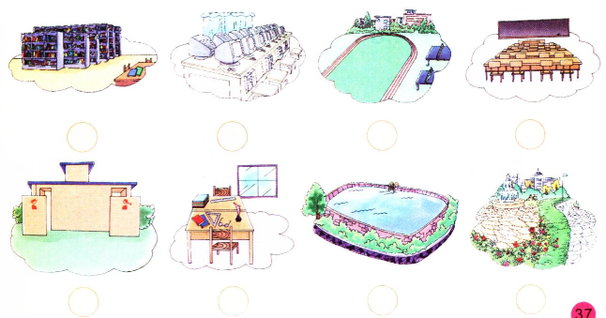
Tick what you have in your school

Slide 5
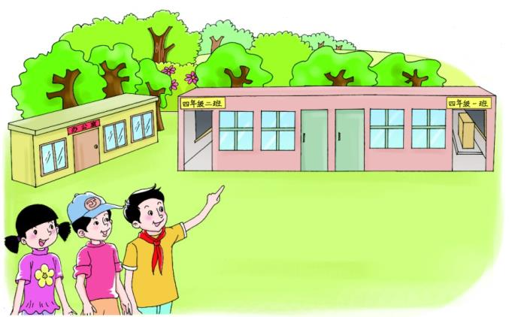
Let’s talk
听录音，回答问题：
Is there a teachers’ office?

Slide 6
听录音，跟读课文
Look! Those are our classrooms.
Yes, there is.
Is there a teachers’ office?

Slide 7
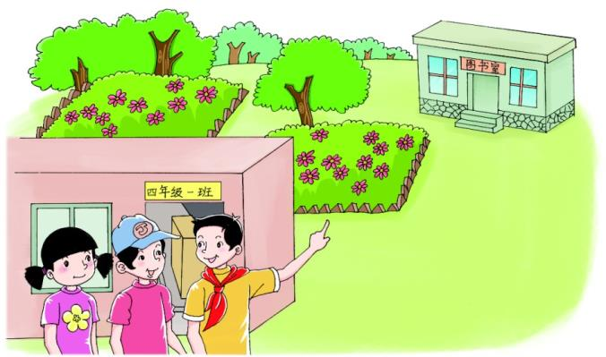
Let’s talk
听录音，回答问题：
Is the library small or big?

Slide 8
听录音，跟读课文
Is there a library?
Yes. There is a small library.
No, there aren’t.
Are there any computers in the library?

Slide 9
Role play
三人一组，假设有两名同学A和B来自己学校参观，同学C向他们介绍自己的学校。例如：
C：Look! Those are our…
A: Is there a…?
C：Yes, there is.
B: Is there a…?
C：Yes, there is./ No, there isn’t.
B: Are there…?
C: No, there aren’t.

Slide 10
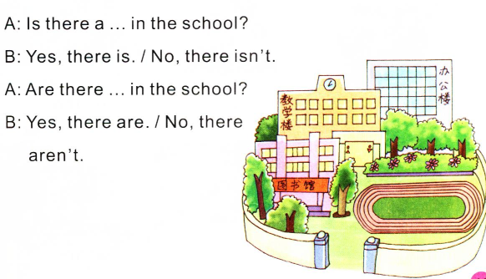
Look and talk
根据图片中的内容同桌之间互相问答

Slide 11
Summary
使用There be句型对学校的设施和功能进行问答：
Is there …?
回答用：Yes, there is. / No, there isn’t.
当问的东西不是一个时，则用：
Are there…?
回答用：Yes, there are. / No, there aren’t.

