Slide 1
Unit 12
What did you do last weekend?
R 七年级下册
第5课时
WWW.PPT818.COM

Slide 2
Review
英汉互译。
1. stay up late
2. fly a kite
3. make a fire
深夜不睡；熬夜
放风筝
生火

Slide 3
4. 跑开
5.互相；彼此
6.搭起；举起
run away
each other
put up

Slide 4
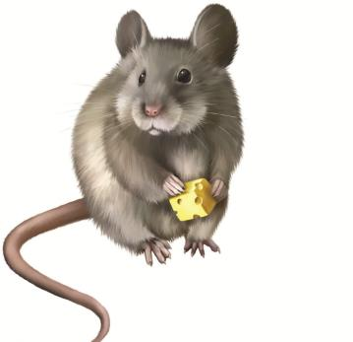
Words Guessing
mouse

Slide 5
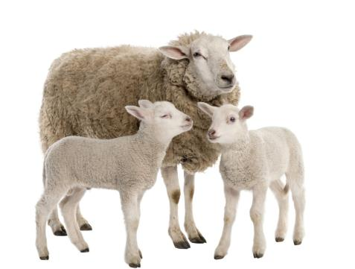
sheep

Slide 6
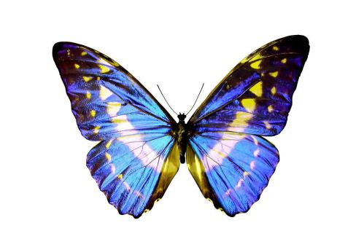
butterfly

Slide 7
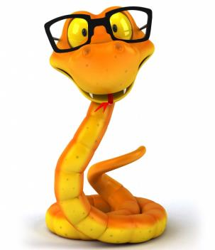
snake

Slide 8
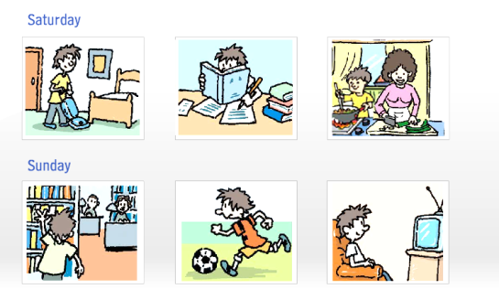
3a
Look at the pictures and complete the passage.

Slide 9
I had a busy weekend. On Saturday morning, I cleaned my room. In the afternoon, I _________________. It was a little difficult. On Saturday night, I stayed at home and __________________ cook dinner.
did my homework
helped my mother

Slide 10
On Sunday morning, I ___________________. I read a book about history. Then in the afternoon, I ________________ with my friends. On Sunday night, I ______________. I saw an interesting talk show.
went to the library
played soccer
watched TV

Slide 11
3b
Write about what you did last weekend.
思路点拨
本单元的写作内容也与过去发生的事相关，所以要注意时态。同时，写作时要注意必须按照时间顺序来描述周末的活动，最后写出自己的感受。注意在写作过程中灵活运用各种句型。

Slide 12
写作模板
用问句引入话题
How was your weekend? I had a great weekend…
详细介绍周末活动
It…on Saturday. I stayed… in the morning. In the
afternoon, I…with my parents. They…On Sunday
morning,…In the evening,…
总结活动的感受 We had a good time at the party.
What a great weekend I had!

Slide 13
One possible version
My Great Weekend
How was your weekend? I had a great weekend. It was rainy on Saturday. I stayed at home and watched TV in the morning. In the afternoon, I went shopping with my parents.

Slide 14
They bought me some new clothes. On Sunday morning, I met my classmates and we played ping-pong. In the evening, I went to the birthday party with them. We had a good time at the party. What a great weekend I had!

Slide 15
Self Check
Complete the phrases. Then use some of them in the past forms to write a story.
_______ out with friends _______ for a walk _______ apples _______ photos | fly a _______ milk a _______
 | camp _______ the lake study _______ a test
go
kite
go
cow
pick
by
take
for

Slide 16
Complete the conversation.
A：I had a school trip last week.
B：Really. ___________________(go)?
A：I visited the fire station.
B：_____________________ (go with)?
A：I went with my classmates.
Where did you go
Who did you go with

Slide 17
B：__________________ (do)?
A：We watched the firefighters work. What an
interesting job they have!
B：_____________________ (learn anything)？
A：Sure. We learned how to call the fire station and
what to do when there is a fire.
What did you do
Did you learn anything

Slide 18
Exercise
单项选择。
1.The man was ___ old that he couldn’t walk any more.
A. very B. quite C. so D. too
2. I saw him ___ basketball when I walked through the
park.
A. play B. playing C. plays D. played
C
B

Slide 19
3. His brother stayed up late night, so his mother _____ this morning.
A. wake up him B. woke up him
C. woke him up D. wake him up
C
4. She was _______ afraid _______ she cried.
A. too; to B. so; that
C. such; that D. to; too
B

Slide 20
句型转换。
He cleaned his room yesterday. （对画线部分提问）
_______ _______ he ________ yesterday?
My vacation was great. （对画线部分提问）
_______ _______ your vacation?
What did do
How was

Slide 21
Jim went to the movie last night. （改为一般疑问句）
______ Jim _______ to the movie last night?
4. She did her homework last night. （改为否定句）
She _______ _______ her homework last night.
Did go
didn’t do

