Slide 1
Unit 3 Care for the Earth
WWW.PPT818.COM

Slide 2
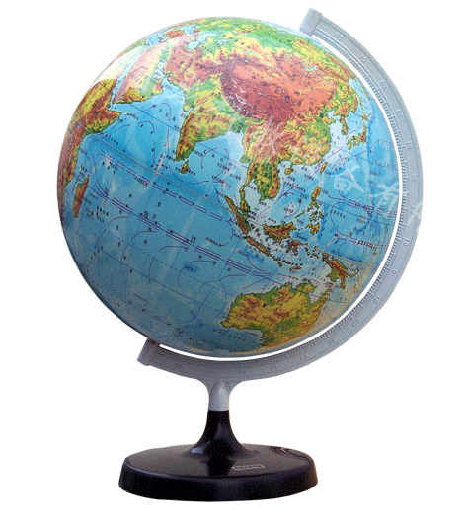
>>Lead-in
Free talk
We live on the earth. It’s our earth. It’s our home. It’s our mother earth. Where do we live, can you point it out?

Slide 3
>>Presentation
Read and answer
What bad things do we do to our earth?
We cut down too many trees. We waste too much water and make the air dirty.
What should we do?
We should care for our earth. We should do something to make the water and the air clean. We should plant more trees and help the animals.

Slide 4
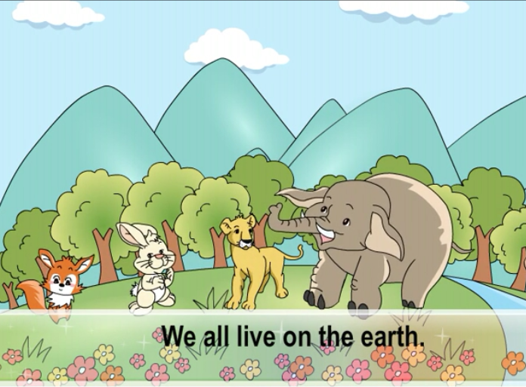
>>Presentation
Let’s learn more

Slide 5
>>Presentation
Read again and tick or cross
( ) 1. There are mountains, trees and
flowers on the earth.
( ) 2. We live on the earth with many animals.
( ) 3. We should cut down more trees.
( ) 4. We make all the water dirty.
( ) 5. We should care for the animals.

Slide 6
>>Presentation
Read and fill in the blanks
There are _____ trees, flowers, rivers
and _________ on the earth.
(2) We cut down ____ _____ trees.
(3) We waste ____ _____ water and make
the air _____.
many
mountains
too
many
too
much
dirty

Slide 7
>>Presentation
Let’s learn
care for
关心，爱护
Alice has a white rabbit and
she cares for it.

Slide 8
>>Presentation
Let’s learn
do bad things to
对……做坏事，损坏 ……
We are friends. We shouldn’t do bad things to each other.

Slide 9
>>Practice
Think and write
爸爸妈妈都很爱护我。
2. 我们要爱护这些小数木。
3. 人们不应该做损害我们地球的事情。
1. My father and mother care for me very much.
2. We should care for the small trees.
3. People shouldn’t do bad things to our earth.

Slide 10
>>Presentation
Think and write
many 和much的用法
many和much都表示“许多”。但是many修饰可数名词，much修饰不可数名词。Many和much都可以用a lot of 替换，但a lot of一般用于肯定句中。如：
There are many people in the park during
the holiday.
There is much milk and juice in the fridge.

Slide 11
>>Presentation
Think and write
too many与too much的用法
too many和too much表示强调，意为“太多”。用法与many 和much基本形同，不同的是too much可作福词短语，用来修饰动词。如：
I eat too much, so I don’t feel good.(修饰动词eat)
There is too much bread on the table. (修饰名词bread)
I’m very busy today, because I have too many
things to do. (修饰名词things)

Slide 12
>>Presentation
Let’s learn
well和good都表示“好”的意思。但是well常用作副词，用来修饰动词。如文中的study well, eat well, sleep well, play well 当well作形容词时，表示身体状况好、健康。
例如：
—How are you?
—I’m well. Thank you.

Slide 13
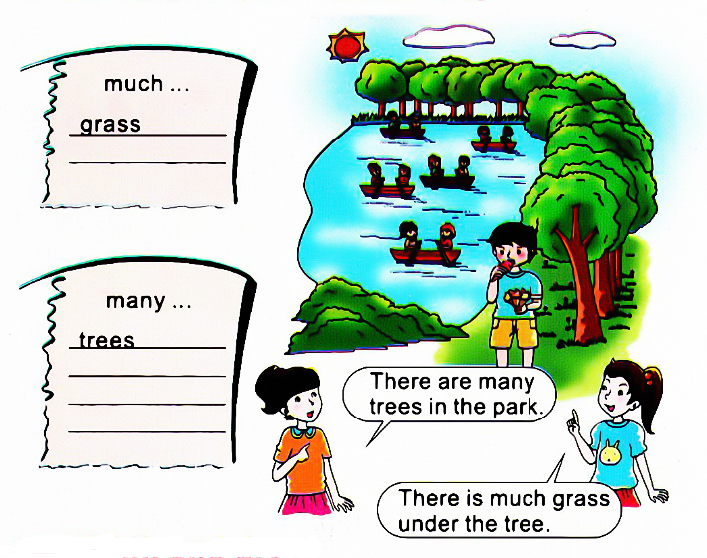
>>Practice
Look, group, write and say

Slide 14
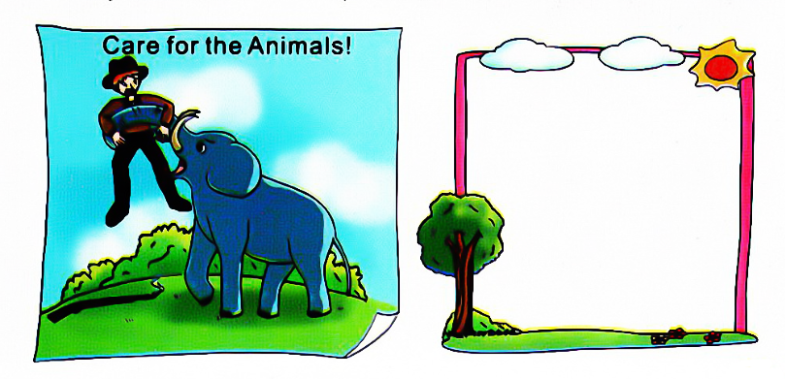
>>Practice
Think and draw
Can you make another poster?

Slide 15
>>Practice
常用环保口号
Save water.
Turn off the lights before you leave.
Low Carbon Life.
Don’t walk on the grass.
Don’t waste food.
节约用水。
离开前请关灯。
低碳生活。
不要践踏草坪。
不要浪费粮食。

Slide 16
>>Summary
care for
关心，爱护
do bad things to
对……做坏事，损坏 ……

Slide 17
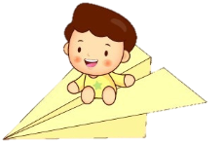
>>Homework
1.观看课文动画，按照正确的语音、语调朗读课文对话。
2.仿照“Think and draw 制作海报。
3.预习“Read and answer”。
close

