Slide 1
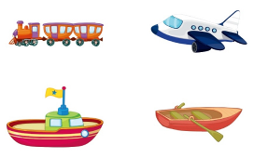
Unit2 Can I help you?
人教精通版五年级下册
WWW.PPT818.COM

Slide 2
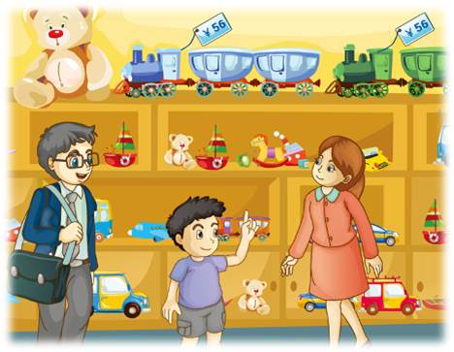
>>Review
Think and say
1. What does Dick want to buy?
2. What color does he like?
3. How much is it?

Slide 3
>>Lead-in
Free talk
Do you like shopping?
Where do you usually go?
Who’d like to go with you?

Slide 4
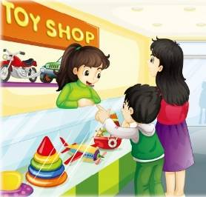
>>Presentation
Look and say
Look! Lisa and her mum are shopping.
Guess! What are they talking about?
What do they want to buy?

Slide 5
>>Presentation
Look and say
They want to buy some toys.
Do you know these toys?
toy train
toy plane
toy ship
toy boat

Slide 6
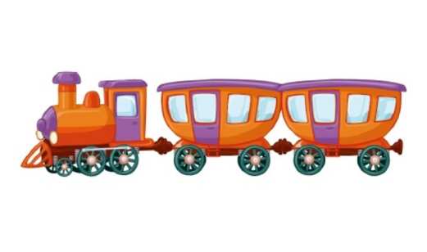
>>Presentation
Look and say
Can I help you?
Yes. I want a toy train.
￥56
How much is it?
It’s fifty-six yuan.

Slide 7
>>Presentation
Look and say
Can I help you?
Yes. I want a toy plane.
￥68
How much is it?
It’s sixty-eight yuan.

Slide 8
>>Presentation
Look and say
Can I help you?
Yes. I want a toy ship.
￥45
How much is it?
It’s forty-five yuan.

Slide 9
>>Presentation
Look and say
Can I help you?
Yes. I want a toy boat.
￥30
How much is it?
It’s thirty yuan.

Slide 10
>>Practice
Look and say
What’s missing?

Slide 11
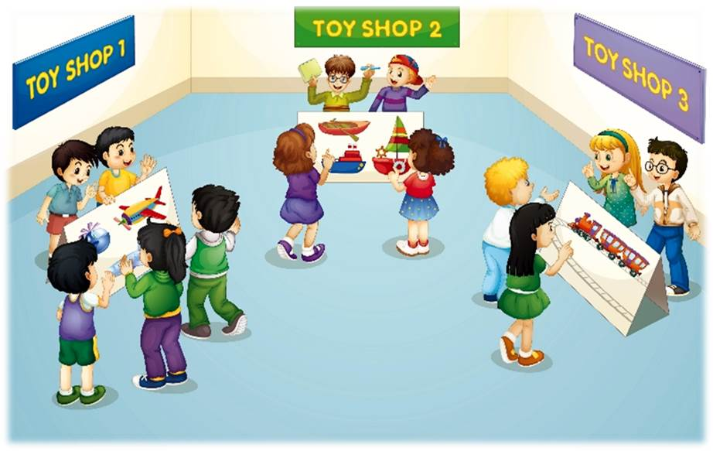
>>Practice
Let’s act
1
Can I help you?
4
Sure!
How much is it?
5
Can I have a toy ship?
3
Yes, I want a toy plane.
It’s fifty-six.
2
7
We’ll take it.
6

Slide 12
>>Practice
创编对话
根据图片情境，模仿本课
对话，创编新的对话吧！

Slide 13
>>Practice
Let’s chant

Slide 14
>>Summary
1.本课的重点单词：
toy
train
plane
ship
boat
2.本课的重点句型：
—Can I help you?
—Yes, I want …
—How much is it?
—It’s …

Slide 15
>>Homework
1.观看课文动画，按照正确的语音、语调朗读课文对话。 2.在四线三格中正确抄写本课的新单词，不少于5遍。
3.预习 Lesson 9。

