Slide 1
Unit 2 Let’s play sports! Study skills
WWW.PPT818.COM

Slide 2
Lead-in
Enjoy a song and the perfect pronunciation. Pay attention to the pronunciation of the letters in red.

Slide 3
/ɪ/
Rhythm of the Rain
Listen to the rhythm of the falling rain,
Telling me just what a fool I’ve been.
I wish that it would go and let me cry in vain,
And let me be alone again.
The only girl I care about has gone away.
Looking for a brand new start!
But little does she know that when she left that day.
Along with her she took my heart.
Rain, please tell me now.
Does that seem fair
For her to steal my heart away
When she don’t care I can’t love another,
When my heart’s somewhere far away.
The only girl I care about has gone away.
Looking for a brand new start! ...
/e/
/æ/
/æ/
/ ɒ /
/ʌ/
/æ/
/e/

Slide 4
Learn the vowels
cap cat dad man map
/æ/
desk egg pen red yes
/e/
big city him sit with
/ɪ/
box dog long not stop
/ɒ/
but cup duck run sun
/ʌ/

Slide 5
Read the words below. Then put them in the correct sound groups. (Part A)
clock club fun get happy
listen bad often swim well
/æ/ | /e/ | / ɪ / | / ɒ / | / ʌ /
happy
bad
get
well
listen
swim
clock
often
club
fun

Slide 6
Read the poem
What's that sound in the middle of cat? /æ/, /æ/, /æ/, that’s /æ/ in the middle.
What's that sound in the middle of hat? /æ/, /æ/, /æ/, still /æ/ in the middle.
What's that sound in the middle of hen? /e/, /e/, /e/, that’s /e/ in the middle.
What's that sound in the middle of pen? /e/, /e/, /e/, still /e/ in the middle.
What's that sound in the middle of pig? /ɪ/, /ɪ/, /ɪ/, that’s /ɪ/ in the middle.
What's that sound in the middle of wig? /ɪ/, /ɪ/, /ɪ/, still /ɪ/ in the middle.
What‘s that sound in the middle of dog? /ɒ/, /ɒ/, /ɒ/, that’s /ɒ/ in the middle.
What‘s that sound in the middle of hog? /ɒ/, /ɒ/, /ɒ/, still /ɒ/ in the middle.
What's that sound in the middle of bug? /ʌ/, /ʌ/, /ʌ/, that’s /ʌ/in the middle.
What‘s that sound in the middle of rug? /ʌ/, /ʌ/, /ʌ/, still /ʌ/ in the middle.

Slide 7
Can you read out these words? (Part B)
hand
habit
lab
mad
help
lend
test
wet
film
bill
risk
silk
hot
job
top
rock
mum
gun
just
luck
习惯
借出
账单
工作
枪
风险
实验室
测验
顶端
只是
疯的
潮湿的
丝绸的
岩石；摇滚乐
运气
/æ/
/e/
/ɪ/
/ɒ/
/ʌ/

Slide 8
Find out the different one
A B C D
B
sad many fan maths
( )
/æ/
/e/
/æ/
/æ/
D
tell left clever hello
( )
/e/
/e/
/e/
/ə/
B
city library flim kitchen
( )
/ɪ /
/aɪ/
/ɪ /
/ɪ /
story orange long hospital
A
( )
/ɔ:/
/ɒ/
/ɒ/
/ɒ/
( )
C
jump lunch pupil study
/ʌ/
/ʌ/
/ju:/
/ʌ/

Slide 9
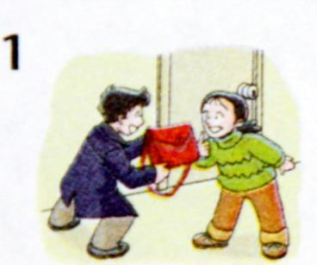
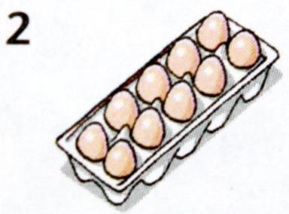
Read the phrases below (Part C)
take this bag
these eggs
/eɪ/
/æ/
/i:/
/e/

Slide 10
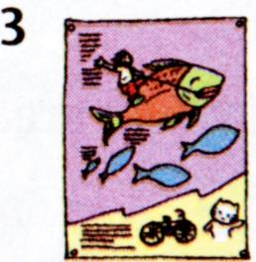
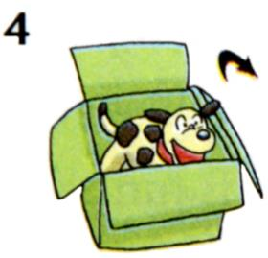
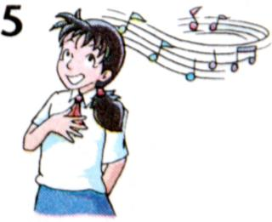
a nice picture
open the box
/aɪ/
/ɪ/
/əʊ/
/ɒ/
a music club
/ju:/
/ ʌ /

Slide 11
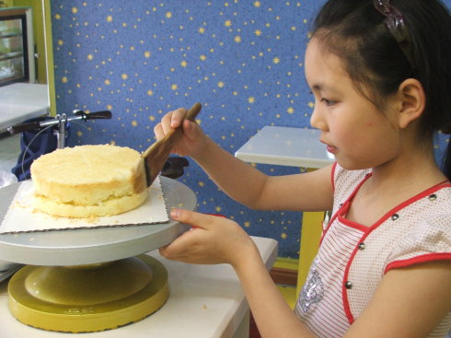
Look and say
The girl is making a cake.
/eɪ/
/eɪ/

Slide 12
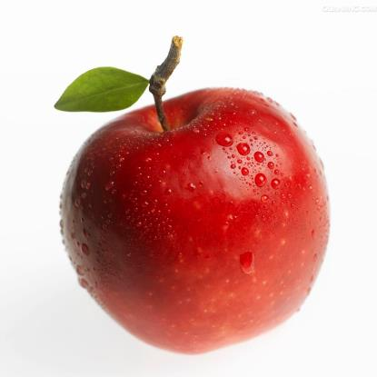
Look and say
What a red apple it is!
/e/
/æ/

Slide 13
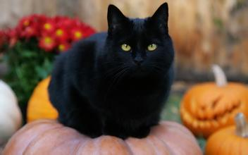
Look and say
There is a black cat standing on the pumpkin.
/æ/
/æ/
/æ/
/ʌ/

Slide 14
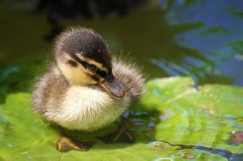
Look and say
How cute the duck is!
/ju:/
/ʌ/

Slide 15
Look and say
Do you like to live in a big city?
/aɪ/
/ɪ/
/ɪ/
/ɪ/

Slide 16
Look and say
Riding a bike is good for us.
/aɪ/
/aɪ/
/ʌ/

Slide 17
Look and say
How do you go home every day?
/əʊ/
/əʊ/
/e/

Slide 18
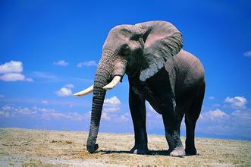
Look and say
Elephants have a long nose.
/e/
/æ/
/ɒ/
/əʊ/

Slide 19
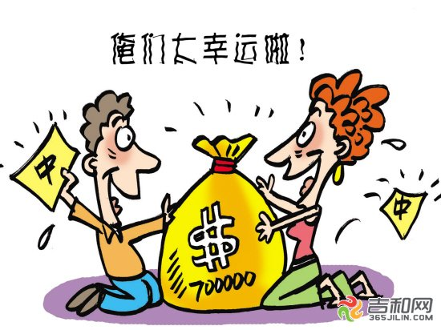
Look and say
They are so lucky.
/əʊ/
/ʌ/

Slide 20
Let's chant
Sandy has a pet.
That is a cat.
He is fat.
And he likes apples best.
Oscar, don’t go.
Tell me the use of letter O.
Put it in a cat, and you can get a coat.

Slide 21
Homework
1. Read and write the five phonetic symbols.
2. Find out all the related words in the word list.

