Slide 1
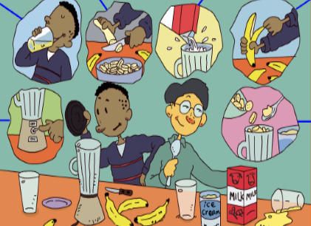
人教版八年级上册
Unit 8
How do you make a banana milk shake?
Section B（第1课时）
WWW.PPT818.COM
0

Slide 2
1.能准确表达可数名词与不可数名词的数量。 2.能恰当运用表示顺序的副词表达制作步骤的先后顺序。 3.懂得不同的国家地区有不同的生活饮食习惯，并学会尊重。 4.能有自己动手制作食物的生活情趣，并与他人分享美食。 5.能从品尝美食想到珍惜食物。
学习目标

Slide 3
自学互研
新词自查
根据句意及汉语提示完成句子
1. What do you like in your sandwiches (三明治)?
2. How much butter (黄油) do you need?
3. Here are three pieces (片 ) of bread on the table.
4. I like vegetables very much, especially lettuce (莴苣).

Slide 4
情景导入
How do you make a banana milk shake?
First, peel the bananas and cut up the bananas.
Next, put the bananas and ice-cream in the blender.
Then, pour the milk into the blender.
Finally,turn on the blender and drink the milk shake.

Slide 5
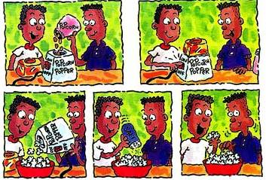
How do you make popcorn?
First, put half a cup of corn into the popcorn machine. Next, turn on the machine. Then, pour the popcorn into a bowl. Finally, put some salt. You can eat it.

Slide 6
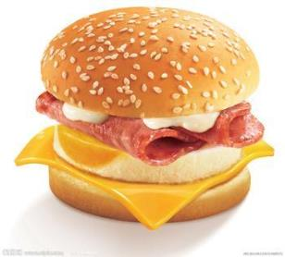
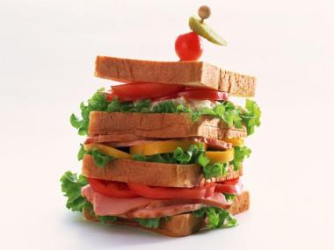
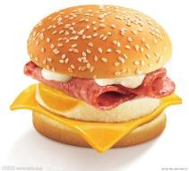
New words
hamburger
sandwich
hamburgers
sandwiches

Slide 7
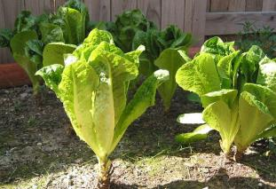
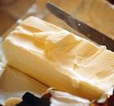
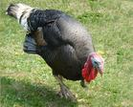
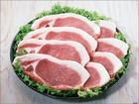
two pieces of
two spoons of
lettuce
butter
a turkey
turkey pieces

Slide 8
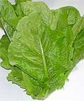
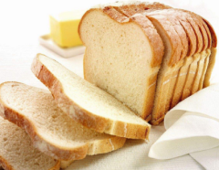
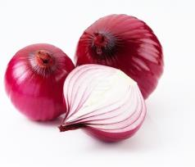
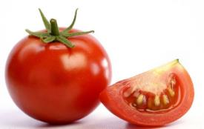
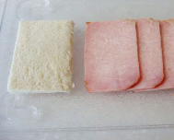
Do you like ... in sandwiches?
butter
lettuce
bread
onion
tomato
turkey

Slide 9
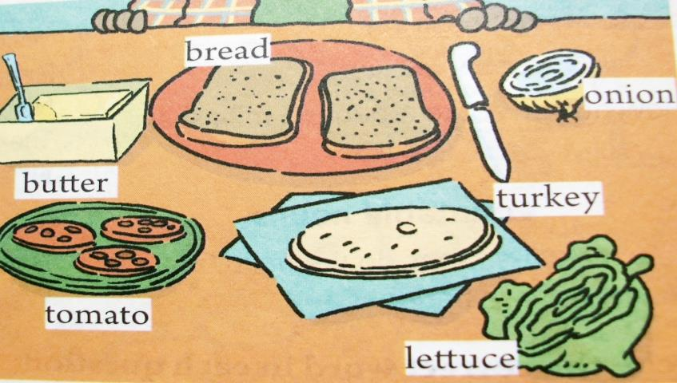
1a Make a list of things you like in a sandwich.

Slide 10
In my sandwich I like ________________________________________________________________________
tomatoes, lettuce, turkey and onion, but I don’t like butter or onion.

Slide 11
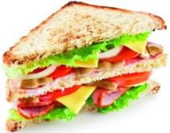
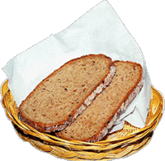
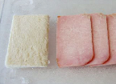
How do you make a sandwich?
bread
two pieces of bread
We need...
butter
a piece of butter
turkey 火鸡肉
turkey slices 火鸡肉片

Slide 12
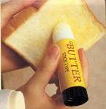
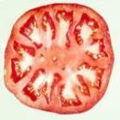
Let’s make a turkey sandwich.
First
Put some relish on a slice of bread.
Next
Cut up one tomato.
Put the tomato on the bread.

Slide 13
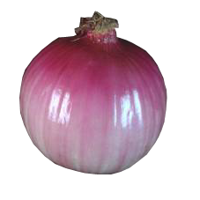
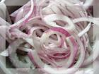
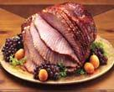
Next
Cut up an onion.
Next
Add two slices of turkey.

Slide 14
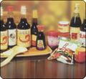
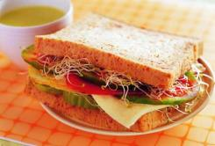
Then
Put two teaspoons of relish on the turkey.
Finally
Put another slice of bread on the top and eat it.

Slide 15
1b Ask and answer questions with a partner. Find out what he / she likes in a sandwich.
A: Do you like lettuce in a sandwich?
B: Yes, I do.
A: Do you like tomatoes?
B: No, I don’t.

Slide 16
1c Listen and circle the words you hear.

Slide 17
1d Listen again. Write the ingredients in the order you hear them.
bread
First | butter
Next
Then
Finally
tomatoes
onion
cheese
lettuce
another piece of bread

Slide 18
1e Tell your partner how to make a cheese sandwich.
First, put some butter on a piece of bread.
How much butter?
About one spoon.

Slide 19
Make a survey. How to make your favorite sandwich?
First | butter bread
Next
Then
Finally
Have a report
In my group, we’ll make a …sandwich for my mother\father… . First,…Next,…Then,…Finally,…

Slide 20
一、选词填空
turkey finally relish
tomato then put
put
First _____ the butter on the two slice of
bread. ______ cut up one ________. Put
the tomato on the bread. Next, add
two slice of ________. _________ put
two teaspoons of ________ on the
turkey.
Then
tomato
turkey
Finally
relish

Slide 21
二、单项选择
B
1. It’s getting dark. Can you ______ the light?
A. turn off B. turn on C. turn over
2. — ______ yogurt do you need?
— One teaspoon.
A. How many B. How much C. Which
B

Slide 22
C
3. The baby can eat ____ bread for breakfast.
A. two B. many of C. two slices of
4. I have _______ bananas in the fridge.
A. a lot B. many C. much
5. Would you like ____ relish on the bread?
A. many B. any C. some
B
C

Slide 23
Homework
1、Read and try to remember the new words and phrases.
2、Make their favorite sandwiches for your family.

