Slide 1
Unit8 Topic 1
How is the weather in winter?
Section A
WWW.PPT818.COM

Slide 2
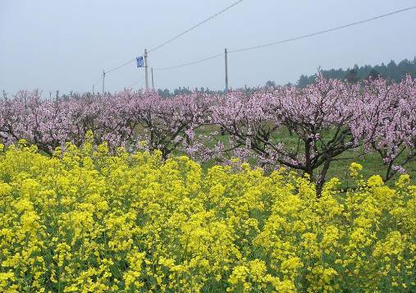
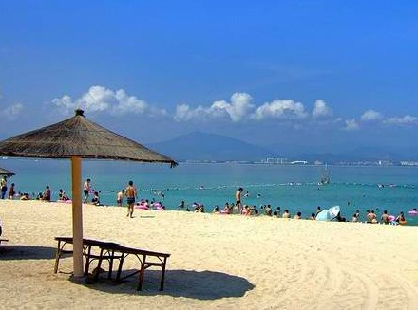
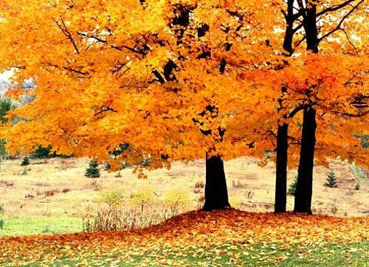
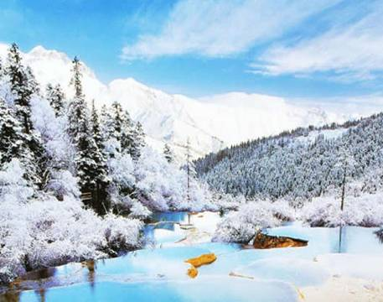
spring
summer
seasons
fall
winter

Slide 3
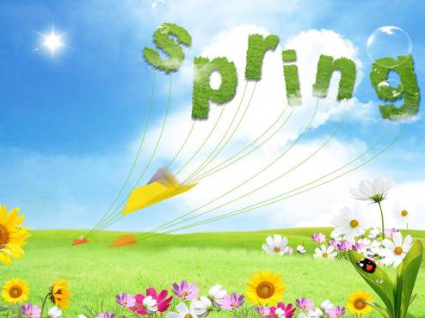
--What's the weather like in spring?
--It's warm.
What can we do in spring?
We can...

Slide 4
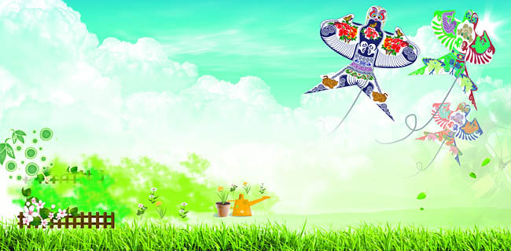
It's a good season for flying kites.
It's a good season to fly kites.

Slide 5
--What’s the weather like in summer?
--It's hot.
We can go swimming.

Slide 6
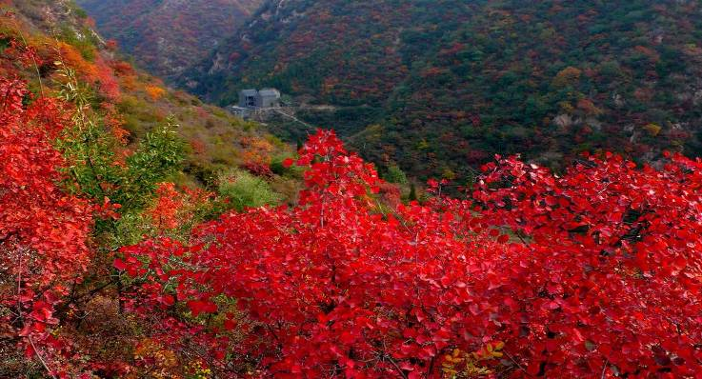
--How is the weather in fall?
--It's cool.

Slide 7
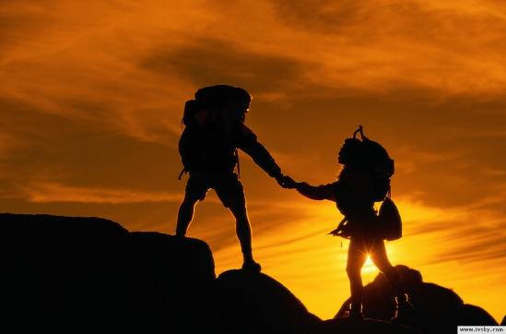
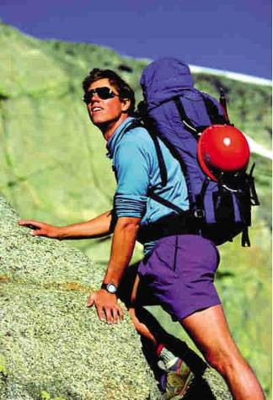
climb hills
It's a good time to climb hills.
It's a good time for climbing hills.

Slide 8
Winter
--How is the weather in winter?
--It's cold.

Slide 9
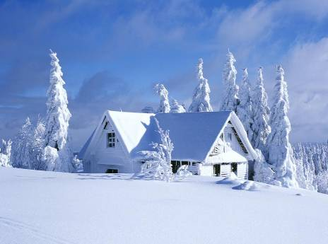
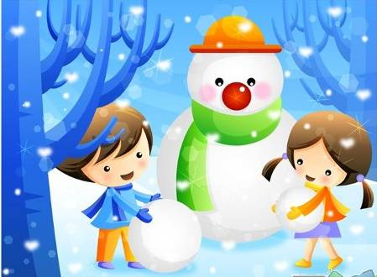
snows i.
When it snows, we can make snowmen.

Slide 10
Listen to 1a and match.
spring
summer
fall
winter
cool
warm
cold
hot
go swimming
make snowmen
fly kites
climb hills

Slide 11
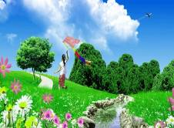
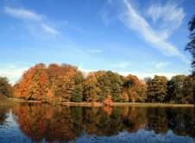
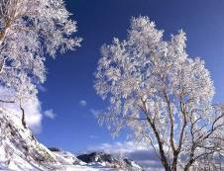
Work in pairs and practice 1a. Then make up a new conversation with the following sentence stuctures.
A:What's the weather like in...?
How is the weather in...?
B:It's...
It's a good time/season for doing/to do...
We can ...

Slide 12
Listen and complete the conversation.
(K---Kang, J---Jane)
K:Jane, which season do you like best, spring, summer,
fall or winter?
J:Well, it's hard to say. I liked winter before, but now I like _______ best.
K:Why?
J:Because I learned to swim last year, and I can often ____________ in summer. What about you?
K:I don't like summer very much because it often rains. My favorite season is _________ . When it snows, I can make__________ .
summer
go swimning
winter
snowmen

Slide 13
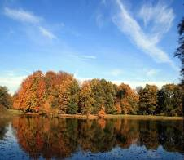
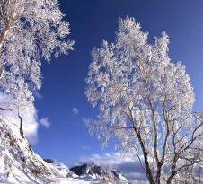
Talk about your favorite season.
Example:
A:Which season do you like best?
B:I like ...best./My favorite season is...
A:Why do you like it ?
B:Because it's a good time...
Because we can...

Slide 14
Write a short passage about the season you like best. (About 50 words)
Example:
Winter
There are four seasons in a year. I like winter best. There are three months in winter. The weather is very cold. But when it snows, I can make snowmen with my friends. It's very interesting. Do you like winter?

Slide 15
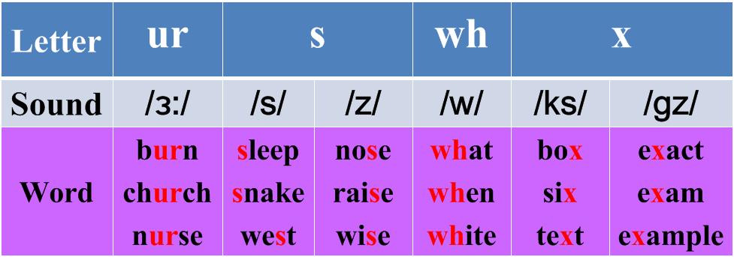
Listen and read the sounds and words aloud.

Slide 16
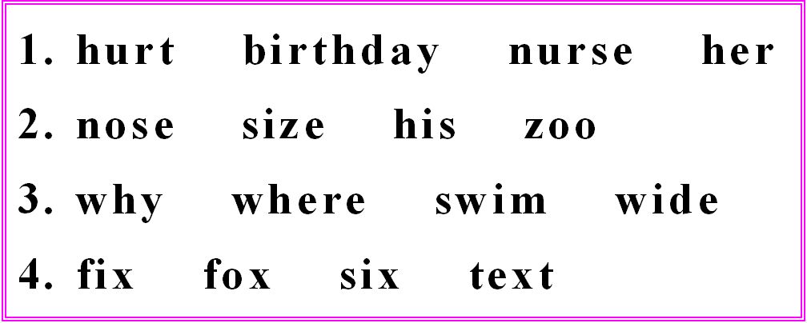
Read each group of words.Circle the letters with the same sound.Then listen,check and repeat.

Slide 17
Summary
1. What’s the weather like …?
=How is the weather …?
2. It’s a good season for doing sth.
= It’s a good season to do sth.
3. Which season do you like best?
=What's your favorite season?
I like … best./My favorite season is...
4. make snowmen

Slide 18
Homework
1. Read 1a and retell it.
2. Finish Section A in your workbook.
3. Preview Section B of this topic.

