Slide 1
Unit4 I have a ball.
人教精通版三年级上册
WWW.PPT818.COM

Slide 2
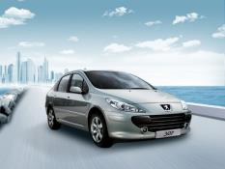
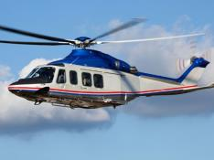
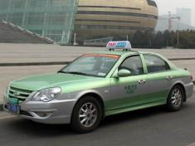
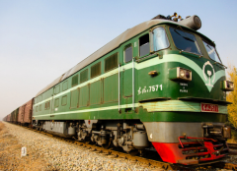
Review
Play a game
快速抢答
I have a …

Slide 3
Lead-in
Let’s sing
We Wish You a Merry Christmas

Slide 4
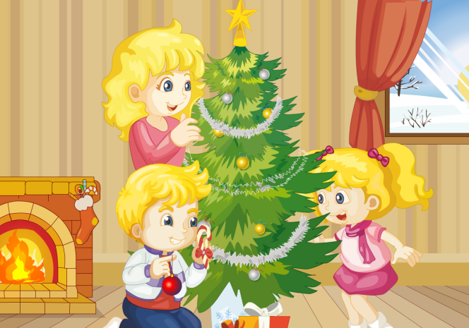
Presentation
Fun story
Read and act.

Slide 5
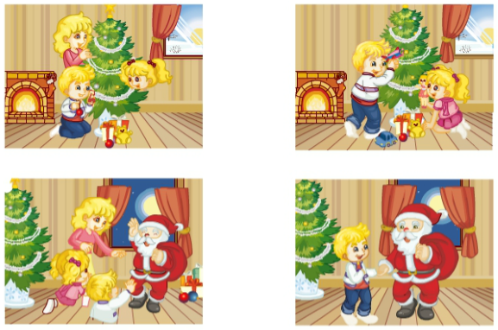
Presentation
Listen and repeat
Look, Kate! I have a plane.
Cool! I have a doll.
Hello! Merry Christmas!
I have a kite, a ball, a car, a plane …
Look! It’s Santa!
Wow! Really?
Merry Christmas!
!

Slide 6
Presentation
Listen and repeat
Here you are.
Bye!
You’re welcome.
Super! Can I see it?
Thank you!
Thank you!
Goodbye!
Goodbye!

Slide 7
Practice
Let’s read
1
2
3
Read together.
(齐读)
Read in roles.
（分角色读）
Read in groups.
(分组读）

Slide 8
Show time
小组合作，试着练习对话并表演，其他同学评价。
 | 模仿录音中的语音语调，有感情地朗读。
 | 可以脱离课本，适当改动其中部分，语音地道。
 | 适当添加内容，意思完整，有创新，表演生动。
Good
Great
Excellent

Slide 9
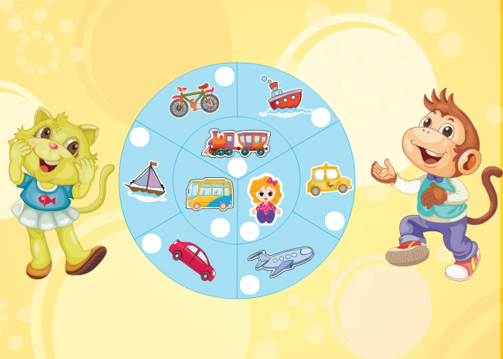
Presentation
Let’s check
Listen and number.

Slide 10
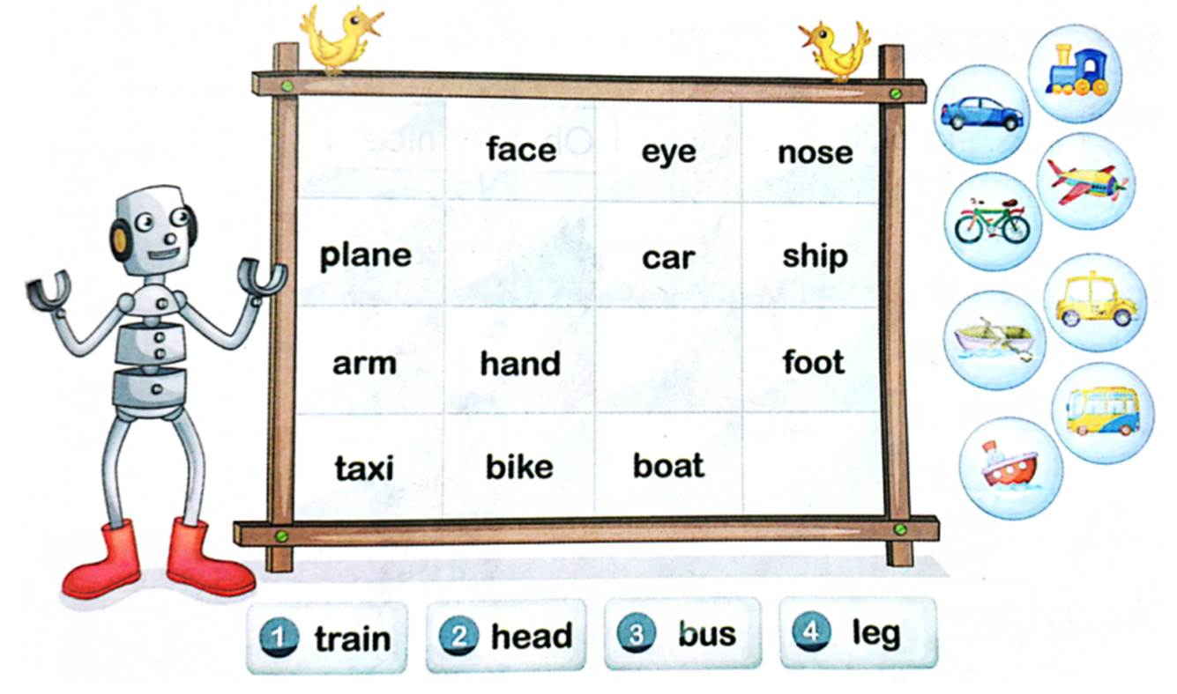
Presentation
Let’s think
Fill in the right words.
head
train
leg
bus

Slide 11
Practice
Game 1
Choose and say
1
2
kite
ball
3
4
doll
car
5
6
7
8
bus
balloon
bike
taxi
9
10
11
12
train
ship
boat
plane

Slide 12
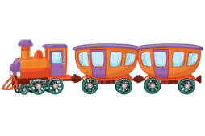
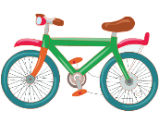
Practice
Game 2
Point and say

Slide 13
Homework
1.观看或跟读Fun story部分的课文动画或录音，并注意语音、语调。
2.复习本单元所有的单词，并读给你的父母听。
3.预习Lesson 25。
Close

