Slide 1
Unit10 Funny cartoons
WWW.PPT818.COM

Slide 2
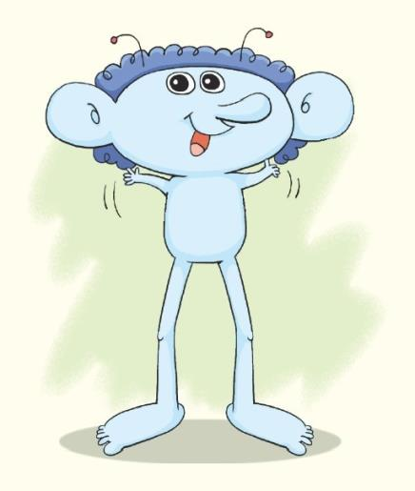
Look and say
Hello.I’m Beebo.
Notes:
2

Slide 3
head
a big/small head
I have a big head.
Notes:
3

Slide 4
arm
two arms
two short / long arms
I have two short / long arms.

Slide 5
hand
two hands
two big / small hands
I have ___ big / small hands.

Slide 6
leg
___ legs
two short / long legs
I have ___ ____ / ____ legs.
Notes:
6

Slide 7
foot
____ feet
____ ____/ ____ feet
___ ____ ____ ____/ ____feet
Notes:
7

Slide 8
body
____ ____/ ____ ____
___ ____ ____ ____/ ____ ____.
Notes:
8

Slide 9
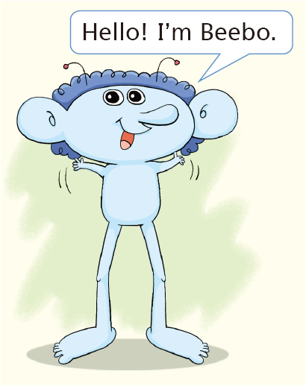
I have …
Notes:
9

Slide 10
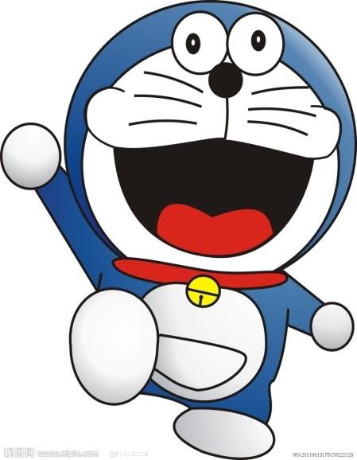
Hi,I’m Doraemon.
I have a big head.
My mouth is big.
My arms are long
I have short legs.
My hands and feet are small.

Slide 11
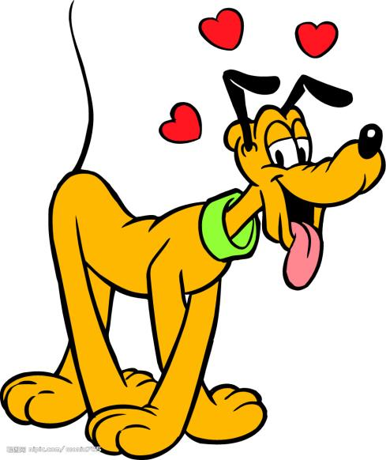
Hi,I’m Pluto.
I have two long ears.
My mouth is big.
I have a small body.
My legs are long.
My feet are big.

Slide 12
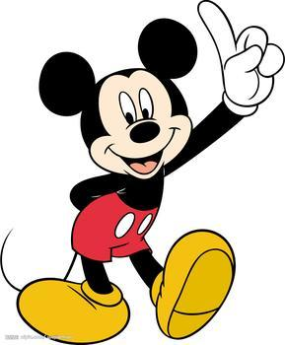
Hi,I’m Mickey Mouse.
I have two big ears.
My mouth is big.
I have a small body.
My arms are long.
My legs are short.
I have big hands and feet.

Slide 13
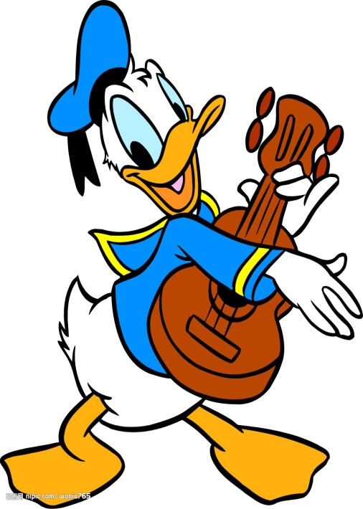
Hi,I’m Donald Duck.
I have…
My ___ is/are ___.

Slide 14
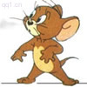
Hi,I’m Jerry.
I have…
My ___ is/are ___.

Slide 15
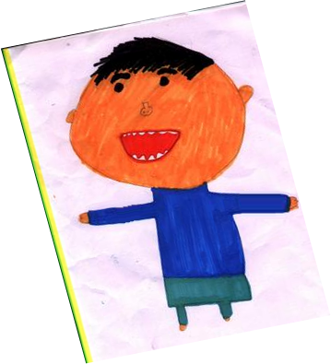

Slide 16
Hi, I am Jason.
I have a big head.
My eyes are small.
My mouth is big.
I have a small body.
My arms are long.
My hands are small.
I have two short legs.
Notes:
16

Slide 17
Home work
画一幅你的自画像并行进自我介绍．

Slide 18
Head knees and toes

