Slide 1
Unit 4 Growing up
Reading
WWW.PPT818.COM

Slide 2
课前自主预习
score
单词闯关 | 1.得分________ 2．命名________ 3．尽管，虽然_____________ 4．强迫，迫使________
name
although/though
force

Slide 3
单词闯关 | 5．逗留；保持不变________ 6．要紧，有重大影响________ 7．university________ 8．scholarship________
remain
matter
大学
奖学金

Slide 4
单词闯关 | 9.领导，带领vi. & vt. ________→领导者n. ________ 10．简单的adj. ________→仅仅；简直adv. ________ 11．成功vi. ________→n. ________→adj. ________→adv. ________ 12．成就，成绩n. __________→实现，达到vt. ________
lead
leader
simple
simply
succeed
success
successful
successfully
achievement
achieve

Slide 5
短语互译 | 1.参加……选拔(或试演)______________ 2．泄气，灰心______________ 3．成功地做某事______________ 4．改变主意______________ 5．注意，察觉______________ 6．决定做某事______________
try out for sth
lose heart
succeed in doing sth
change one's mind
take notice of
decide to do sth

Slide 6
短语互译 | 7.from then on ______________ 8．get sb to do sth______________ 9．be forced to do sth ______________ 10．graduate from… ______________ 11．at that time______________ 12．as a result______________
从那时起
使某人做某事
被迫做某事
从……毕业
在那时
因此，结果

Slide 7
句型在线 | 1.他训练得更加刻苦，并使教练改变了他的主意。 He _________________ and got the coach____________________. 2．因此，他成功地获得了奖学金。 ________________， he ________________ a scholarship. 3．在NBA注意到他之前，他在那里待了大约一年的时间。 He ________________ for about a year before the NBA ____________________ him.
practised even harder
to change his mind
As a result
succeeded in getting
remained there
took notice of

Slide 8
课文初探 | 根据课文内容，判断正(T)误(F)。 ( )1.Spud Webb is the tallest player in the NBA. ( )2.Spud scored twenty points in his first game. ( )3.In his first year of senior high, Spud was leader of the team. ( )4.At last North Carolina State University invited Spud to play basketball. ( )5.Spud's proudest moment came in 1988—he won the Slam Dunk Contest.
F
T
F
T
F

Slide 9
课堂互动探究
词汇点睛
●1 lose heart泄气，灰心
[观察] So long as we don't lose heart, we'll find a way to overcome the difficulty.只要我们不灰心，就能找到克服困难的方法。
This is not the time to lose heart.现在不是泄气的时候。

Slide 10
[拓展] 与lose相关的短语：
lose weight 减肥 lose one's way迷路
lose oneself in 沉浸于，沉湎于 lose the game输了比赛

Slide 11
活学活用
1．别泄气，总有一天你的梦想会实现的。
_________________. Your dream _______________ one day.
Don't lose heart
will come true

Slide 12
●2 name vt. 命名
[观察] They named their son John. 他们给儿子起名为约翰。
[拓展] name的其他用法：
(1)n. 名字；名声
I don't remember his name.我不记得他的名字。
His actions have given him a bad name.
他的行为给他带来了不好的名声。

Slide 13
(2)vt. 说出……的名字
Can you name all the plants in this garden?
你能叫出这座花园里所有植物的名字吗？
(3)name after…意为“以……命名”。

Slide 14
2．她是根据她祖母的名字起名的。
She ____________________ her grandmother.
was named after

Slide 15
●3 although conj. 尽管，虽然
[观察] She kept on working although she was tired.
她虽然疲劳但仍继续工作。

Slide 16
[探究] although可以引导__________状语从句，在一个句子中，不能和__________连用，但可以和yet, still等连用。
Although he is very old, (yet) he is quite strong.
他虽然年纪很大了，但还很强壮。
Although we are poor, we are still happy.
我们虽然穷，但仍然很快乐。
让步
but

Slide 17
3．2017·葫芦岛 Don't take off your sweater. ________ it's a
sunny day, it isn't warm.
A．While B．Although
C．Because D．Unless
B
【解析】考查连词。句意：不要脱掉毛衣。虽然今天是个晴天，但并不暖和。although意为“虽然，尽管”。故选B。

Slide 18
●4 remain vi. 逗留；保持不变
[观察] He remained there for about a year…
他在那里待了大约一年的时间……
[探究] remain作不及物动词，意为“逗留；保持不变”。
[拓展] remain还可用作系动词，表示“仍处于某种状态”，后可接名词、形容词、不定式、现在分词或过去分词作表语。此外复数形式remains作名词，表示“剩余物”。

Slide 19
4．2017·河南 The plane ________ on the ground for two more
hours because of the bad weather.
A．ran B．moved
C．shook D．remained
D
【解析】考查动词词义辨析。句意：飞机因为恶劣的天气在地面上又停留了两个小时。run意为“跑；跑步”；move意为“移动”；shake意为“摇晃；震动”；remain意为“保持；逗留”。故D项符合题意。

Slide 20
●5 take notice of注意，察觉
[观察] He remained there for about a year before the NBA took notice of him.
在NBA注意到他之前，他在那里待了大约一年的时间。

Slide 21
[拓展] 含take的常见短语：
take off脱下；起飞 take away拿走
take place发生 take in欺骗
take care of照顾 take photos拍照
take part in参加 take care 当心
take up 占据 take out 拿出，取出

Slide 22
5．在会上他不理会汤姆的建议。
He didn't ____________ Tom's suggestion at the meeting.
take notice of

Slide 23
句型透视
●1 While attending junior high, Spud tried out for the school team, but he was refused at first because he was too small.
斯巴德上初中时，参加了校队的选拔，但是起初因为太矮，他被拒绝了。
[探究] (1)“While attending junior high…”为省略句，省略了________________。
主语和be动词/he was

Slide 24
(2)try out for…意为“参加……选拔(或试演)”。
His brother's example encouraged him to try out for the football team.
他哥哥的榜样激励他去参加足球队的选拔。

Slide 25
活学活用
1．2017·达州—What's the matter, Jack?
—I ________ down while I ________ on the ice. I got hurt
badly.
A．was falling; skated B．fell; was skating
C．fell; skated D．was falling; skating
B
【解析】while意为“当……时”，其引导的从句强调在过去某一刻正在发生的动作，用过去进行时态；fall为非延续性动词，用一般过去时态；skate为延续性动词，用过去进行时态。故选B。

Slide 26
●2 As a result, he succeeded in getting a scholarship.
因此，他成功地获得了奖学金。
[探究] ____________________________ 意为“成功地做某事”。
succeed in doing sth
[拓展] success n. (可数名词)成功的人或事；(不可数名词)成功
successful adj. 成功的
successfully adv. 成功地
succeed in doing sth＝have success in doing sth
＝be successful in doing sth＝do sth successfully 成功地做某事

Slide 27
2．2016·天水—What do you think of the speech given by
Chairman Xi Jinping in the UN?
—It's very exciting. His speech ________ getting
foreign friends' appreciation.
A．succeeded in B．looked down
C．gave up D．came about
A

Slide 28
●3 Through hard work, Spud Webb proved that size and body
type do not matter—you can do almost anything if you never give up.
通过努力，斯巴德·韦伯证明高矮胖瘦不重要——只要永不放弃，几
乎没有什么你做不到的。

Slide 29
[探究] prove 意为“证明；证实”。其用法如下：
(1)prove＋名词/代词
Can you prove that? 你能证实那一点吗？
(2)prove＋直接宾语(sth)＋to＋间接宾语(sb)
Can you prove your theory to us?
你能向我们证明你的理论吗？

Slide 30
(3)prove＋宾语＋宾语补足语
They proved themselves wise and brave.
他们证实自己机智、勇敢。
All this proved him (to be) an honest man.
这一切都证明他是一个诚实的人。
(4)prove＋从句
This just proves that I was right.这恰好证明了我是对的。

Slide 31
C
3．At last, she may ________ the most suitable person for the job.
A．proves to be B．prove that
C．prove to be D．proves that

Slide 32
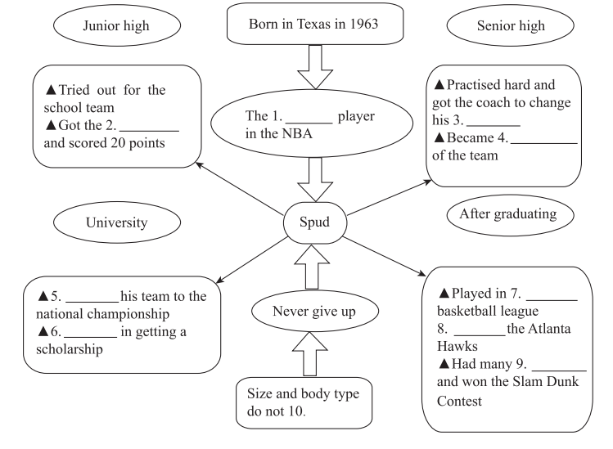
课文回顾
chance
shortest
mind
leader
Led
another
Succeeded
Joined
achievements
matter

