Slide 1
Unit 5 Topic 2
A few students are running around the playground.
Section D
WWW.PPT818.COM

Slide 2
Guess what Jim is doing in the classroom.
Is Jim ... in the classroom?
Yes? No?
Yes, he is listening to music in the classroom.

Slide 3
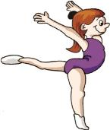
Guess what they are doing in the gym.
?
Are they ... in the gym?
Yes? No?
Yes, they are dancing in the gym.

Slide 4
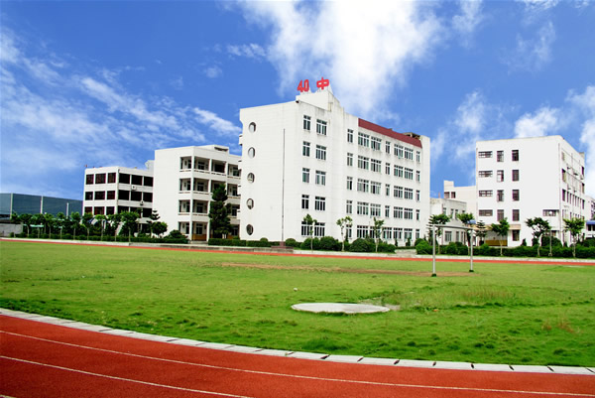
Guess what Kangkang is doing on the playground.
?
Is he ... on the playground?
Yes? No?
Yes, he is playing ping-pong with Michael on the playground.

Slide 5
Write down the V-ing forms of the verbs.
① play ② watch
③ make ④ swim
⑤ sing ⑥ have
⑦ do ⑧ sleep
⑨ come ⑩ put
playing
watching
making
swimming
singing
having
doing
sleeping
coming
putting

Slide 6
grammar
Present Continuous
Are
________ you doing your homework?
Yes, I am. / No, I'm not.
Yes, we are. / No, we aren't.
________ Kangkang reading in the library?
Yes, he is. / No, he isn't.
________ Wang Wei and Lin Tao dancing, too? No, ____________.
Is
Are
they aren't

Slide 7
Present Continuous
What are you doing?
______ looking for my wallet.
What is he/she doing now?
__________ reading.
What are Jane and Maria doing?
________ talking.
I'm
He's/She's
They're

Slide 8
Functions
may I borrow
Excuse me, _____________some English workbooks?
Of course.
__________ can I keep them?
Two weeks.
You must return them on time.
Sure, I will. Thank you.
How long

Slide 9
Listen to the passage and complete the table.
Person | Activity | Place
Jane |  | in the room
Maria | is dancing
Kangkang |  | on the playground
Michael | is swimming
The teachers |  | in the office
is singing
in the gym
is running
in the swimming pool
are working

Slide 10
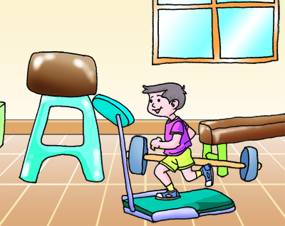
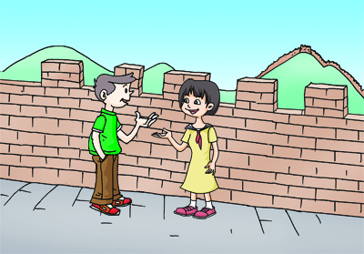
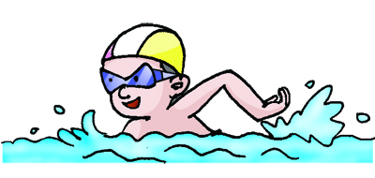
Listen to 2 and number the pictures.
1
3
2

Slide 11
Read the passage, circle the activities and underline the places.
____________
Wen Wei is my good friend. Here are some photos of his. Look! He is running in the gym in Picture 1. In Picture 2, he is swimming in a swimming pool. He looks happy because he loves swimming. In Picture 3, he is talking to a Japanese girl on the Great Wall. The Great Wall is wonderful. I also want to visit it one day.
_______________
____________________
_______________________

Slide 12
Key points
Here are some photos of his.
photos of his 双重所有格，his 在此用作名词性物主代词。
He looks happy because he loves swimming.
love doing sth.
a Japanese girl
The Great Wall is wonderful.
I also want to visit it one day.
also与too都表示“也”，also常用于句中，too 用于句末。

Slide 13
Look at the pictures and retell the passage.
1
3
2

Slide 14
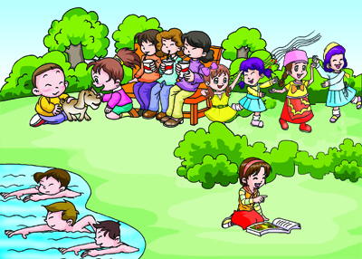
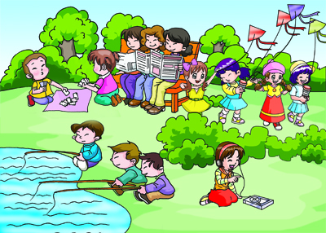
Work with your partner to find the differences between the following two pictures.
Describing What They Are Doing
1
2

Slide 15
summary
1. Learn some new words:
because, Japanese, wonderful, also
2. Review the present continuous tense.
3. Review the names of school buildings.

Slide 16
Homework
Write a passage about the differences between the two pictures.
You may begin like this:
Three boys are swimming in Picture 1, but they are fishing in Picture 2 …
1
2

