Slide 1
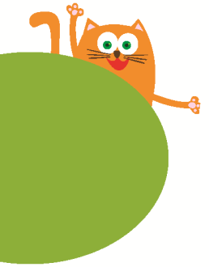
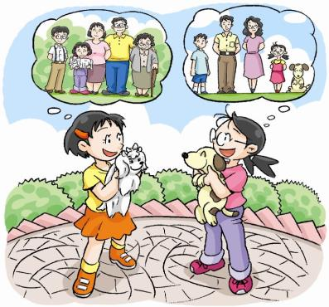
4
Do you have any cousins?
第一课时
WWW.PPT818.COM

Slide 2
Ask and answer
About Jill’s family
How many people are there in Jill’s family?
There are eight people in Jill’s family.
What’s Jill’s uncle’s name?
His name is John.
Who is Lily?
She is Jill’s aunt.
Who is Dan?
He’s Uncle John and Aunt Lily’s son.
He’s Jill’s cousin.

Slide 3
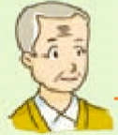
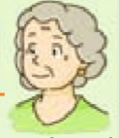
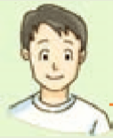
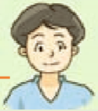
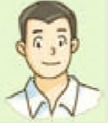
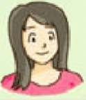
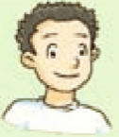
Look and read
My family
Hello, I’m Jill. This is my family. There are eight people in my family. Look, they are my grandparents. They are my parents. They are my uncle and aunt. And this is my cousin. His name is Dan. He’s Uncle John’s son.
grandfather
grandmother
father
mother
uncle
aunt
(John)
(Lily)
Jill
Dan

Slide 4
Think and do
…’s family tree

Slide 5
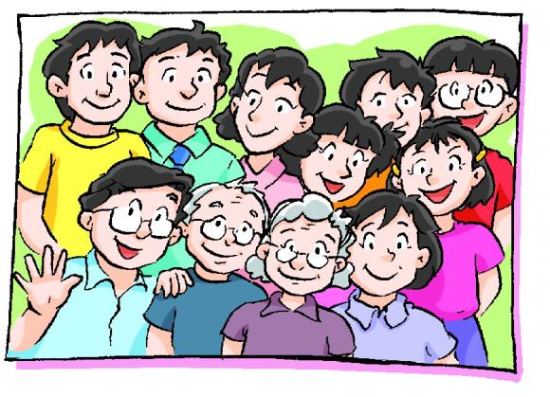
Look and read
Do you have any cousins?
Yes, I do.
No, I don’t.

Slide 6
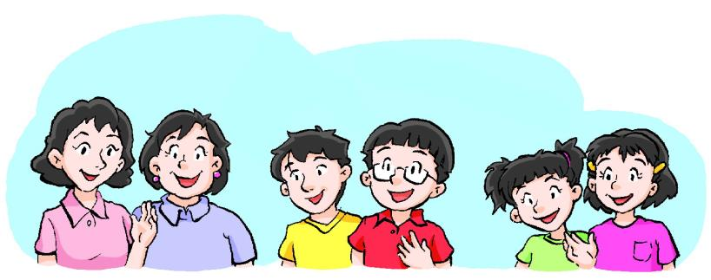
Ask and answer
About you
uncles
aunts
cousins
Do you have any ?
Yes, I do.
No, I don’t.
Notes:
6

Slide 7
Ask and answer
About Jill
Do you have any cousins?
Yes
Yes， I have one cousin.
, I do.
How many cousins do you have?
I have one cousin.
Notes:
7

Slide 8
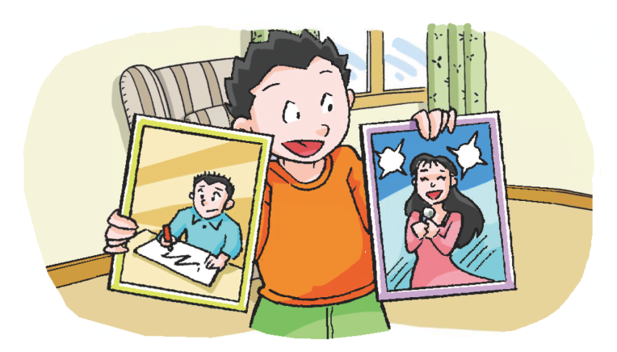
Ask and answer
About Mark
Do you have any cousins?
Yes. I have one cousin.
Yes. I have two cousins.

Slide 9
Look and read
Do you have any uncles?
Yes, I have one uncle.
Yes, I have two/three/… uncles.
No, I don’t have any uncles.

Slide 10
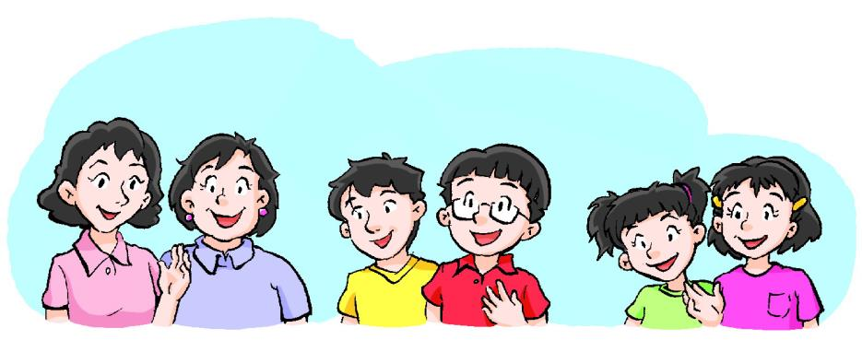
Ask and answer
About you
Do you have any …?
Yes, I have ...
No, I don’t have any ...

Slide 11
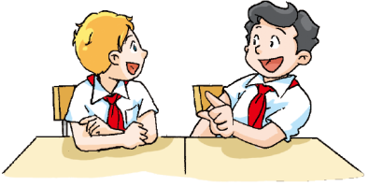

Slide 12
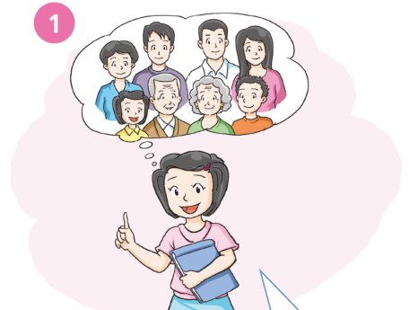
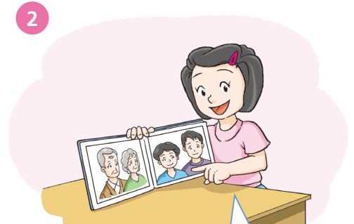
They’re my ________ and my _____________.
Hello, I’m Jill. I have ____ _______ ________.
parents
a
grandparents
big
family

Slide 13
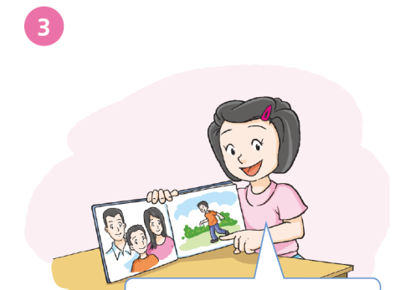
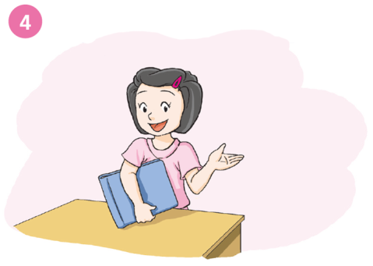
What about you? Do you _____ _____ ________?
have any cousins
This is ____ ________.
His name’s _____.
He’s _____ ______ ____.
my
cousin
Dan
Uncle John’s son

Slide 14
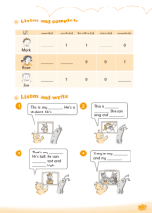
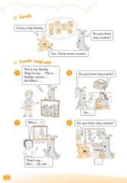
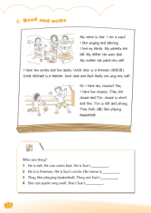
Homework
Listen to and read Student’s Book page 18 “Listen and say”.
Copy and recite the sentences on page 18.
Complete the survey.
Complete Workbook pages 21, 22 and 24.

