Slide 1
Unit3 Where is my car?
WWW.PPT818.COM

Slide 2

My Little Cat
Cat,cat,my little cat
Where's my little cat?
On the bed,on the bed.
It is on the bed.

Slide 3
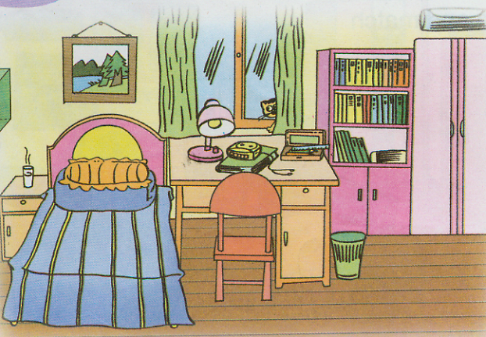
Work with Language

Slide 4

Let's Chant

Slide 5

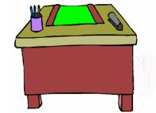
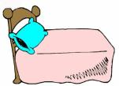

In, in, in the bag .
On, on, on the desk.
Under,under,under the bed.
Behind,behind,behind the chair.

Slide 6
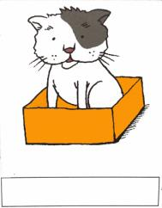
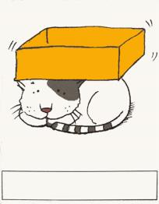
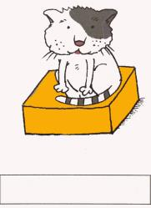
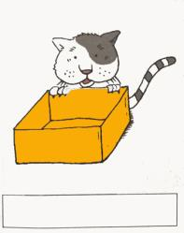
Match
The cat is under the box.
The cat is on the box.
The cat is in the box.
The cat is behind the box.

Slide 7



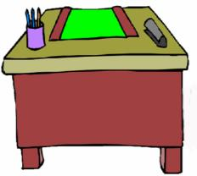


desk
bed
chair
box
ball
table

Slide 8
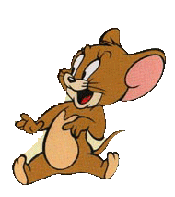
Who is he?
He’s Jerry.

Slide 9

Jerry is in the shelf.

Slide 10

Jerry is on the shelf.

Slide 11


Jerry is over the shelf.

Slide 12

Jerry is under the desk.

Slide 13
Jerry is beside the chair.

Slide 14
Jerry is by the window.

Slide 15

Jerry is behind the curtain.

Slide 16

Jerry is in front of the lamp.

Slide 17

Watch the video and answer the following questions:
1. Where is the table?
It’s against the wall.
2. Where is the chair?
It’s in the corner.
3. Where is the bed?
It’s by the window.

Slide 18
Watch the video and answer the following questions:
4. Where are the books?
They’re on the shelves.
5. What’s on the ceililng?
It’s a spider.

Slide 19
Choose and Do

Slide 20
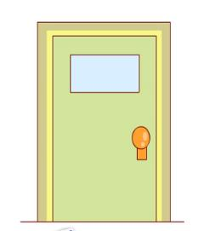

1
2
3
4

Slide 21
Put your ruler on the winder.

Slide 22
Put your shoe in front of the door.

Slide 23
Put the stool on your right foot.

Slide 24
Put your rubber under your nose.

Slide 25
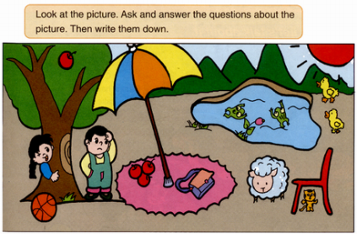
用以下的词填空：
is / are
in front of, under, in, on, behind, beside
is
on
Where ___ the apple? It’s _________ the tree.
Where ___ the boy? He’s ________ the tree.
Where ___ the girl? She’s _________ the tree.
Where ___ the ball? It’s _______________ the tree.
Where ___ the cat? It’s _________ the chair.
Where ___ the sheep? It’s _________ the chair.
Where ______ the frogs? They’re ______ the pond.
is
under
is
behind
is
in front of
is
under
is
beside
are
in

