Slide 1
Module
11
Body language
Unit 3 Language in use
WWW.PPT818.COM

Slide 2
_{Language practice}
_{Give them more personal space.}
_{Wave to say goodbye.}
_{Be careful!}
Don’t stand too close to North Americans.
_{“祈使句”}

Slide 3



_{关注生活中的“祈使句”}

Slide 4




Slide 5
_{祈使句小结}
1.定义：用于表达命令、请求、劝告、警告、禁止等的句子叫做祈使句，祈使句最常用于表达命令，因此又叫做命令句。
祈使句因对象（即主语）是第二人称，所以通常都省略。祈使句的动词都为一般现在时，句末则使用句号或感叹号来表示结束。
例：Go and wash your hands. (去洗你的手。—命令)
Be quiet, please.（Please be quiet.）
（请安静。——请求）在表达请求时，可以加上please
Be kind to our sister. (对姊妹要和善。——劝告）

Slide 6
Watch your steps. （走路小心。——警告）
Look out！Danger！ 小心！危险！——强烈警告
表达比较强烈的语气时，可以用感叹号。
Keep off the grass. （勿践草坪。——禁止）
No parking. （禁止停车。——禁止）
祈使句也常把主语“You”表达出来，使对方听起来觉得柔和些，例如：
You go and tell him, Tom. （Tom, 去告诉他。）
2、相关口令
祈使句无主语, 主语you常省去;
动词原形谓语当, 句首加don't否定变;
朗读应当用降调, 句末常标感叹号。

Slide 7
3、表现形式 ——●肯定结构:
Do型——动词原形开头
即:动词原形(+宾语)+其它成分。
如:Please have a seat here. 请这边坐。
有的祈使句在意思明确的情况下,动词可省略。
如:This way, please. =Go this way, please. 请这边走!
Be型——动词Be开头
即:Be + 表语(名词或形容词)+其它成分)。
如:Be a good boy! 要做一个好孩子!
Let型——动词Let开头。
即:Let + 宾语 + 动词原形 + 其它成分)。
如:Let me help you. 让我来帮你。

Slide 8
3、表现形式 ——●否定结构:
Do型和Be型的否定式都是在句首加don't构成。
如:Don't forget me! 不要忘记我!
Don't be late for school! 上学不要迟到!
Let型的否定式有两种:
①“Don‘t + let + 宾语 + 动词原形 + 其它成分”
②“Let + 宾语 + not + 动词原形 + 其它成分”。
如:Don't let him go.
Let him not go. 别让他走。
No开头——用来表示禁止性的祈使句。
如:No smoking! 禁止吸烟!
No fishing! 禁止钓鱼!

Slide 9
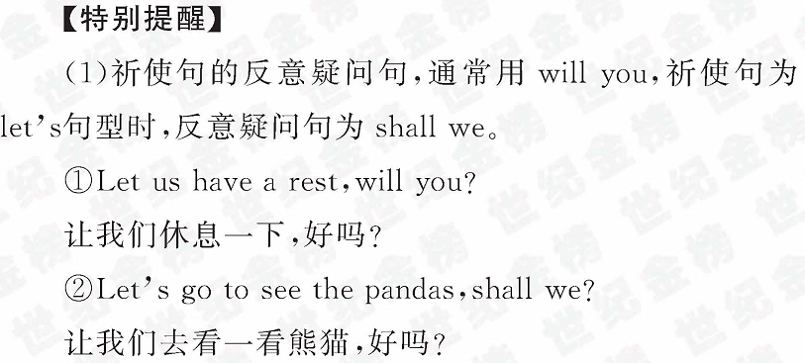

Slide 10
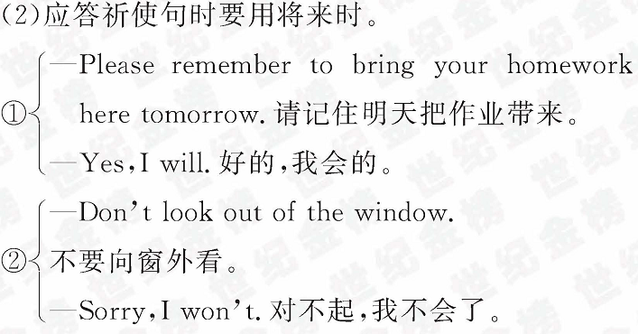

Slide 11
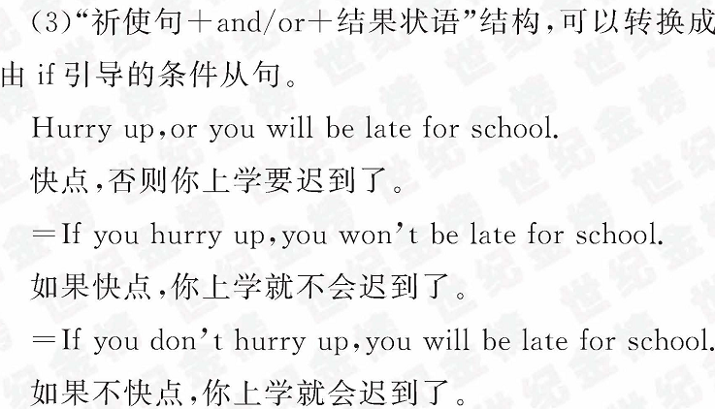

Slide 12
翻译下列各句。
1. 咱们一起玩吧！
2. 请不要迟到。
3. 回答这个问题。
4.不要让猫进来。
5. 上课安静。
6. 不要随处乱扔垃圾。
7. 友好待人。
Let’s play together.
Don’t be late, please.
Answer the question.
Don't let the cat come in
/Let the cat not come in .
Be quiet on class.
Don’t throw litter everywhere.
Be friendly to classmates.

Slide 13
1 work in pairs. Talk about do’s and don’ts in a foreign country.
 | Do’s | Don’ts
Britain | _{Stand in line.} _{Shake hands.} _{Say “please” and “thank you”.} _{Open doors for others.} _{Look at people when you talk.} _{Be on time.} | _{Touch people.} _{Ask a woman’s age.} _{Stand too close.} _{Say anything too personal.}

Slide 14

2 Make a list of do's and don'ts to help
visitors to Britain.
_{Stand in line.}
Don’t touch people when you talk to them.
…

Slide 15
Do shake hands when you meet a friend.
_{Do stand in line.}
_{Do expect rain.}
_{Please talk about the weather.}
Do Say “please” and “thank you”.
Do look at people when you talk
_{Don’t touch people.}
Don’t ask people personal question.
_{Don’t ask women’s age.}
Don’t talk with food in your mouth.
_{Don’t be late.}

Slide 16
3 Rewrite the sentences.
It’s important to listen to the teacher.
_{Listen to the teacher.}
You cannot shout in the classroom.
_{Don’t shout in the classroom.}
1. It’s important to be careful.
2. It’s important to clean and tidy the lab.
3. You cannot touch anything if the teacher doesn’t ask you to.
4. You cannot bring food or drink into the lab.
5. You cannot enter the lab alone.

Slide 17
1. It’s important to be careful.
2. It’s important to clean and tidy the lab.
3. You cannot touch anything if the teacher
_{doesn’t ask you to.}
4. You cannot bring food or drink into the lab.
5. You cannot enter the lab alone.
_{Be careful.}
_{Clean and tidy the lab.}
Don’t touch anything if teacher isn’t ask you to.
_{Don’t bring food or drink into} _{the lab.}
_{Don’t enter} _{the lab alone.}

Slide 18
Answer the questions. Use the words
and expressions from the box to help you.
all right arm in arm close different
hold on to kiss three times point at
shake hands with wave
1.How do the British say hello to each other when
_{they first meet?}
2. Does body language mean the same thing in
_{different countries?}
They shake hands with each other.
_{No , it doesn’t.}

Slide 19
3. How do the Russians say hello to each other
_{when they meet?}
4. Is it polite to stand close to North Americans?
5. Is it all right to wave goodbye in Greece?
6. How do you usually say goodbye with body
_{language?}
_{They usually kiss three times.}
_{No ,it isn’t.}
_{No ,it isn’t.}
_{I wave my hand.}

Slide 20

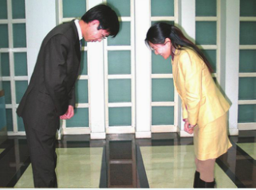
Around the w rld
_{The Japanese bow}
In Japan, people bow to say “thank you”, “sorry” ,“hello”，“goodbye”, “you’re welcome”，“excuse me”, and many other things. Children and young people bow lower(更低) when they greet older(更老的) people. It’s a way of being polite and showing respect.

Slide 21
选择：
1. ______ this kind of peach, and you will like it.
A. To try B. Trying
C. Try D. Tried
2. __________, or you’ll be late.
A. Hurry up B. Take it down
C. To hurry up D. Hurries up
3. Ssh! ________ talk loudly. The baby is sleeping
right now.
Do B. Does
C. Don’t D. Doesn’t
√
√
√

Slide 22
4. “_______ exercise every day, my child. It’s good for
your health,” Father said.
A. Taking B. To take
C. Take D. Takes
5. Don’t _______ too much TV. It’s bad for your eyes.
A. watch B. watched
C. watching D. to watch
6. ________ sleep too late. It’s bad for your health.
A. Do B. Not
C. Don’t D. Please not
√
√
√

Slide 23


课外延伸----祈使句

Slide 24
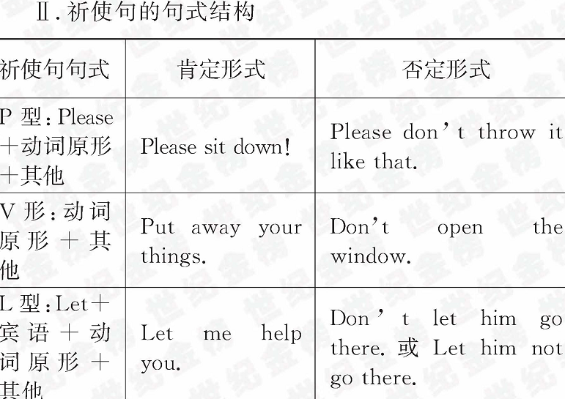
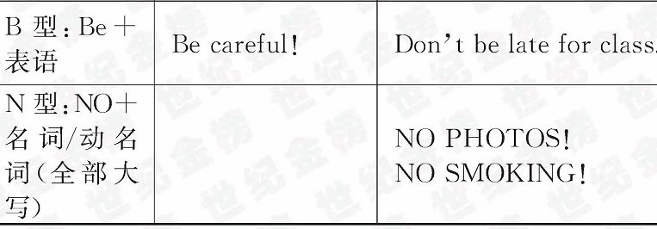

Slide 25
1.—Don’t be late again, Mike?
—_______________.
A. No, I don’t B. Don’t worry
C. Sorry, I won’t D. I don’t know
【解析】选C。

Slide 26

2.Which sign means “No Photos”?
【解析】选C。禁止拍照。

Slide 27
3.Tom!________ talk loudly. My little brother is sleeping.
A. Do B. Does C. Don’t D. Doesn’t
4.—Sorry for being late again. —_______here on time next time, or you’ll be punished.
A. Be B. Being C. To be D. Been
【解析】选A。
【解析】选C

Slide 28
5.Hurry up, or you will miss the train.(改为同义句)
_______you ________ hurry up, you will miss the train.
【解析】If;don’t。祈使句+or+简单句。可转换为if引导的条件状语从句的复合句。

Slide 29
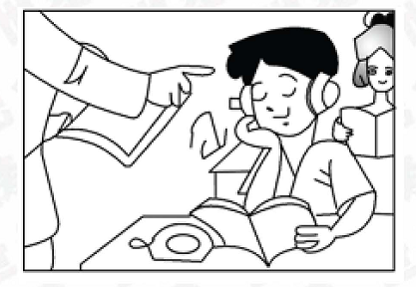
6.看图写句子
Which school rule is the boy breaking?
答案：Don’t listen to music in class.

Slide 30
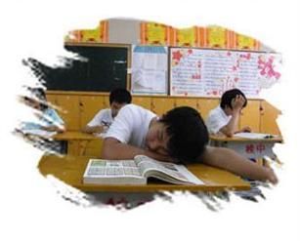
答案：Don’t sleep in class

Slide 31
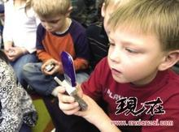
答案：Don’t use cell-phone in class

Slide 32
二、用括号内所给动词的恰当形式填空。
It’s an important meeting. _________ (not, be) late.
___________ (not, make) any noise! Your mother is sleeping.
__________ (not, speak) with your mouth full of food.
_________ (not, talk) and _______ (read) aloud.
Don’t be
Don’t make
Don’t speak
Don’t talk
read

Slide 33
5. ___________ (not, leave) your
homework for tomorrow, Larry.
6. _______ (look) out! A car is coming.
7. _______ (give) us ten years and just
see what our country will be like.
8. _________ (not, let) the baby cry.
Don’t leave
Look
Give
Don’t let

Slide 34
Work in pairs. Talk about different
ways of saying hello and body language in China.
Write the information on your poster.
Find or draw some pictures to add to
your poster.
8 Show your poster to the whole class.

