Slide 1
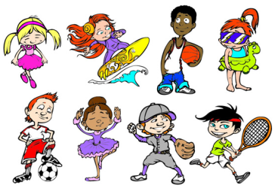
Unit4 What Do You Do on Saturday?
陕旅版
四年级下册
第三课时
WWW.PPT818.COM

Slide 2
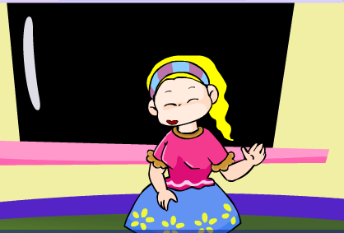
>>Warm-up
Let’s chant

Slide 3
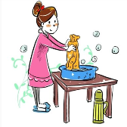
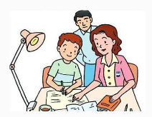
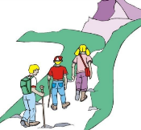
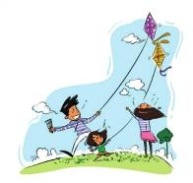
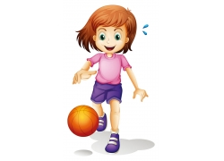
>>Review
Make sentences
What do you/does your … do …?
I/He/She/They (often) ...

Slide 4
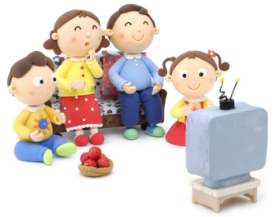
>>Presentation
Let’s learn
What do they often do in the evening?
They often watch TV in the evening.
Do they often watch TV in the evening?
Yes, they do.

Slide 5
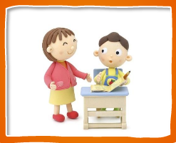
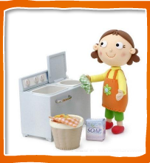
>>Presentation
Let’s learn
-Does he often play football on Sunday?
-Does she often do some
washing on weekend?
-Yes, he does. /
No, he doesn’t.
-Yes, she does. /
No, she doesn’t.

Slide 6
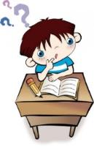
>>Presentation
Listen, then ask and answer
Does Alice often do her homework on Saturday?
Yes, she does.
What does Alice’s brother do on Sunday?
He often plays football.
Does Alice’s father play football on Sunday?
No, he doesn’t. But sometimes he plays basketball.

Slide 7
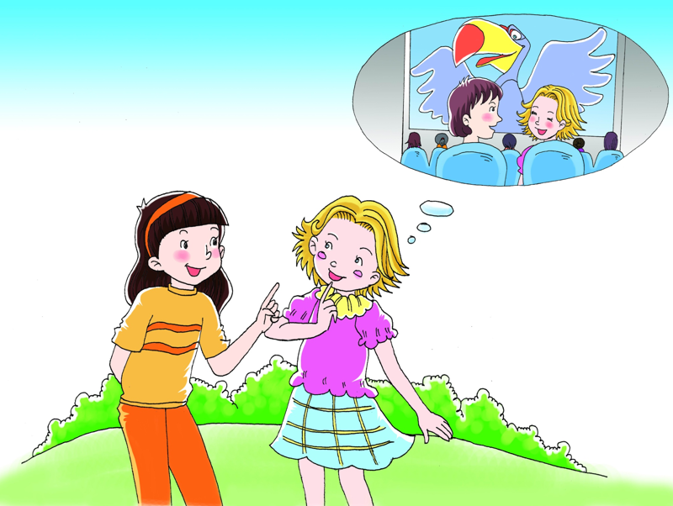
Do you often do your
homework on Saturday?
Yes, I do. And sometimes
I see a film with my mom.

Slide 8
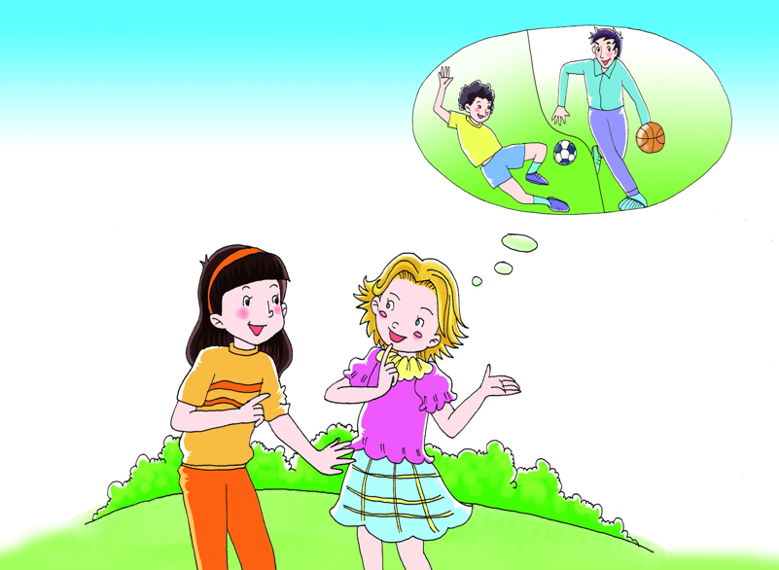
What does your brother
do on Sunday?
He often plays football.
Does your father
play football, too?
No, he doesn’t. But sometimes
he plays basketball.

Slide 9
>>Practice
Read it by yourselves for one minute .
自读课文一分钟。
一分钟倒计时
60
10
50
Learning tip :
当你自己朗读时，遇到不会读或不明白意思的单词或句子，可以把它圈起来，请教同学或老师！
20
40
30
开始

Slide 10
>>Practice
Show time
小组合作，练习对话并表演，其他同学评价。
 | 模仿录音中的语音语调，有感情地朗读。
 | 可以脱离课本，适当改动其中部分，语音地道。
 | 适当添加内容，意思完整，有创新，表演生动。
Good
Great
Excellent

Slide 11
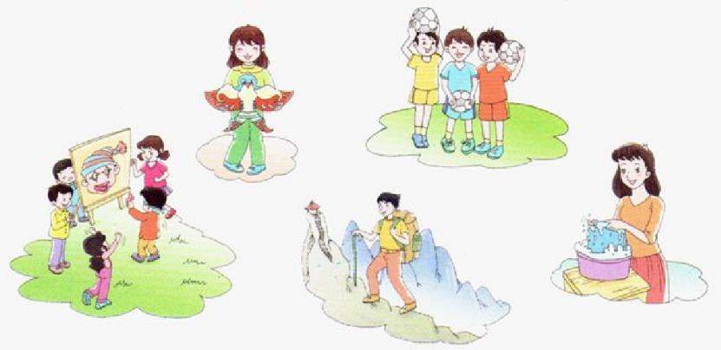
>>Practice
Look and talk
A: What does she often do?
B: She often flies a kite.

Slide 12
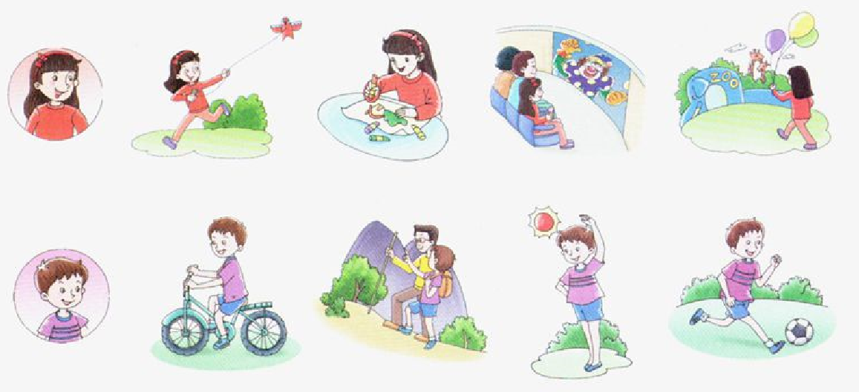
>>Practice
Listen and circle
√
√
√
√

Slide 13
>>Summary
本课所学的重点句型：
-Do you/Does your … often … on Saturday?
-Yes, .../No, …
例如：
-Does he often play football?
-Yes, he does.

Slide 14
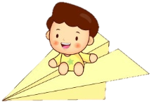
>>Homework
1.听课文录音并跟读，按照正确的语音、语调朗读并表演课文对话。 2.同桌之间分组表演Let’s talk，并在此基础上进行对话创编。
3.预习 Unit4 B Read a story。
close

