Slide 1
Unit 1
Past and Present
Reading 2
WWW.PPT818.COM

Slide 2
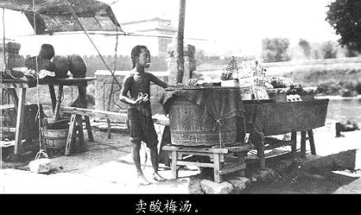
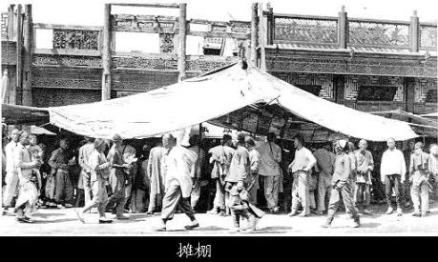
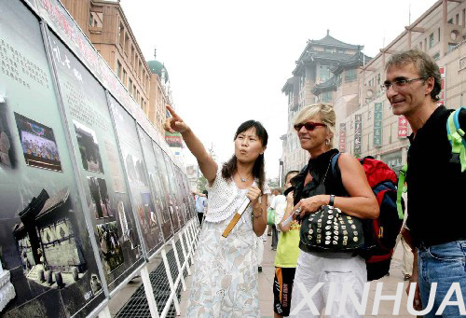
Beijing has changed a lot!

Slide 3
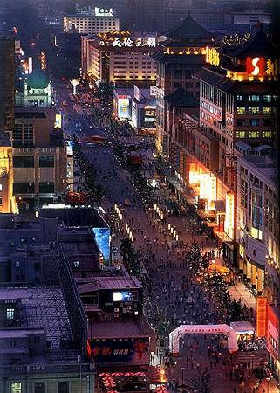
Wangfujing street
market stalls
in the past
shopping malls
at present

Slide 4
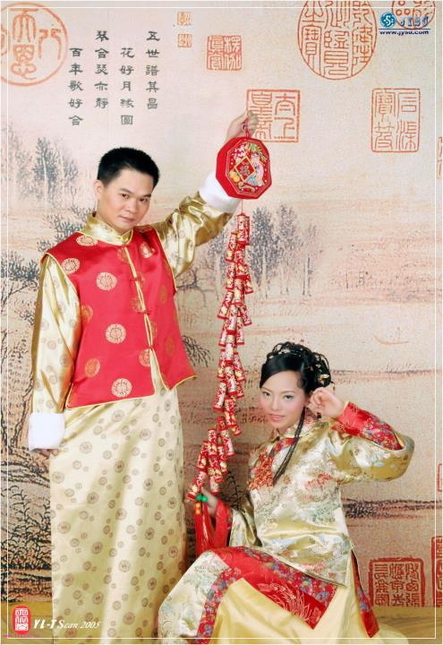
marry
married
get married
They got married last year. So the girl is the man’s wife now.

Slide 5
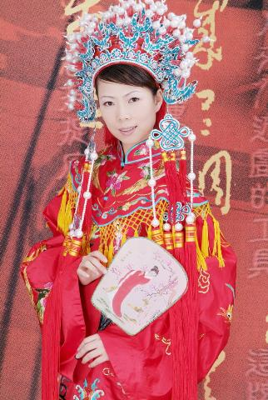
wife –wives
A thief’s wife
used a knife on
the shelf and
half a leaf to
kill a wolf.
f/fe
ves

Slide 6
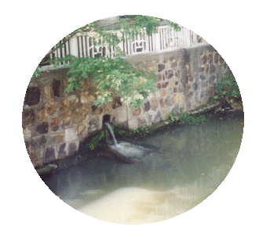
dump vt/vi 倾倒;倒垃圾
dumper n 垃圾车;清洁工人
dump truck 自动卸货车
The factory used to
dump the waste into
the river.
May I use your pen?
He used a knife to cut it.
We used to go fishing there.
(But now, we don’t often do so.
use
used to do
(过去常常做)

Slide 7
他过去常常去公园读书.
我们过去常在课后打篮球.
--你妈妈年轻的时候常去溜冰吗?
--她不常常溜冰,她常常去散步.
He used to read books in the park.
We used to play basketball after class.
Used your mother to go skating when she was young?
No, she usedn’t. She used to walk.

Slide 8
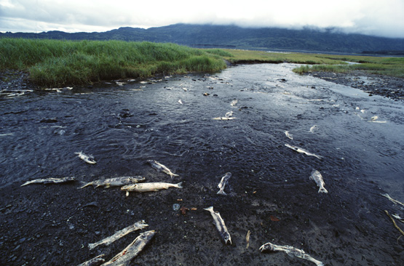
realize: get to know and understand
reduce: make something less or smaller in size, price, etc.
The government realized that the poison killed the fish and polluted the water.
People took actions to reduce the pollution.

Slide 9
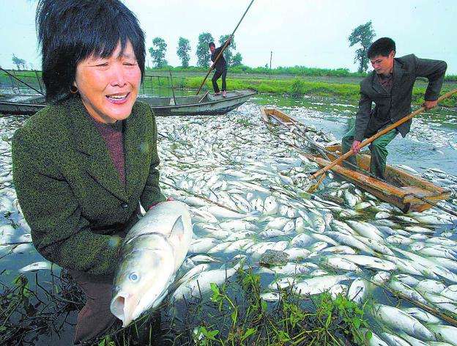
pollute vt.
polluted adj.
pollution n.
Someone has polluted the river.
The polluted river has killed many fish.
Many fish have died of the pollution.

Slide 10
Mr. Chen lives in Sunshine Town. After he got ______, he and his wife ______ to a new house. Last year, they moved again when their
Children ______ them a new flat. In the past there were small ________ , shops and market stalls in the town. Now the place has _______ a lot. The town centre is now a park. Many of Mr. Chen’s old friends have ______ to other areas. Sometimes, they come back and go to the new park to play ____ and Chinese ____ with Mr. Chen, but they do not often see each other. Mr. Chen feels_____ from time to time.
Revision:
married
moved
bought
restaurants
changed
moved
cards
chess
lonely

Slide 11
自学反馈
moved
1.My family _______(搬到) to Sunshine Town in 2001.
2.We must stop those factories from _________ (污染) the rivers.
3. I don’t feel ______ (孤独) at all. I have a lot of good friends.
polluting
lonely
pleasant
4.It’s very __________(愉快的)to travel by plane.
5.Let’s go to the ________(电影院) this evening
cinema

Slide 12
6.Mr Black is very fat, she wants to r______ (make sth less or smaller in size, weight, etc. ) her weight.
7.Mr Black and Mrs Black got m________ (having a husband or wife ) in 1982
educe
arried
ealized
8. At last, I r__________ ( get to know and understand sth) that Jim wasn’t an honest boy.
9. Suzhou is in the s________ (in or of the south) part of Jiangsu.
10. I have known Amy s_________ (from a time in the past till now) I came to this school.
outhern
ince

Slide 13
pollution
11. Water ______ is more terrible than noise _______. (pollute)
12.He _____ to do some reading in the morning. (use)
13. His country _________ a lot since 1982.(change)
14. The old man was _________ when his wife died. (alone)
pollution
used
has changed
lonely

Slide 14
引入新课，知识梳理
实际上
结婚
改变许多
搬到……/搬出……
在过去/目前
市场小摊
in fact
get married
change a lot
move to…./move out of…
in the past/at present
market stalls

Slide 15
6.变成公园
7打牌/下棋
8减少噪音污染
9在某些方面
10开阔的空间
11感觉有点孤单
12时常
turn into a park
play cards/play chess
reduce the noise pollution
in some ways
open space
feel a bit lonely
from time to time

Slide 16
选用词组的适当形式填空：
get married, turn …into, take off, in fact, change a lot, in the past, noise pollution, as often as, from time to time
I miss my friends in the primary school ______________ because I cannot see them _________ before.
My uncle _____________ since he ___________.
from time to time
as often as
has changed a lot
got married

Slide 17
选用词组的适当形式填空：
get married, turn …into, take off, in fact, change a lot, in the past, noise pollution, as often as, from time to time
noise pollution
3. There was ____________ in my living area _____________. But now it has become much quieter than before.
4. We are pleased when the plane __________ on time.
in the past
took off

Slide 18
选用词组的适当形式填空：
get married, turn …into, take off, in fact, change a lot, in the past, noise pollution, as often as, from time to time
In fact
5. He looks naughty. ___________, he is a very clever boy.
6. We are trying our best to ________ our country _________ a modern and strong one.
turn into

Slide 19
独立训练
1.Actually, I have already been him for two years.
A.married with B. marry with
C. married to D. marry
2.－ have you been here?
－3 years.
A.How often B.How long
C.How far D.How
3.Because of the busy traffic,
the plane when he arrives.
A.has landed B. has taken off
C. landed D. took off
C
B
b

Slide 20
4.Once upon a time,there was a __ village.The people there were kind.
A.lonely B. alone
C. lone D. only
5.David shanghai for more than three months.
A.came to B. has been to
C. has been in D. has come to
6.None of us knew what had happened they told us about it.
A.when B.until
C.after D. thought
A
c
B

Slide 21
拓展总结
用所给词的适当形式填空：
We ______ learned English in Grade Three in the primary school. (one)
They had a very ______ trip to Hangzhou. (please)
My parents were very _____ when I got good marks in the English test. (please)
first
pleasant
pleased

Slide 22
pollutes
4. The poison in the waste ________
the river. Water ______ is more terrible than noise _______. (pollute)
5. He has had nothing after the ______ of his shop. (close)
6. His parents often tell him to drive carefully and _______. (safe)
7. Do you feel _______ after seeing the doctor? (good)
pollution
pollution
closing
safely
better

Slide 23
8. Book 8B is ____________ than Book 8A. (difficult)
9. The old man was _________ when his wife died. (alone)
10. Used your mother _____ (meet) skating when she was young?
No, she ______. She used ____ (walk).
8. Book 8B is ____________ than Book 8A. (difficult)
9. The old man was _________ when his wife died. (alone)
10. Used your mother _____ (meet) skating when she was young?
No, she ______. She used ____ (walk).
11.Great ______ (change) have taken place in our hometown.
12. Nobody in our class likes to play ______ (china) chess
more difficult
lonely
to meet
to walk
usedn’t
usedn’t
changes
Chinese

Slide 24
拓展练习
选用上列动词的现在完成时填空：
has turned
Look! The pumpkin _________ into a pretty lantern.
Millie is our old friend. How long ____ we _____ her?
--Does Mr Black live here?
-- No. He ________ to another block.
have known
has moved

Slide 25
4. Nanjing _________ a lot since 2000.
5. My cousin is no longer a student. He __________ an office worker now.
has changed
has become
were
6-Where _____ you born, Li Ming? – In Guiyang. (be)
7-_____ you ________ (mend) your shoes, Bob?
-Yes, I________ (mend) them twenty minutes ago.
8. -_____ you _________(receive) any letters from him recently?
-Not yet.
Have mended
mended
Have received

Slide 26
9.”The world without Thieves” is a very moving film. I _________ (see) it twice already.
10. -I am sorry to have kept you waiting.
-Oh, not at all. I ___________ (be) here for only a few minutes.
11. –How long _____ you______(be) here?
-Only ten minutes. Tim ______ (walk) here with me.
have seen
have been
have been
walked

Slide 27
把下列句子译成英语:
达标检测
1.政府已经把这个地方变成了一个公园.
2.见到我的一些老朋友已经变得更困难了.
3.他们已经搬到北京的其他地方了.
The government has turned the place into a park.
It has become more difficult
to see some of my old friends.
They have moved to other areas in Beijing.

Slide 28
4.当我两岁时,我随我的家人搬到这儿,从
那时起我就一直住在这儿.
I moved here with my family when
I was two years old and have lived
here since then.
5这些年来阳光镇已经发生很多变化了吗?
Has Sunshine Town changed a lot
over these years?

Slide 29
6.从那时起,我就住在那里.
I have lived there since then.
7.我家就在这个镇的南部( south/southern)
My house is in the south / (southern part) of the town.
8.他们是两年前结的婚.
They got married two years ago.

Slide 30
8.你变了许多.
You have changed a lot.
10.我们的政府已经将那个地方变成了美丽的公园.
Our government has turned the place into a beautiful park
6.你常和谁下中国象棋?
Who do you play Chinese chess with?
7.Sandy过去常常在那棵树下看书
Sandy used to read books under the tree.

Slide 31
8. 有时我感到有些寂寞.
Sometimes I feel a bit lonely.
9.后来政府意识到水污染是一个非常严重的问题.
Later, the government realized (that) water pollution was a serious problem.
10.这几年间我看许多部鲁讯的书(over)
I have read many books by Luxun over these years.

